Slide 1


Multi-Criteria Analysis
A framework for spatial decision making
MCAS-S development partnership

Slide 2
Outline
Challenges in Environmental Management
Introducing multi-criteria analysis (MCA)
  What makes a good multi criteria analysis?
  The framework
  Example - Where to buy coffee. Step 1-5
Introducing MCAS-S software
  What is MCAS-S?
  When to use MCAS-S
  Example – Where to live in Australia
  Where to get data
  Getting data into MCAS-S
Notes:
After completing this module students should be able to :
Understand the multi-criteria analysis (MCA) framework
Apply a means-to-an-end diagram
Develop a spatial decision support model
Interrogate data using MCAS-S software
Consider how to choose and prepare appropriate data for spatial MCA
This lecture is best presented by demonstrating the “Where to live in Australia” slides in the MCAS-S project “WhereToLiveMCASS2018”
This lecture is also accompanied by a tutorial exercise to restrict spread of an invasive weed and teacher notes.

Slide 3

Challenges in environmental management
Decisions often include environmental, social, and
economic aspects.
Problems can be difficult to define, are still evolving, have no “right answer”.
These “wicked problems” may benefit from multi-criteria analysis.
Cotter Dam Canberra, Image courtesy of Department of Agriculture and Water Resources image library Photographer Joshua Smith
Notes:
One of the challenges in environmental management is to make decisions which include environmental, social and economic aspects.
Environmental managers and policy makers often discover that problems are difficult to define, are still evolving, don’t have consensus about which inputs to include or their relative valuation, and have no “right” answer. Instead you may be expected to meet multiple and competing objectives, compare scenarios and explore trade-offs. These “wicked” problems may benefit from multi-criteria analysis.

Slide 4
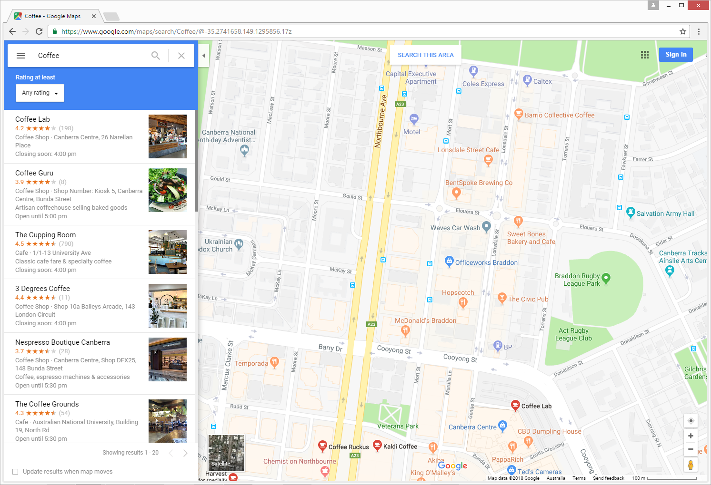
Introducing multi-criteria analysis (MCA)
We all use multi-criteria analysis (MCA).
For example:
“Where should I get my coffee?”
This module is about formalising, recording and refining the decision-making process.
Notes:
Multi-criteria analysis helps decision makers develop coherent preferences for a given problem so that decisions can be taken with more confidence.
Multi-criteria analysis (MCA) is an assessment method that does not need to monetise all the inputs (unlike cost-effectiveness and cost-benefit analysis).
Common elements of an MCA are a performance matrix, weighting and ranking process.

Slide 5
What makes a good multi-criteria analysis?
Good MCAs are:
Structured
Defensible and transparent
Able to include qualitative and quantitative data
Broader than cost-benefit analysis
MCA can:
Include social, economic and environmental information
Evaluate options, trade-offs and consequences
Incorporate stakeholder values, public opinion and policy goals
Be spatial or non-spatial
Notes:
Multi-criteria analysis is a decision making framework
Many tools exist
Can be spatial or non spatial

Slide 6
The framework
Define or identify components for evaluation
  Objective
  Criteria
  Inputs
Assemble or collect data
Explore and combine data
  Rank or scale data
  Apply weights
Calculate final score and develop options
Review; repeat the process to refine
1. Define / identify
2. Assemble data
3. Explore and combine data
4. Calculate / develop options
5. Review and report
Notes:
The basic stages of an MCA are to define the context, structure the problem, complete an analysis, come to a decision, and review.
This can be considered as a 5-step framework

Slide 7
Example: Where to buy coffee? Step 1.
Where should I get my coffee?
a) Objective
Define the problem, the decision context, criteria and inputs.
b) Criteria
Bang for my buck
Time
c) Inputs
Quality
Price
Distance
Notes:
The first step; defining the problem, is critical to a successful MCA and it is worth ensuring that sufficient time and effort is dedicated to this stage.
In some cases, a satisfactory definition of the problem and the objective may only be reached as an iterative process by reviewing an incomplete MCA.
The decision context includes the administrative, political, historical and social structures that surround the decision being made.
MCA is all about multiple conflicting objectives. There are ultimately trade-offs to be made.
Objective – What is the overall ambition?
Criteria – these are measures of performance by which the options will be judged. Grouping input data by criteria can help you check whether criteria are relevant to the objective.
Inputs (data) – select by relevance to the objective

Slide 8
Example: Where to buy coffee? Steps 2-4.
 |  | Higher is better | Cheaper is better | Closer is better |  | Indicate your preferences
Collect data | Coffee shop | Quality | Price ($) | Distance (m)
 | Hipster café | 8 | 3.7 | 60
 | Family restaurant | 5 | 2.75 | 400
 | Artisan café | 9 | 4.2 | 550
 | Servo | 1 | 2.5 | 350
 | Minimum | 1 | 2.5 | 60
 | Maximum | 9 | 4.2 | 550
 |  |  | Normalise data
Rank data | Coffee shop | Quality | Price | Distance
 | Hipster café | 0.88 | 0.29 | 1.00
 | Family restaurant | 0.50 | 0.85 | 0.31
 | Artisan café | 1.00 | 0.00 | 0.00 |  |  |  | Add Indicators * Weights
 | Servo | 0.00 | 1.00 | 0.41
 |  |  |  |  |  |  | Final score | Coffee shop | Score
 |  |  | Specify weights |  |  |  |  | Hipster café | 3.54
 |  |  |  |  |  |  |  | Family restaurant | 2.31
Apply weights | Weights | 2 | 1 | 1.5 |  |  |  | Artisan café | 2.00
 |  |  |  |  |  |  |  | Servo | 1.61
Notes:
2- Assemble or collect data (Quality, Price and Distance – in this case data sourced from Google maps, and sample purchase from each shop then compiled into a table)
3- Explore and combine data (this can be as simple as a matrix with ticks and crosses as to whether each criteria is met).
Rank or scale data – for example quality collected on a scale of 1 = low to 9 = high (values then rescaled to 0-1 with lowest input assigned 0 - servo and highest input assigned 1 – Artisan cafe)
Apply weights – for this example Quality ranked as 2x as important as price and distance 1.5x as important as price.
4- Calculate final score and develop options – for this example Hipster café received the highest score of 3.54. What would happen if price or distance were the most important variable?
5- Review - Look back at the input data and check that result seems sensible. Is your result biased by any inputs?
This is an example of a non-spatial MCA using a spreadsheet to display the performance matrix and complete the ranking and weighting process.
The decision is based on the highest final score.

Slide 9
Summary
Multi-criteria analysis (MCA)
Next
a decision making framework
many tools exist
spatial or non spatial
spatial MCA using MCAS-S
concepts applicable to other tools
means-to-an-end diagram
example – Where to live in Australia?

Slide 10

What is MCAS-S ?
What is MCAS-S?
Free spatial tool
Supports MCA as well as other spatial analysis
Addresses ‘where’ questions
Flexible and simple to use
Shows all the data that informs a decision
Updates on the fly
Useful for workshops
http://www.agriculture.gov.au/abares/aclump/multi-criteria-analysis/mcas-s-tool
    ‘Where can we most effectively invest in revegetation?’
    ‘Where is the greatest risk to soil resources?’
Notes:
MCAS-S Spatial software made freely available by MCAS-S Development Partnership.
Intended to make the process of spatial analysis fast, flexible and transparent.
Unfortunately only works on Mac computers running a virtual PC. There are plans to move online
Download
MCAS-S Software version 3.2 (2018)
Two versions – use the 64-bit installer if possible
Registration – to contact users and compile statistics

Slide 11
When to use MCAS-S ?
Yes
Do I want to know “where”?
No
Can I define my area?
Use a non-spatial tool
Can I make my data spatial?
Consider other tools, e.g.:
cost benefit analysis
cost effectiveness
cost utility analysis
Do my input data have the different units?
Do I need a flexible framework?
Is transparency important?
Consider other tools!
Use MCAS-S

Slide 12
Exercise: Where to live in Australia
Step 1. Define
Exercise
  ‘Where to live in Australia?’
  There is no single ‘right’ answer
  Step 1: Define objectives, criteria and data
  A means-to-an-end diagram can express our objective and criteria
  Our first example priorities are: proximity to skiing and coast and urban land uses.
  Open “Where to live - blank.mcas”
Where to live?
Close to recreation
Urban setting
Skiing
Coast
Land use
Notes:
We will now do a very simple Multi-Criteria analysis in MCAS-S.
Where to live in Australia is a very good example for a multi-criteria analysis as there is no single right answer.
The context is very important. Does the decision affect an individual or a family? What are their requirements for employment? Healthcare? Education? Climate? Affordability? Recreation? Family? Transport? Access to services?
In this case we will start with a very simple example for an individual who want to live in an urban area but is most passionate about skiing and diving. Once we have developed this example in MCAS-S we can also review and update this example to include more criteria as the requirements (or our understanding of the requirements) evolve.
This ability to review has been applied in multi stage projects such as protecting the Great Barrier Reef from nutrient run-off in reef catchments where part of the project was collecting new input data.

Slide 13
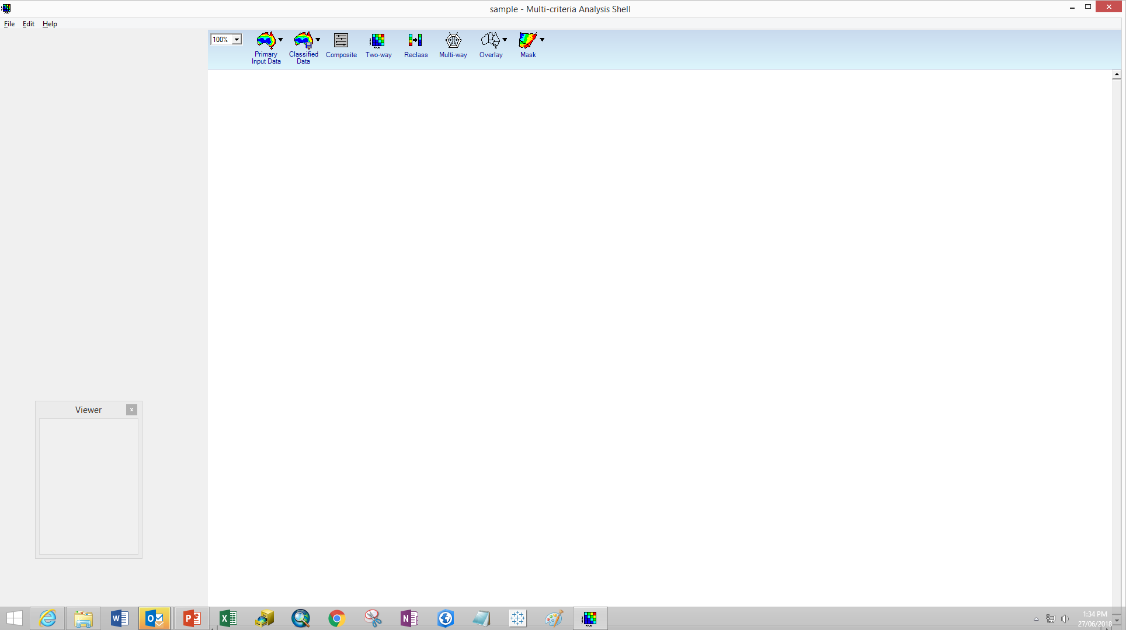
The MCAS-S interface
Data and Tools
Workspace to assemble your model
Viewer
Notes:
Open the sample MCAS-S project by:
navigate to the project in windows explorer or
open the MCAS-S software and use the file menu, open existing project to find the sample project.
Next 5 slides best demonstrated by opening the MCAS-S software and demonstrating live.
Students could follow on their own machines if software and exercise installed in advance.
At the top of the interface are the options to bring in data and create analyses. We will explore these in more details later.

Slide 14
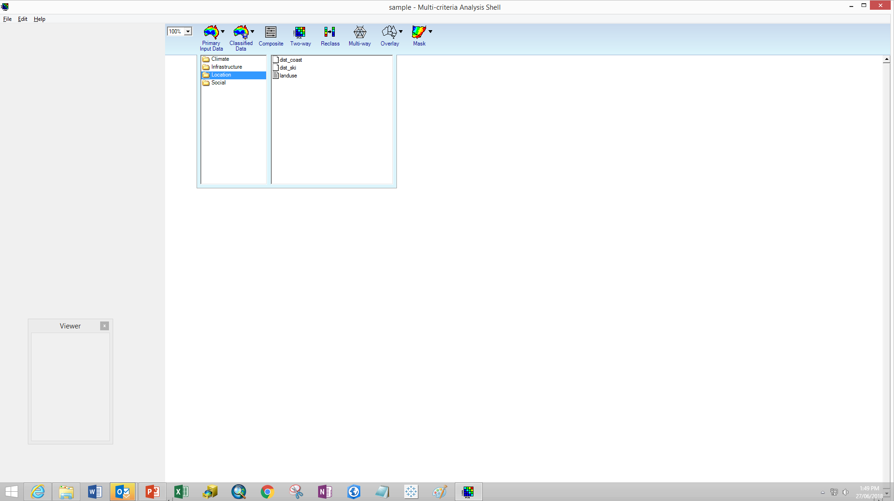
Step 2: Assemble data
Select all three datasets:
Click holding the Shift key
Drag into the workspace
Notes:
Click on Primary Input Data Icon to see the preloaded data layers ready for analysis.
Expand the Location folder
Bring the 3 layers into the project by holding the shift key while clicking and dragging into the workspace.

Slide 15
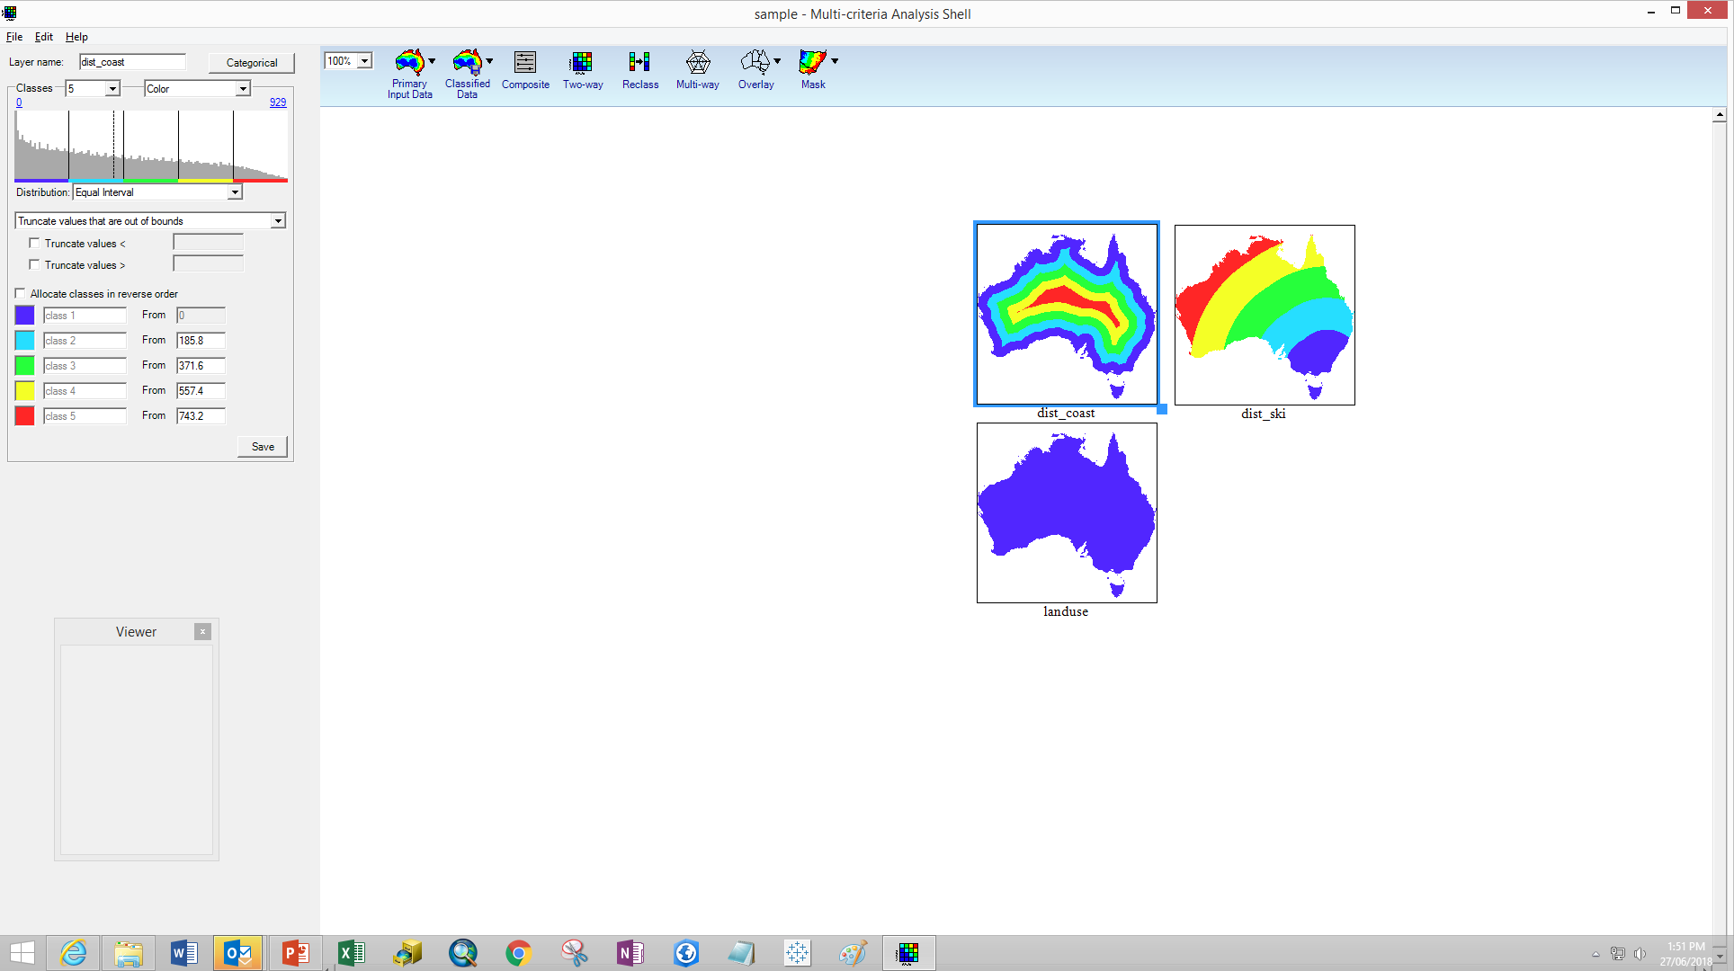
Step 3: Explore data
Rename layers:
  ‘dist_coast’ to ‘Close to coast’
  ‘dist_ski’ to ‘Close to skiing’
  ‘landuse’ to ‘Suitable land use’
Classify data:
‘Close to coast’ and ‘Close to skiing’
  Distribution Log
  Allocate classes in reverse order
‘Suitable land use’ – select 3 classes:
  Not suitable (blue)
  Partly suitable (green) = Nature conservation, Other protected areas, Minimal use, Production forestry, Plantation forestry, Agricultural classes (grazing, cropping and horticulture), Intensive animal and plant production
  Suitable (red) = Urban intensive uses
Notes:
Steps:
Rename all input layers to sensible names (input data filenames are restricted by number of characters and cannot have spaces but MCAS-S display names don’t have these limitations)
Classify or scale all layers
In order to compare and combine different types of data MCAS-S requires you to classify all inputs in a consistent way. In this example we will make locations which are suitable places to live as Red and locations which are unsuitable places to live as Blue.
‘Close to coast’ and ‘Close to skiing’ are continuous data layers. These represent a scale of distance from close = small numbers to far = large numbers. We are more interested in places which are closer to the coast and skiing. MCAS-S by default shows higher values as Red so we need to ‘allocate classes in reverse order’ to show our suitable places as red.
‘Suitable land use’ is a categorical data layer. Land use contains categories such as ‘Urban’. Categorical data layers are brought in with all categories assigned to the dark blue (lowest) class. We will assign red to our most suitable land uses.

Slide 16
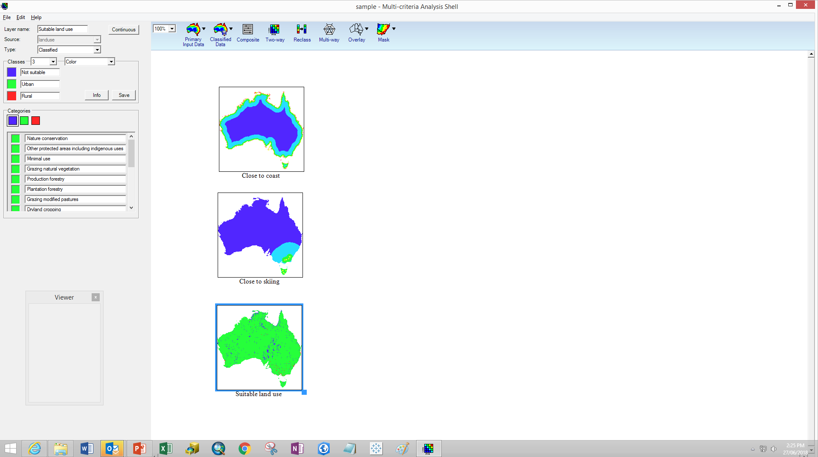
Step 3: Combine data
Combine inputs using a ‘Composite’
Drag Composite tool into the workspace
Rename to ‘Where to live’
Set Weighting for each layer to 1
Overlay ‘states’
Notes:
There are three main methods to combine data layers:
Two-way
Multi-way
Composite – we will use this one
These methods will be explained in more detail later.

Slide 17
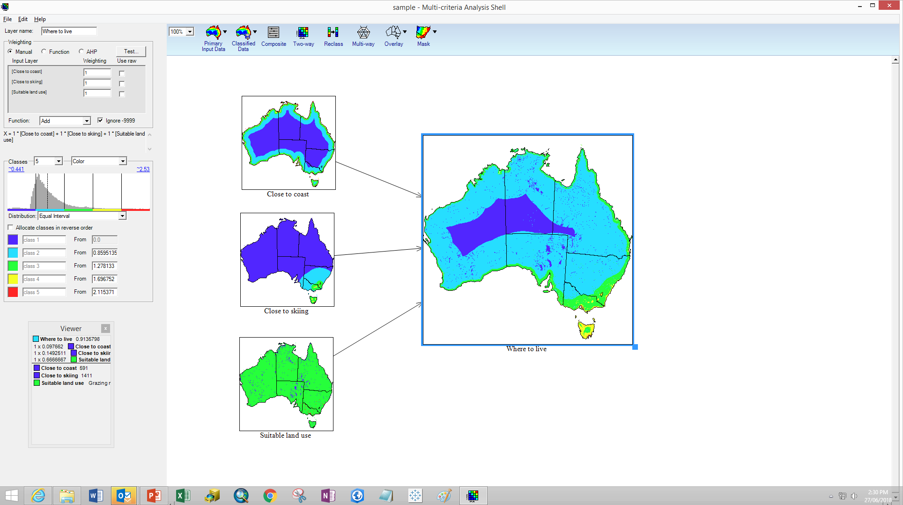
Step 4: Develop options
Change the weightings
  Skiing is more important than diving
Change the ranks
  Reclass ‘Suitable land use’ to prioritise agriculture
Consider the results
Notes:
See the immediate flow through of changes to input layers on the ‘Where to live’ output.
Step 5. Review! What else is important?
Now that you have been introduced to some of the basic MCAS-S functions lets build on this project by including more input layers.
Lets start back at step 1.

Slide 18
1. Define objective, criteria and inputs
1
2
3
4
5
Objective
  What is the overall ambition?
Criteria
  Measures by which options will be judged.
  “What is the difference between a good and bad choice?”
Input data
  Simple, Measurable, Available, Relevant, Timely
  Avoid overlap
Where to live in Australia
Good job
Access to services
Suitable climate
Suitable location
Income
Low unemployment
Urban or major town
Close to towns
Close to main roads
Cool winters
Warm summers
Sufficient rainfall
Sunny days
Close to coast
Close to skiing
Preferred land use
Notes:
Now that we’ve seen what MCAS-S can do let’s put some more thought into our analysis.
OBJECTIVE
Where to live in Australia.
The objective is the foundation of a useful evaluation.
Structuring objectives is key, especially in complex situations. Your objective or decision context in this case needs to take into account the needs of your stakeholders. Who will be relocating?
What are their needs and values?
CRITERIA
The criteria need to meet the objective and defined stakeholder priorities. Criteria should be specific, measurable, and if possible independent of each other. Keep the number of criteria as low as possible while ensuring a well-founded decision.
INPUT DATA
Input data are the layers you will use to complete your analysis. Because MCAS-S is flexible you can always decide to add extra data or remove inputs from your analysis and compare the outputs.
DON’T try to include as much available data as possible or start with your favourite data source.
Select data by relevance to the objective.
Appropriate input data will be:
Simple, Measurable, Available, Relevant, Timely
Input data can be quantitative (for example Rainfall) - or qualitative (preferred land uses)
When the exact data is not available you will need to decide whether substitutes or surrogates are acceptable. Examples of proxies or surrogates might be being close to a small town might assume access to limited services such as general store, and post office while a major town might be assumed to offer medical services, and a high school or university. For vegetation; greenness or normalized difference vegetation index (NDVI) is often used to assume productivity of pasture or crops, while Gross Domestic Product (GDP) is commonly used to compare the economic performance of a countries or regions.
Natural units ($/year, number of jobs, distance from roads)
Proxies (FTEs for cost, NDVI for productivity)
Constructed scales (temperature, Richter scale)
Classes (land use, vegetation type)

Slide 19




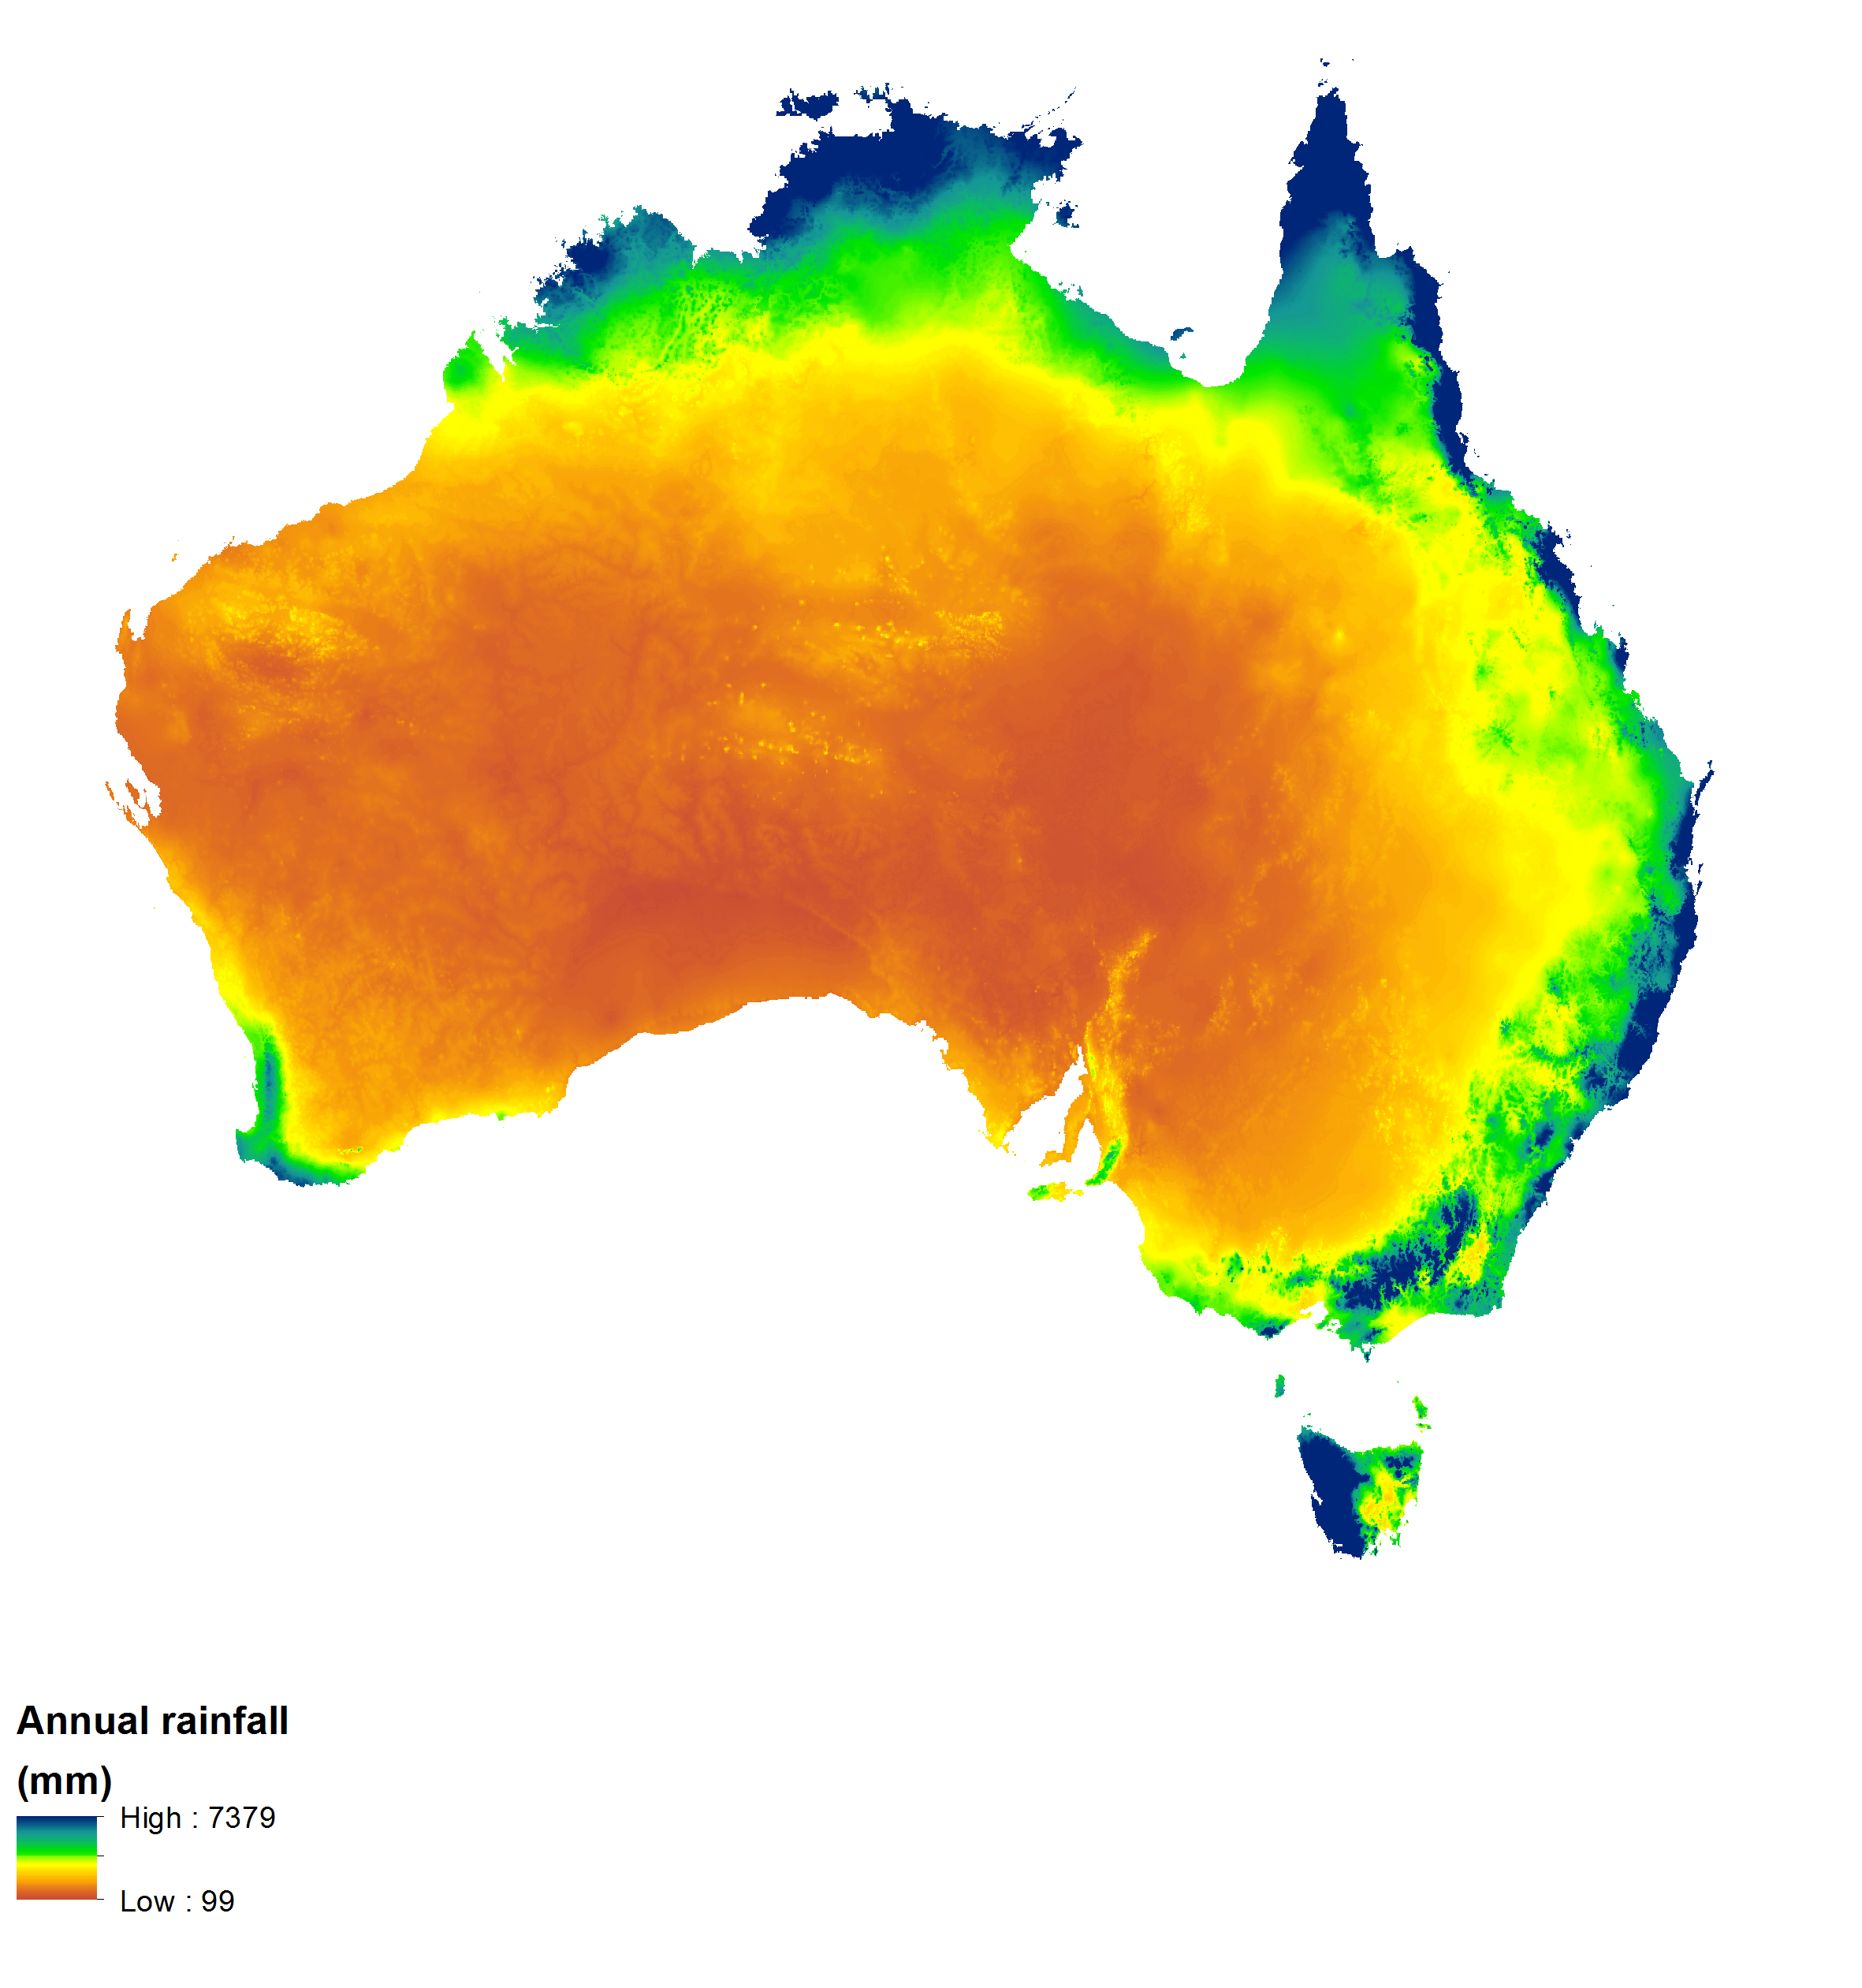
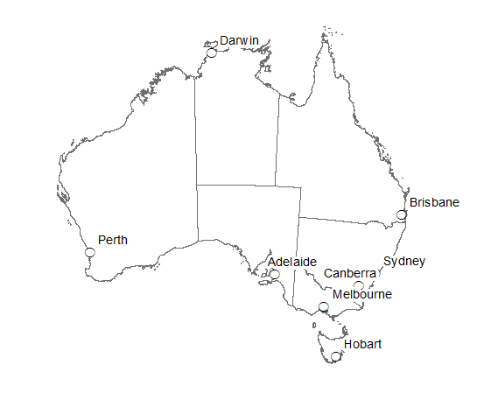
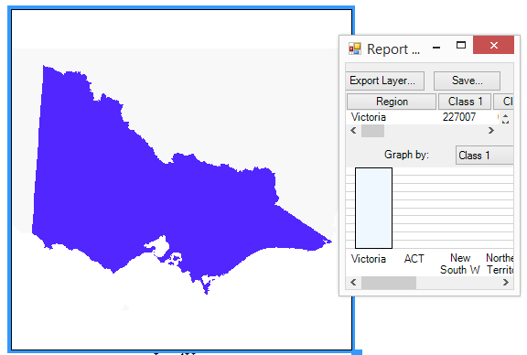
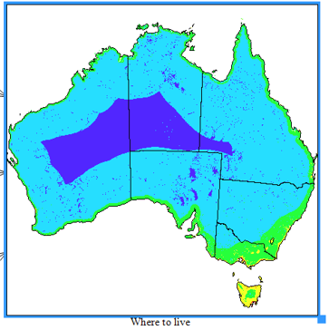


2. Assemble inputs – MCAS-S data
1
2
3
4
5
Primary | Overlay | Mask | Classified
Indicator The workhorse | Provide context Lines and points | Constrain analysis Report and view | MCAS-S Output You made it!
Categorical rasters Continuous rasters Time series rasters | Vector | Categorical raster | Categorical or continuous raster
GeoTIFF, ESRI Raster, BIL | Shapefile | GeoTIFF, ESRI Raster, BIL | GeoTIFF
Notes:
To put together an analysis it helps to understand how to work with data in MCAS-S. You can use:
Primary input data
Overlays
Mask data
Primary input data is the MCAS-S work horse. This is what you do your analysis on. This data is a grid of pixels each with a value. All primary input layers can be dragged in from the primary input data icon. Primary input data can be organized into folders by theme. Primary input data are grids or rasters. GeoTIFF is a good format to work in.
The main two types of primary input data are Categorical and Continuous. We will discuss these types in more detail later.
Overlays are lines or points.
You can’t do analysis on these. They just provide context.
Overlays can be points, lines, or polygons such as towns or states.
Overlays are vector files such as shapefiles.
Masks are actually the same as categorical primary input data. Masks are grids or rasters.
Masks are used to constrain the analysis to a particular area and do statistical reports.
Any layer you create and export in MCAS-S will be saved in the classified folder. These are raster data.

Slide 20
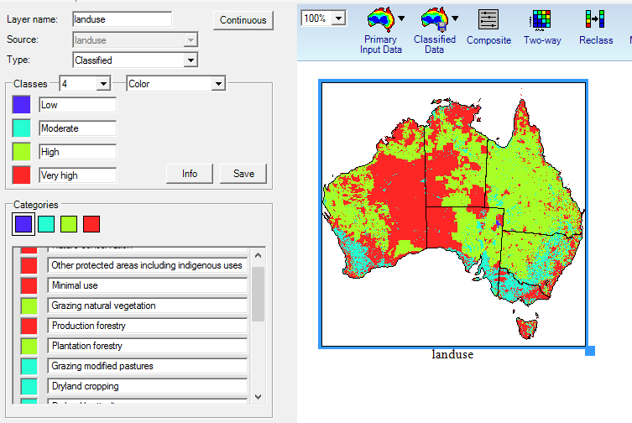
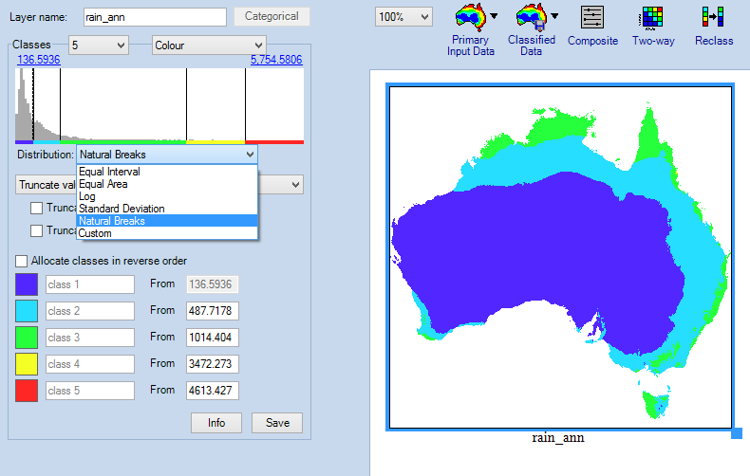
2. Assemble data inputs - Classification
1
2
3
4
5
Categorical
Continuous
    2 - 10 classes
    Use a consistent classification: ‘Low’ to ‘High’ or ‘Unsuitable’ to ‘Suitable’
    MCAS-S scales between ~0 to 1
    Name classes for reference or reporting
Notes:
The two main types of primary input data are: Categorical and continuous.
Categorical = land use
Categorical data are grouped or categorised according to some common property, such as soil type or vegetation type. The numbers may not be important or in order. When you bring in a categorical dataset MCAS-S will assign every category to the lowest class (blue). To use this type of data in MCAS-S you will need to assign an importance to each class such as ranking from ‘low’ to ‘high’, or ‘not suitable’ to ‘suitable’.
Continuous data = rainfall
Continuous data have a range of values from a minimum to a maximum such as surface elevation or temperature. The numbers are meaningful and in order. MCAS-S will automatically classify these layers into 5 classes from low to high using an equal interval between the values. By default MCAS-S will assign areas of high rainfall to a red class giving these more importance that areas of low rainfall.
You can change the distribution to suit your analysis.
Distribution:
Equal interval: unbiased, good for showing data points which either under or over-represented
Equal area: maximise the spread of the data, but may misclassify outliers
Log: useful for distance measures or normally distributed data
Standard deviation: useful for normally distributed data
Natural breaks (Jenks): naturally occurring categories which minimise within-class variances and maximises between-class variance
Custom: manual entry
In general MCAS-S assumes larger numbers (or red classes) are more important. Allocate classes in reverse order is used to assign more importance to low numbers.
Where possible use reliable sources such as published scientific literature or expert knowledge to set class thresholds.
Both categorical and continuous data can be brought into MCAS-S as a time series. A time series are a group of layers representing the same type of information, such as rainfall, at the same locations over time. Using a time series lets you do some statistical analysis for the series.

Slide 21



3. Explore and combine data
1
2
3
4
5
How to combine inputs?
  How can the input data best inform your objective?
  Are any inputs critical?
  What type of answer do you want?
  - Yes / No
  - Scale or shortlist
  - Count
  MCAS-S tools
  - Two-way (coincidence)
  - Multi-way (coincidence or count)
  Mask, Count,
  - Composite (assign weights):
  Manual, Formula, Analytical Hierarchy Process
Explore
Compare
Combine
Notes:
One of the problems with the flexibility of MCA and MCAS-S is that it can be difficult to choose how to combine criteria to meet your objective.
How to do this ultimately depends on your objective: what you want to achieve.
MCAS-S may provide you an “answer” when there are actually no places where all your inputs coincide.
Therefore it is important to be explicit about what an identified location means, check this against the objective, the input data and the combination method.
Applying weights are required for some types of combinations . In this case the greater the importance, the higher the weight.
You can use multiple methods to combine inputs in the one MCAS-S project.
We will go through the three main methods: two-way, multi-way and composite.

Slide 22
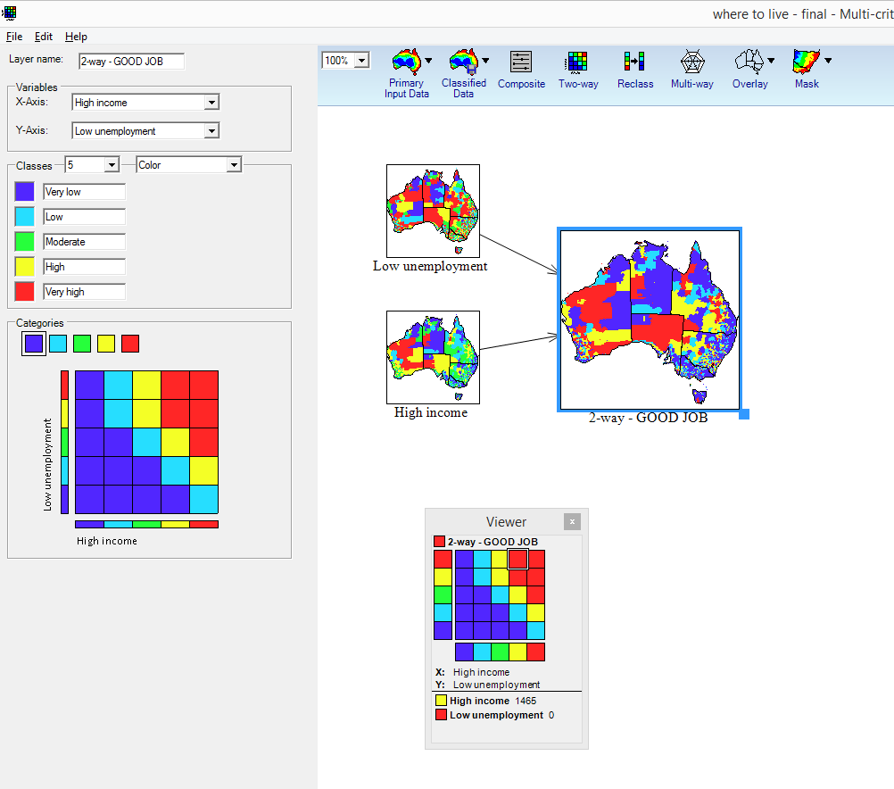
Combine tools: Two-way
Requirements:
Two layers ONLY
Scaled or classified (not Raw)
Scales don’t need to align
Coincidence

Slide 23
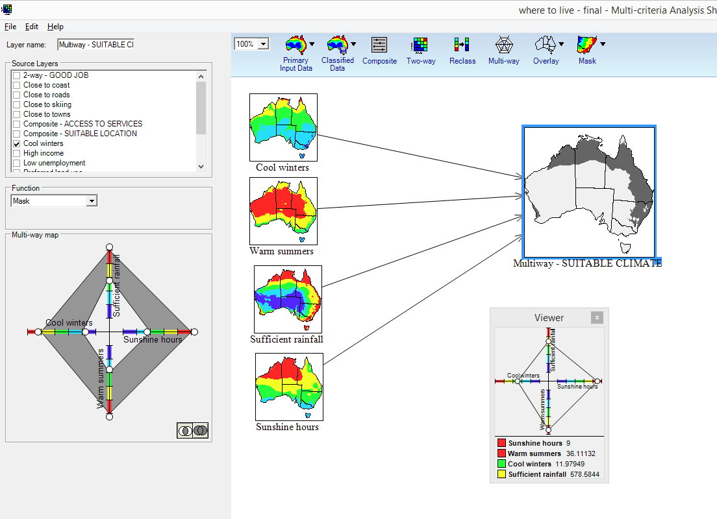
Combine tools: Multi-ways
Requirements:
Two or more layers
Scaled or classified (not Raw)
Scales don’t need to align
Coincidence (mask) or
Conditions met (count)

Slide 24
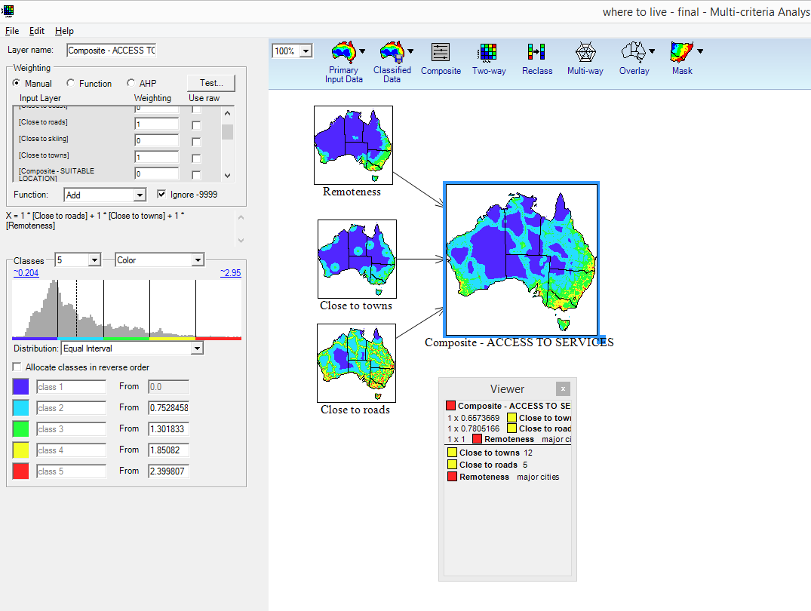
Combine tools: Composites
Requirements:
Two or more layers
Raw, scaled or classified
Scales align
Specify weights:
  Manual
  Function editor
  Analytical Hierarchy Process (AHP)
Notes:
When using manual composites you are combining the weighted values. This assumes that a high value in one input is comparable or substitutable with a high value in another input. For example where no location exists with high values in all inputs the highest overall score wins.
Writing a function provides more control over the analysis. For example you can use if statements and apply thresholds based on the actual data input values.
Analytical Hierarchy Process is useful in workshops where participants are uncertain of the absolute weights to apply but do know which inputs are more or less important that other inputs.

Slide 25
Combine tools: Matrix
 | Two-way | Multi-way |  |  | Underlay | Composite |  |  | Sensitivity Analysis (only for manual composite)
 |  | Mask | Coincidence count | Composite |  | Manual | Function | AHP
More than two input layers |  | Π | Π | Π |  | Π | Π | Π
New output layer | Π | Π | Π | Π |  | Π | Π | Π | If chosen
Rapid assessment | Π | Π | Π | Π | Π | Π |  |  | Π
Check for correlation¹ | Π
Check whole project |  |  |  |  | Π
Use raw values |  |  |  |  |  | Π | Π |  | Π
Specify weightings |  |  |  |  |  | Π | Π | Π
Test weights |  |  |  |  |  |  |  |  | Π
Inputs have equal weight |  | Π | Π | Π |  | Π | Π
Inputs have different weight |  |  |  |  |  | Π | Π | Π
Integer weights |  |  |  |  |  | Π | Π | Π | Π
Non-integer weights |  |  |  |  |  |  | Π
classes do not align² | Π |  |  |  | Π |  | Π
All inputs combined using same function |  |  |  |  |  | Π |  | Π
Inputs combined using different functions |  |  |  |  |  |  | Π
Binary output required | Π | Π |  |  |  |  | Π
Non-binary output required |  |  | Π | Π |  | Π | Π | Π | Π
Notes:
A matrix is a very simple type of Multi-Criteria analysis.
This matrix shows the ways that inputs can be compared or combined in MCAS-S compared to a set of criteria.
We have already discussed two-ways, multi-ways and composites.
This matrix shows that:
If you want to assign different weight to each input you would choose a composite function.
If you want a yes/ no answer you would choose a two-way, multi-way mask or write a composite function.
Underlay is a way of viewing one layer as a transparency behind other layers. Sensitivity analysis is comparing the effect of modifying selected weights in a manual composite.

Slide 26
4. Develop options - come to a decision
1
2
3
4
5
Change weights
Include or exclude inputs
Tools include:
Sensitivity analysis
Correlation analysis
What is an option?
A complete, internally coherent and distinct solution to the problem.
For each option:
Is the result robust / expected / acceptable / practical?
Estimate consequences
Choosing between options:
Is there a dominant option?
What trade-offs or choices distinguish between options?
Notes:
In MCAS-S the options are usually locations in space (and or time if using a time series).
However depending on the context MCA may more broadly be used to choose between:
Physical objects (e.g. houses, cars, coffee (as in the first example))
Ideas, policy approaches
Methods (such as the tools matrix shown earlier)
Locations in space
Points in time

Slide 27
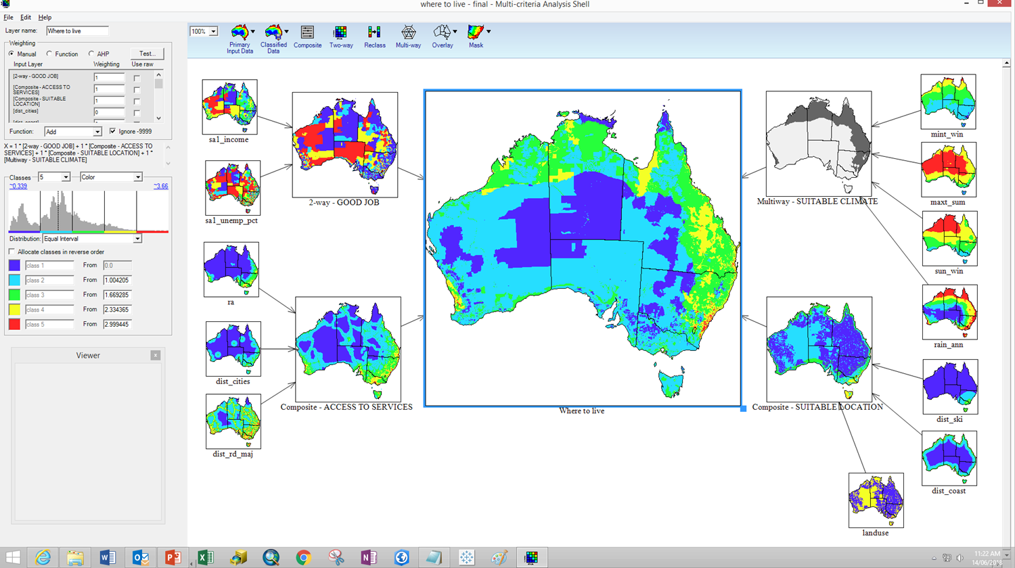
Where to live?
Notes:
Here we show a mapped option or decision. Red shows potential locations.
Sanity check:
What are you going to do with the information? Is the identified area practical?
Is the answer what you expect? What does it actually mean?
How many of the input conditions have been met? (if few or no inputs are met your answer could be a mediocre compromise)
How reliable is this result? Are the inputs and methods good enough?
Want some statistics?

Slide 28
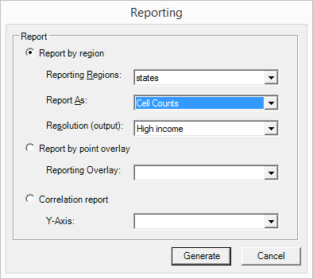
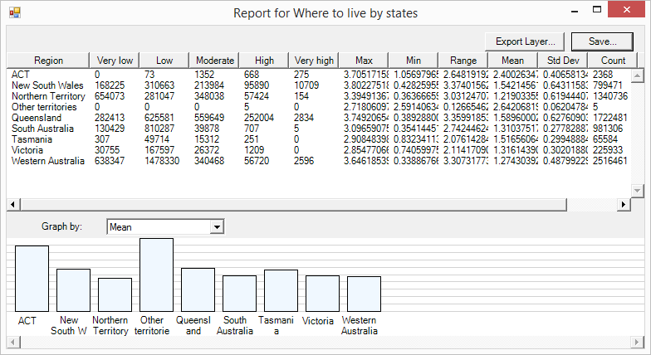
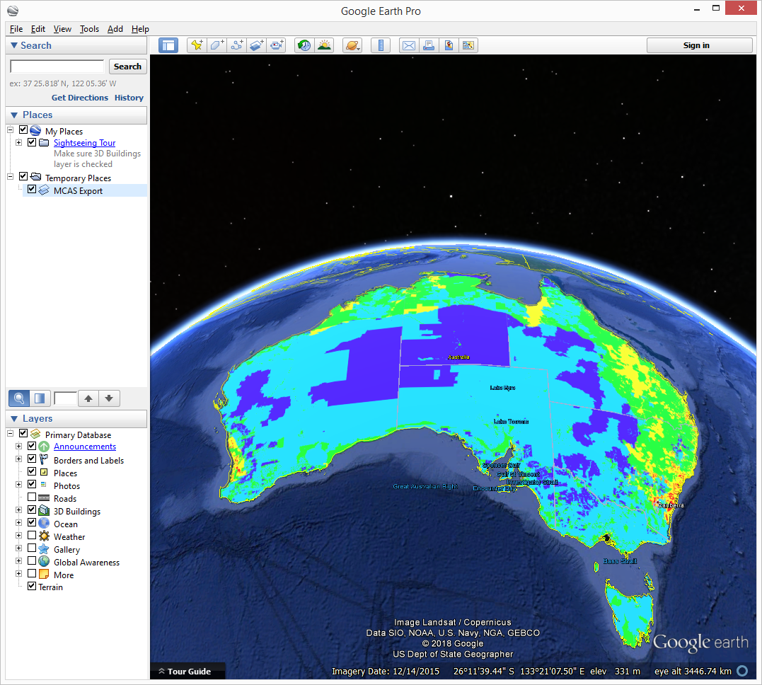
5. Review and report - analysis
1
2
3
4
5
Export
  Google Earth
  To another software for further analysis or presentation
Mask layers can be selected
Proportion or cell counts
Analysis
  Area by region
  Share of region
  Report on a point (city)

Slide 29
Where to get MCAS-S data
Data packs hold all the data you need for a project:
Primary
Overlay
Mask
Classified
Project based, e.g. Lantana exercise
National – datasets useful for NRM, public, consistent
  Biophysical – climate, soils, terrain
  Social – remoteness index, SEIFA, employment
  Economic – land value, farm cash income, rate of return
  Environment – endangered species and communities, protected areas
  Land use, land cover, ground cover, vegetation, agriculture
  Infrastructure – distance to towns, roads, coast, rivers
  Water – soil moisture, distance to water features
  Pests and weeds
  Fire – frequency, time since last burn
TERN data portal http://mcas.auscover.net.au/mcas-s/
Notes:
Currently all MCAS-S data for a project must be stored alongside the project in a specific series of folders.
(This may change in the future).
You can find and download complete data packs or individual data layers relevant to a project.
Most issues with MCAS-S projects are due to not setting up the data properly so downloading a dataset that is ready to go is helpful unless you’ve got GIS experience.

Slide 30
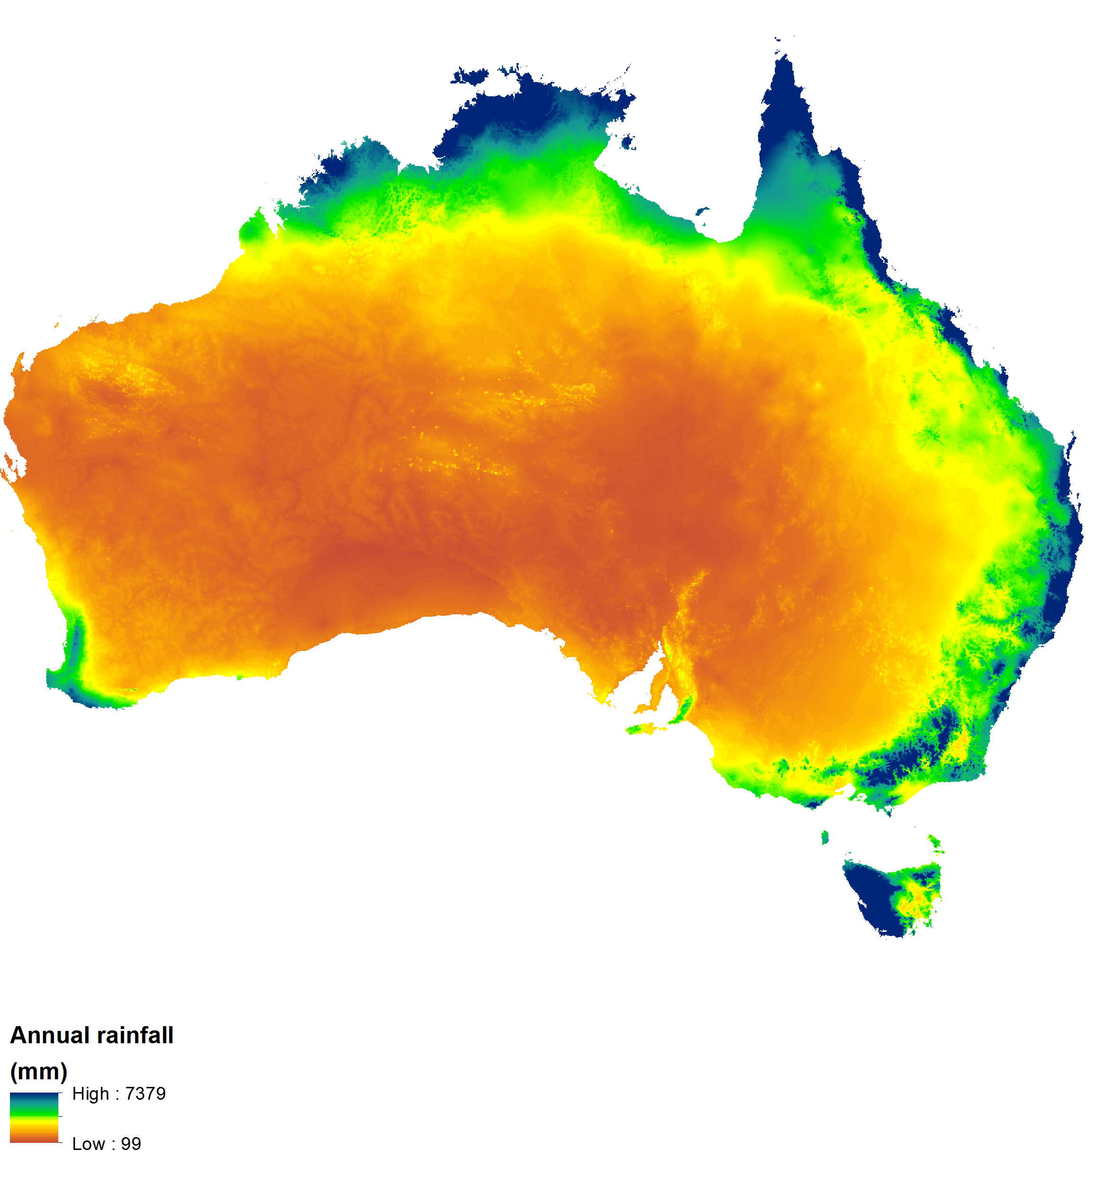
MCAS-S data requirements
MCAS-S uses spatial data that conforms in terms of:
Extent
Projection
Identical extents means that your data overlay each other
Choose a projection that enables the calculation of area e.g.:
National – Australian Albers or Lamberts
Regional – Transverse Mercator
Local – Geographic
Albers
Geographic

Slide 31






www.ecoed.org.au

