Slide 1



Industry BMSB Information
BMSB Seasonal Measures
01 September – 30 April (inclusive)
Hitchhiker Pests Policy | Hitchhiker & NFP Cargo Policy

Slide 2

Agenda
Acknowledgement of country
Data Analysis
Measures for the upcoming BMSB season / What has changed
Questions
  Season Review
  BMSB Risk background
  Data analysis
  Target Risk Countries
  Emerging Risk Countries
  Containerised vs Break Bulk
  BMSB Treatments
  NUFT and 120 hours
  Sealing Declarations
  Management of LCL/FAK Containers
  Verification Inspections
  Preparing for the BMSB Season
  Frequent Scenarios
Notes:
Welcome all to the 2026-2027 BMSB Industry Session. I'd like to begin by acknowledging the Traditional Custodians and Owners of the land and/or water on which we meet today. I'd also like to acknowledge their Elders - past and present, and any other Aboriginal or Torres Strait Islander peoples who may be present here today.’
Differing slightly from information sessions of previous years, we’ll begin with the data analysis because it provides important context for this season’s changes. The data shows that, although the measures are managing significant risk, live and post-border detections demonstrate that BMSB risk remains present and may be changing.
We’ll then explain the targeted changes and cover the broader measures, most of which remain unchanged from last season.
Please feel free to post general questions in the chat and we’ll answer as many as we can towards the end. For consignment-specific scenarios, pathway questions or detailed questions about the analysis, please email HPP@aff.gov.au. This will allow us to provide a more comprehensive response than we can in the chat and address any follow-up questions more effectively.

Slide 3

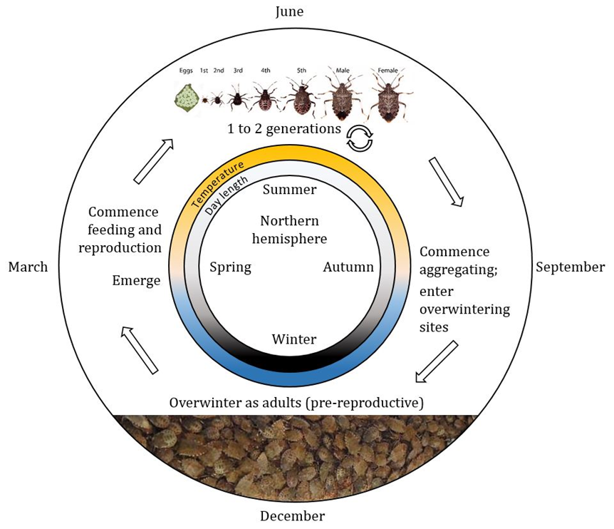
Brown marmorated stink bug (BMSB) lifecycle
Notes:
For those that are not familiar, BMSB is native to temperate east Asia, including China, Japan and South Korea. It has successfully invaded and established throughout Europe and North America.
BMSB damages over 300 agricultural and ornamental plant species. If it establishes in Australia, it would be extremely difficult to eradicate and expensive for farmers to manage. They are also a nuisance for the general public as they enter houses and buildings in large numbers in Autumn. If disturbed or crushed, they emit a foul odour.
Aggregations of reproductively immature adults form in September. The bugs seek dark, sheltered sites to overwinter, entering diapause for several months.
BMSB can infest a range of goods as well as boxes and packaging, and containers transporting infested goods. These goods are often stored outdoors or in industrial buildings that are not well sealed.
After arriving in Australia and being exposed to warm temperatures, the bugs exit their winter diapause and disperse seeking food.
This slide Italics (Candice’s text ) standard text (PSaRA’s text)

Slide 4
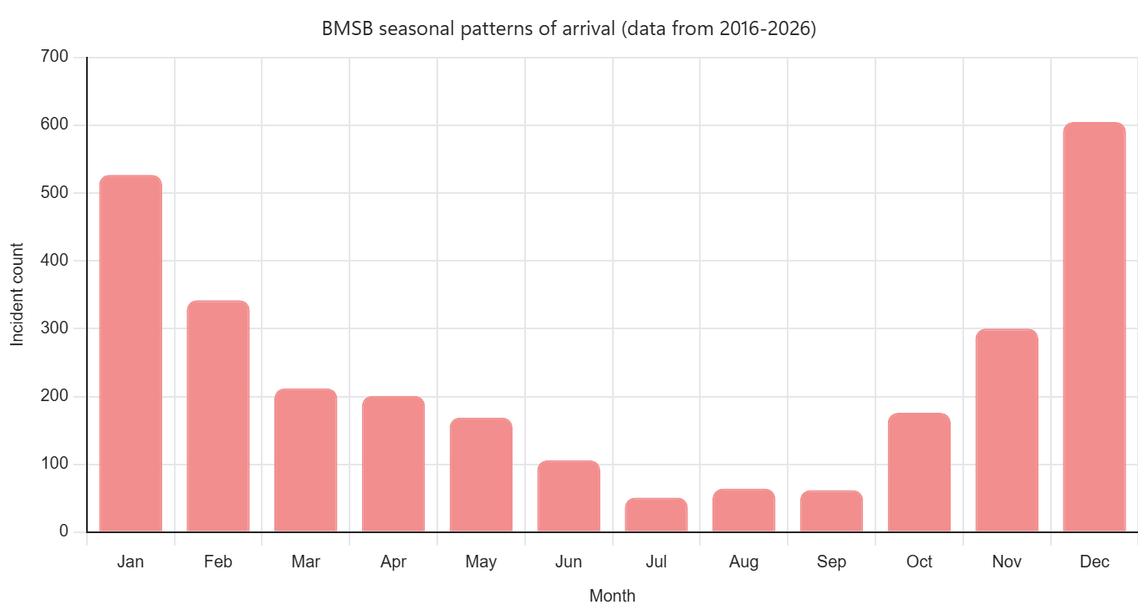
Notes:
In line with the life cycle of BMSB, the BMSB season runs from 1 September to 30 April, reflecting the seasonal pattern of interceptions at the border.
This chart shows the number of incidents of BMSB by month over the last ten years.
(If asked, this chart includes both live and dead incidents).
Arrivals of BMSB begin to rise in October, peaking in December and January and tailing off Autumn.
(If asked, many of the detections in the off months May-Aug were dead and found in consignments of breakbulk).
As you can see this chart establishes the seasonal timing and when we see the peaks and troughs of risk periods; in the next slide looks at how interceptions have changed over time.
This slide Italics (Candice’s text ) standard text (PSaRA’s text)

Slide 5
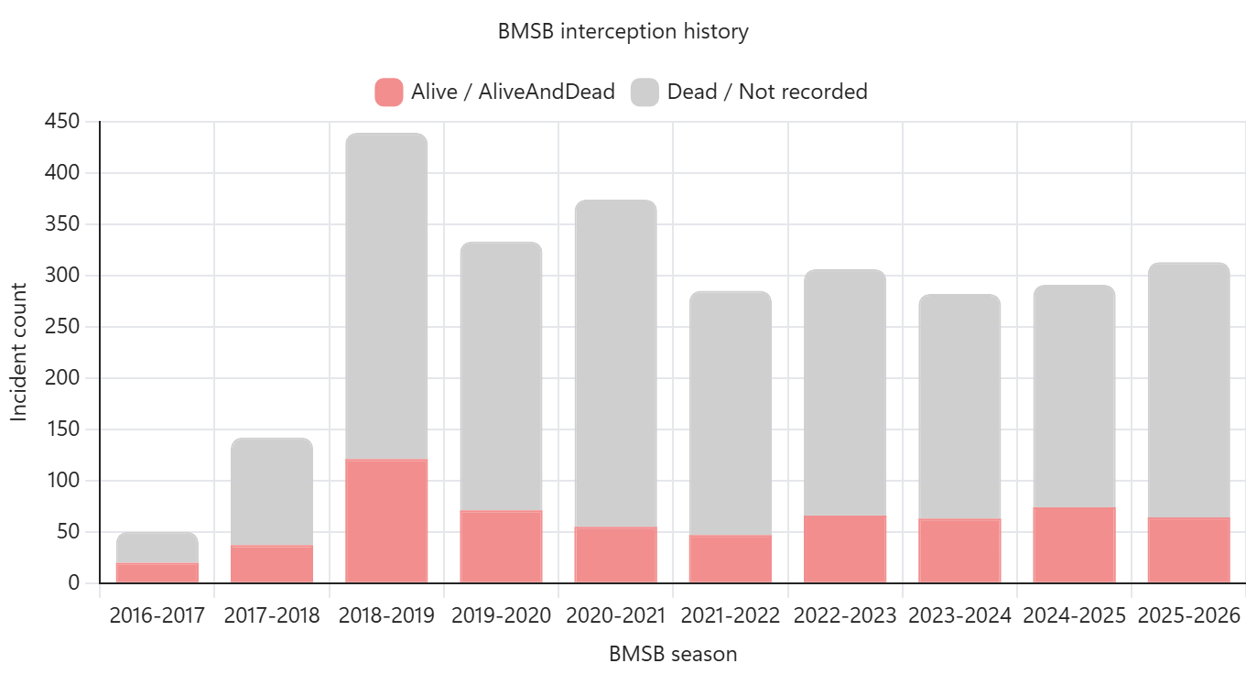
Notes:
BMSB interceptions peaked in 2018-2019. Importantly, the detections represented here are of distinct (or unique) incidents. If individual BMSB [from each incident] were represented it would number in their thousands (for the dead ones).
The high number of dead interceptions is very likely the result of effective offshore treatment for target high risk goods.
The overall number of live detections has remained fairly constant over the past few years, indicating there is still a risk.
This slide Italics (Candice’s text ) standard text (PSaRA’s text)

Slide 6
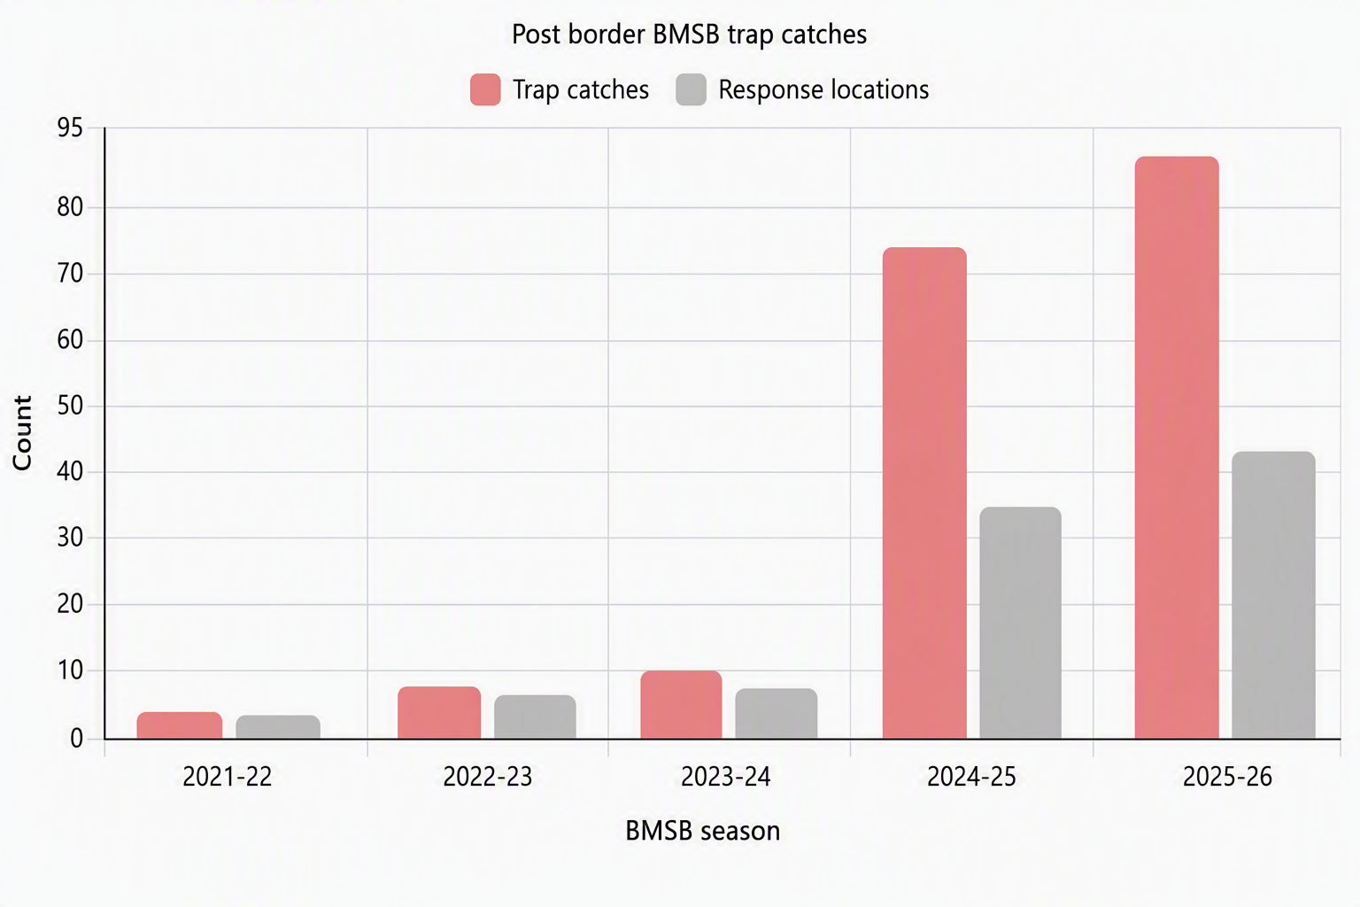
Notes:
However, the risk appears to be changing. In the past two years, Australia has seen a dramatic increase in post-border detections across all states and territories.
This chart records the number of BMSB caught in surveillance traps (pink) and the number of response locations (grey).
The increase in post border detections is very concerning and suggests there is leakage happening on import pathways.
The increase has not been linked to a specific pathway. Some of the increases could be linked to improvements in the surveillance tools and trap grid design (ie this level of leakage has been present but has only recently come to our attention due to the improvements in surveillance).
Currently, there is no evidence of an established population of BMSB in Australia.
(If asked no eggs or nymphs have been found, which are indications of an established breeding population, and no large aggregations of BMSB in areas surveyed).
The department is continuing to review interception data, monitor risk pathways and responds to every BMSB trap detection to ensure the risk is managed.
This slide Italics (Candice’s text ) standard text (PSaRA’s text)

Slide 7
2025-26 BMSB Season Review
BMSB Detections
 |  | 2024-25 1 Sept – 18 June | 2025-26 1 Sept – 17 June
 | Condition | Number of Detections
Biosecurity Intervention Point | Alive | 12 | 15
 | Dead | 164 | 172
Post Biosecurity | Alive | 37 | 64
 | Dead | 6 | 7
Total |  | 219 | 258
YSSB Detections
 |  | 2024-25 1 Sept – 18 June | 2025-26 1 Sept – 17 June
 | Condition | Number of Detections
Biosecurity Intervention Point | Alive | 24 | 13
 | Dead | 97 | 135
Post Biosecurity | Alive | 2 | 7
 | Dead | 0 | 5
Total |  | 123 | 160
    52 AIMS entries
    with BMSB
    detections.
    4,250 BMSB entries lodged through AEPCOMM.
    230 Registered
    AusTreat treatment providers.
    295 SPIs performed
    on Roll-On Roll-Off
    vessels.
    85,573 Total entries referred into AIMs
    for BMSB.
    3,541 consignments with a BMSB profile directed
    for inspection.
    63 Consignments directed for export for arriving non-compliant.
Notes:
This slide brings the most recent two seasons into focus and reinforces the pattern shown in the previous slides.
The department uses detection data and other intelligence to continually review pathways, assess changes in risk and test whether the measures remain effective.
The recent movement in detections supports continued vigilance and provides evidence as to why the department is making two targeted changes for 2026–27 while retaining the broader seasonal framework which we will cover next.
Yellow spotted stink bug, shown here as YSSB, is also being monitored closely. There are no plans at this time to introduce seasonal measures for YSSB equivalent to those used for BMSB.

Slide 8
What is changing this season?
Analysis of import pathway and detection trends of five BMSB seasons found that the standard, treatment-based measures provide the clearest and most consistent basis for managing BMSB risk. Accordingly, the following alternative clearance pathways will cease from the 2026–27 BMSB season:
BMSB Safeguarding Arrangement Scheme
The review found that the scheme did not provide the same level of assurance as the standard BMSB measures for untreated target high risk goods from target risk countries. It also identified issues with consistent implementation and alignment with current legislative requirements. Ceasing the scheme will return these goods to the standard, legislated measures and support Australia’s appropriate level of protection (ALOP).
BMSB rolled goods policy
This temporary policy provided flexibility for shipping delays during the COVID-19 period. As those exceptional conditions no longer apply, the policy will cease. Breakbulk goods that do not meet the standard 120-hour post-treatment window will be managed as untreated breakbulk in accordance with the legislated BMSB measures.
Notes:
The target risk countries, approved treatments, 120-hour window, target high risk goods, declarations and verification inspections remain largely unchanged from last season.
As part of its regular review of pathway performance and detection trends, and to reduce possible pathways where leakage could occur, the department identified that these two alternative clearance pathways should cease. Goods that previously used these pathways will instead be managed under the standard measures.
To cover each change,
The Safeguarding Arrangement Scheme will cease as the scheme in its current form was assessed as not being able to provide the same level of assurance of risk mitigation as the standard measures. Concerns were also identified with achieving consistent implementation, compliance against scheme requirements and alignment with current legislative requirements. Ceasing the scheme does not preclude similar alternative arrangements being considered in the future where appropriate, however .
The rolled goods policy will also cease. It was introduced as a temporary measure originally, to provide flexibility for shipping delays during the COVID-19 period, and those exceptional conditions no longer apply. Breakbulk goods that do not meet the standard 120-hour post-treatment window will be managed as untreated breakbulk under the legislated BMSB measures.
The key message is that these are targeted responses to the evidence of the changes in risk and increase in post border detections.

Slide 9
BMSB Seasonal Measures
Measures apply to goods shipped between 1 September and 30 April (inclusive) as sea cargo. Any target high risk or target risk goods manufactured in, or shipped from a target risk country are subject to the BMSB seasonal measures:
Roll on Roll off vessels that berths at, loads or tranships goods from these countries are subject to heightened vessel surveillance.
Japan, Republic of Korea, United Kingdom and China are currently still considered emerging risk countries.
Airfreight from USA and China will be subject to random verification inspections.
Target high risk goods subject to
  mandatory treatment, and
  random inspection
Target risk goods subject to
  random inspection
Notes:
Now onto the wider measures, the 2026-27 seasonal measures remain largely unchanged from last season. They apply to target high risk or target risk goods manufactured in, or shipped from a target risk country shipped as sea freight from 1 September to 30 April, inclusive.
Target high risk goods will continue to require mandatory treatment and may also be selected for random inspection. Target risk goods will continue to be subject to random inspection.
Heightened vessel surveillance also continues for relevant roll-on, roll-off vessel arrivals.
Eligible goods from emerging-risk countries, and relevant airfreight from the United States and China, continue to be subject to random verification inspection.

Slide 10
Target Risk Countries
2026–27 BMSB season
TARGET RISK COUNTRIES
EMERGING RISK
Standard seasonal measures apply to target high risk goods manufactured in, or shipped from, these countries.
Eligible goods: random verification inspection; treatment not required.
Albania
Andorra
Armenia
Austria
Azerbaijan
Belgium
Bosnia and Herzegovina
Bulgaria
Canada
Croatia
Czechia
France
Georgia
Germany
Greece
Hungary
Italy
Kazakhstan
Kosovo
Liechtenstein
Luxembourg
Montenegro
Moldova
Netherlands
Poland
Portugal
Republic of North Macedonia
Romania
Russia
Serbia
Slovakia
Slovenia
Spain
Switzerland
Türkiye
Ukraine
United States of America
Uzbekistan
United Kingdom
China
Japan
Republic of Korea
HEIGHTENED VESSEL SURVEILLANCE
Applies to roll-on/roll-off vessels that berth in, load in or tranship through target risk countries, as well as China, Japan or the Republic of Korea.
WHAT DETERMINES
THE MEASURES?
SHIPPED FROM A TARGET RISK COUNTRY
MANUFACTURED IN A TARGET RISK COUNTRY
BMSB measures apply, regardless of where the goods were manufactured.
Standard measures continue to apply, including when exported through an emerging or non-target risk country.
Notes:
Here we can see the list of target-risk countries. Standard seasonal measures including treatment, will apply to target high risk goods that have been manufacture and or shipped from these countries.
The emerging-risk countries are shown separately. Eligible goods from these countries are subject to random verification inspection. Treatment is not mandatory unless the goods have been manufactured in (country of origin) a target risk country.

Slide 11
BMSB Approved Treatments
There are four approved BMSB treatment types BMSB for both onshore and offshore use:
Offshore treatments
All treatment providers in target risk countries that intend to conduct BMSB treatments must register under AusTreat.
Treatment providers in non-target risk countries that intend to conduct BMSB treatments are encouraged to register under AusTreat however, it is not mandatory.
All queries relating to offshore BMSB treatment requirements, methodologies and provider registrations and approvals to be directed to offshoretreatments@aff.gov.au.
Onshore treatments
To reduce delays at the border, the department recommends that industry treat offshore or pack containers to allow effective onshore treatment.
  Methyl Bromide
  Sulfuryl Fluoride
  Heat treatment
  Ethyl Formate
  12.1 Methyl Bromide
  12.2 Sulfuryl Fluoride
  12.3 Heat treatment
  12.4 Ethyl Formate
Notes:
Onto approved treatment options.
There are four approved BMSB treatments methyl bromide, sulfuryl fluoride, heat treatment and ethyl formate. Ethyl formate is being introduced as an onshore option this season. Registered ethyl formate entities will be published on the department’s website when they become available.
For offshore treatments, providers in target-risk countries must be registered under an offshore treatment-provider scheme, (or AusTreat), while for treatment providers in non target risk countries being registered with an offshore treatment provider scheme is not mandatory .
Treatment certificates issued by a treatment provider in non-target risk country will be accepted unless the:
Treatment provider is listed as ‘suspended’, 'withdrawn' or ‘under review’ on the List of treatment providers,
or
Unregistered treatment provider is listed as ‘unacceptable’ or ‘under review’ on our webpage.
Treatment certificates must still meet BMSB requirements regardless of where treatment occurs. Reminder there are differences between a standard treatment certificate and a BMSB treatment certificate.
Treating offshore where possible, and coordinating early with treatment providers, remain the best ways to reduce border delays.

Slide 12
120 hours Post Treatment Window
120 hour post treatment window
Goods treated in a target risk country are subject to the 120 hour post treatment window when treated prior to 1 December
  Containerised goods must be sealed in the container.
  Break bulk goods (incl. open top, flat rack and modified containers) must be shipped on board the vessel.
The ‘shipped on board’ date is considered the date listed as shipped or laden on board as per the ocean bill of lading. Original “ETDs” and “Gate in” dates and times are not acceptable.
The 120 hours does NOT apply to:
  Goods treated in non-target risk countries.
  Good treated after 1 December.
120 hour transhipment window
Breakbulk goods that tranship in a target risk country prior to 1 December, are subject to the 120 hour window. Does not apply to sealed containers.
Notes:
The 120-hour post-treatment window remains in place as a legislated requirement. For goods treated in a target-risk country before 1 December, containerised goods must be sealed within the window and breakbulk goods must be shipped on board the vessel within the window.
For breakbulk, the relevant evidence is the shipped-on-board or laden-on-board date listed on the ocean bill of lading. Estimated departure and gate-in dates are not accepted for this purpose.
The window does not apply where treatment occurs in a non-target-risk country or after 1 December.
For awareness when planning the shipping route, the 120-hour transhipment window also applies to breakbulk transhipping through a target-risk country before 1 December.
It is important to plan treatment and vessel loading together to ensure the 120hr time frame is met.

Slide 13
Break Bulk vs Containerised goods
Break Bulk
Includes all flat rack, open top and modified containers.
FCL containers (inc. SOCs) that have been modified, such as those used to house in-built power generators, portable workshops etc., are considered break bulk.
All target high risk goods shipped as break bulk must be treated offshore.
No exceptions will be made for untreated break bulk and goods will be directed for export.
Mandatory offshore treatment – no exceptions
Containerised
Refers to sealed six hard sided containers - general purpose/dry box.
Includes Refrigerated containers (operating or non-operating) are subject to the measures, including treatment.
Includes some hard top open top containers (ISO22U6/ISO22UP, ISO42U6/ISO42UP and ISO45U6/ISO45UP).
Unlike breakbulk six hard sided containers have the option for onshore treatment.
Mandatory treatment either offshore or onshore at container level
Management of LCL/FAK Containers
Less than Container Load (LCL) and Freight All Kinds (FAK) containers with target high risk goods that are shipped from target risk countries between 1 September and 30 April (inclusive) are managed at the container level for BMSB risk prior to deconsolidation.
Notes:
The distinction between breakbulk and containerised cargo will continue to determine if the goods are subject to mandatory offshore treatment.
Flat racks, open tops and modified containers are managed as breakbulk. Target high risk goods shipped as breakbulk must be treated offshore. Untreated breakbulk, or breakbulk that does not meet the 120-hour post-treatment window, will be directed for export. * talk about what is a modified container and to email us to be sure*
Six-hard-sided containers, including relevant refrigerated and specified hard-top open-top containers, may be treated offshore or onshore at container level.
LCL and FAK containers containing target high risk goods are managed at the container level before deconsolidation. We recommend confirming whether cargo is subject to the measures before packing and booking.

Slide 14
BMSB NUFT and Sealing Declarations
BMSB New, Unused and not Field Tested (NUFT)
Goods that can meet all the following criteria will not be subject to mandatory BMSB treatment:
  The goods were manufactured on or after 1 December? (manufacture must start from 1 December of the current BMSB risk season).
  The goods are classified under the following tariff chapters only: 82, 84, 85, 86, 87, 88 and 89?
  Evidence can be provided in the form of a BMSB NUFT (new, unused and not field tested) manufacturers declaration that the goods were manufactured on or after 1 December?
NUFT declarations must state the manufacture start date - refurbishments are ineligible.
Sealing Declarations
Sealing declarations will be accepted by the department to verify:
  goods have been sealed in a six hard sided container in a target risk country prior to 1 September,
  goods have been sealed in a six hard sided container in a non-target risk country prior to being shipped from a target risk port at any time within the BMSB season, or
  goods have been treated and sealed in a six hard sided container within the 120-hour post treatment window.
Sealing declarations must be completed by the exporter/freight forwarder/shipping company at the port of origin / country of origin. Australian based importers/brokers cannot sign off on these declarations, and they will not be accepted by the department.
Sealing declarations cannot be used for break bulk, open top, flat rack or modified containers.
Notes:
NUFT and sealing declarations remain available for eligible goods where the relevant conditions are met.
For NUFT, the goods must be new, unused and not field tested, manufacture date must start on or after 1 December, and the goods must fall within the eligible tariff chapters. The declaration must state the manufacture start date, and refurbished goods are not eligible. The template is available on the department’s website. Please note that the BMSB NUFT declaration differs from the standard NUFT declaration.
Sealing declarations can verify that a six-hard-sided container was sealed in one of the accepted circumstances shown here. They must be completed at origin by the exporter, freight forwarder or shipping company. Australian importers and brokers cannot sign them.
Sealing declarations cannot be used for breakbulk, open-top, flat-rack or modified containers. These evidence requirements remain consistent with previous seasons.

Slide 15
Verification Inspections
Random verification inspections for sea cargo
All goods sent for random verification inspection must be conducted at a 1.1, 1.2, 1.3, 2.1 or 2.2 AA (where approved) in a metropolitan location. The container will be permitted to be dehired prior to inspection.
For entries with multiple containers, containers not selected for inspection will be permitted to be delivered and deconsolidated.
The department may permit inspections at a non-approved AA location / importers premises where containers can be unpacked with the appropriate equipment if required. For approval, please contact the Inspections Group in the corresponding regional office on 1800 900 090.
Inspections conducted at a non-approved AA location or importers premises, will be required to be completed as seals intact inspections under Biosecurity supervision.
Random verification inspections for airfreight
Random inspections apply to target high risk goods shipped as airfreight from United States of America and China between 1 September to 30 April (inclusive).
For goods shipped as airfreight, inspections will be able to be conducted at either a Class 1.1, 1.2 or 1.3 AA.
Notes:
Random verification inspections remain part of the seasonal measures for both sea cargo and specified airfreight.
Break bulk inspection will be performed at the wharf.
For sea cargo, selected containers need to be made available at an appropriate approved arrangement in a metropolitan location, unless another location is approved. Where an entry contains multiple containers, containers that are not selected may generally proceed and be deconsolidated.
For airfreight, random inspections continue to apply to target high risk goods shipped from the United States and China during the season. Reminder to allow time for intervention and to confirm inspection arrangements early. Selection for verification inspection is part of the risk-management framework and cannot be waived simply because delivery timelines are tight.

Slide 16
Prepare early to avoid BMSB delays
Six actions to plan, treat and document your shipment
PLAN YOUR SHIPMENT
TREAT & PACK
DOCUMENT & ALLOW TIME
1
Confirm scope and treatment needs
Use approved providers
Link documents to the consignment
1
3
5
Measures may apply to goods even if shipped from non-target risk countries.
Goods shipped as break bulk requires pre-arrival treatment, without exception.
Use approved providers and compliant certificates. Certificates issued in non-target countries must meet BMSB requirements.
Ensure treatment, shipping and supporting documents clearly relate to the consignment.
2
Check the route and transshipment
4
Meet post-treatment rules
6
Allow time for intervention
Transshipment through a target risk country can change the measures that apply.
Follow sealing and loading timeframes. Mixed cargo stays consolidated and is managed at the highest applicable risk level.
Allow time for onshore inspection. Random verification inspection requirements cannot be waived.
Notes:
Reminders for importers on how to avoid delays.
First, confirm the scope, cargo type and treatment need before shipment. Second, check the full route, including transhipment. Third, use an approved provider and make sure the certificate meets the requirements. Fourth, comply with the sealing and loading timeframes. Fifth, ensure the treatment, shipping and supporting documents clearly link to the consignment. Finally, allow time for inspection or other intervention.
Early planning and accurate documentation remain the most effective ways to avoid delays.

Slide 17
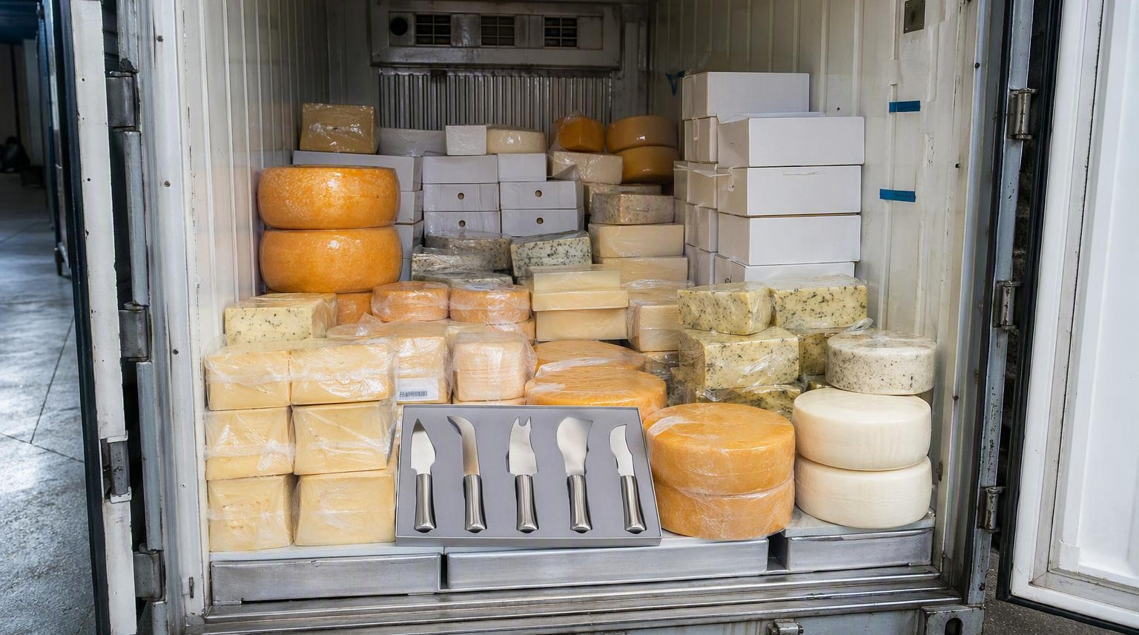
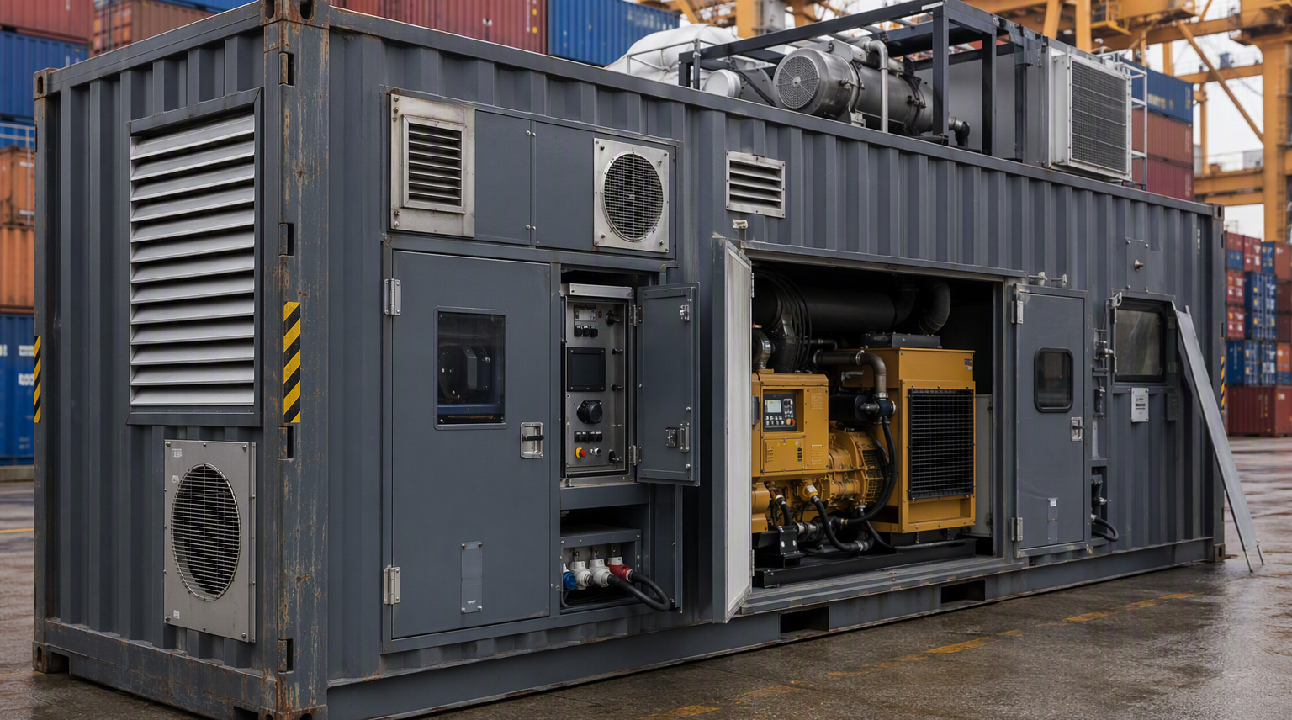
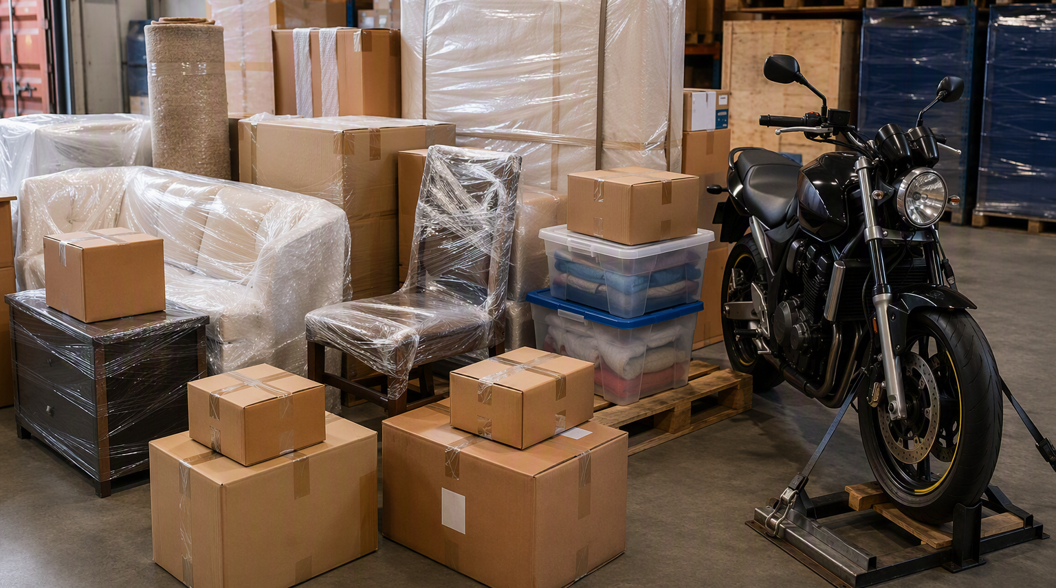

Frequent scenarios
Some common scenarios to be aware of:
Supplier samples
The addition of free samples or promotional materials to consignments that would otherwise not be subject to the measures can result in the whole container being subject to treatment.
Check BMSB requirements before adding them to a shipment or ask your supplier not to add them .
If target high risk goods are packed with other goods, the whole container may be managed at the highest risk level.
Modified containers
Modified containers are managed as breakbulk cargo.
This includes containers used for generators, filtration units or accommodation.
If treatment is required, untreated break bulk must be treated offshore.
Unaccompanied personal effects
Some personal effects may be treated differently.
Goods cleared under an ABF approved B534 form may not need mandatory BMSB treatment.
Vehicles, motorbikes and goods reported on a full import declaration may still need treatment.
Goods shipped from New Zealand
New Zealand clearance does not guarantee Australian clearance.
Goods with a target risk origin may still need to meet Australian BMSB requirements.
Supplier or importer declarations are not accepted as evidence.
Notes:
These are a few scenarios we saw last season that are worth highlighting.
Free samples or promotional materials are not automatically exempt because of their intended use or because they were added unexpectedly by the supplier.
Modified containers will be managed as breakbulk and may therefore require offshore treatment.
Some personal effects can still require treatment, depending on how the goods are reported.
Clearance in New Zealand does not automatically satisfy Australian BMSB requirements where the goods have a target-risk origin. If evidence cannot show that the goods arrived in New Zealand before 1 September, the seasonal measures may apply, including offshore treatment for breakbulk consignments.
The common theme is to check before packing or shipping. If there is uncertainty about classification, origin or treatment, please contact us early rather than waiting until the goods arrive.

Slide 18
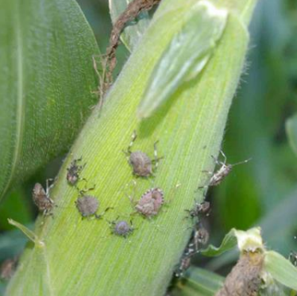
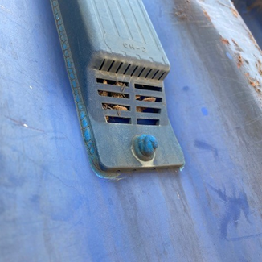
Industry’s role in Biosecurity
See. Secure. Report
Working with offshore suppliers to manage not just BMSB risk,
but all pest risks.
Stay updated on the BMSB seasonal measures by visiting the following
webpages www.agriculture.gov.au/bmsb.
Subscribe to our Import Industry Advice Notices to get updates on changes
to import requirements, including updates on brown marmorated stink bug
seasonal measures https://subscribe.agriculture.gov.au/subscribe.
Questions
  Policy for Hitchhiker Pests: hpp@aff.gov.au
  BMSB Treatments (including registration and approval
  of offshore treatment providers): offshoretreatments@aff.gov.au
  LCL/FAK lodgements: BMSBprocessing@aff.gov.au
Recommend watching webinar: Managing the risk of a serious hitchhiker pest.
https://www.agriculture.gov.au/biosecurity/australia/public-awareness/webinar-series
Notes:
I’ll finish by emphasising the important role industry plays in managing biosecurity risk. The most effective approach is to work with suppliers, treatment providers, freight forwarders and brokers early—before the goods are packed and shipped.
Please continue to check the published BMSB seasonal measures, subscribe to Import Industry Advice Notices and use the contact points shown here if you need guidance on policy, treatment-provider requirements or LCL and FAK lodgements.
Most measures remain consistent with previous seasons. Early planning, correct treatment and complete documentation remain the best ways to avoid delays.
Thank you. We’re happy to take questions.

