Slide 1
Adapting to Climate Change in Australia

Slide 2


Acknowledgment of Country
The Australian Government acknowledges the Traditional Owners and Custodians of Country throughout Australia and recognises their continuing connection to land, waters and community. We pay respect to the people, the cultures and the elders past, present and emerging.
ARTWORK: Looking After Country
© Elizabeth Yanyi Close 2021
This artwork acknowledges the sovereignty of all Aboriginal and Torres Strait Islander people over many vast landscapes across the country — and their custodianship over that land for tens of thousands of years.
Recognition of shared histories across Australia’s landscapes and acknowledging our First Nation people’s sustainable practices — since time immemorial — and the place they have in contemporary land care management and looking after country.
This work is profoundly informed by the interconnectedness of the different facets and textures of the landscape. Elizabeth’s motifs and iconography speak to a concept that is central to her practice –Connection to Country.
Elizabeth Yanyi Close is a Panaka Skin Anangu woman from the Pitjantjatjara and Yankunytjatjara Language Groups, whose family links are to the communities of Pukutja and Amata in the APY Lands.

Slide 3
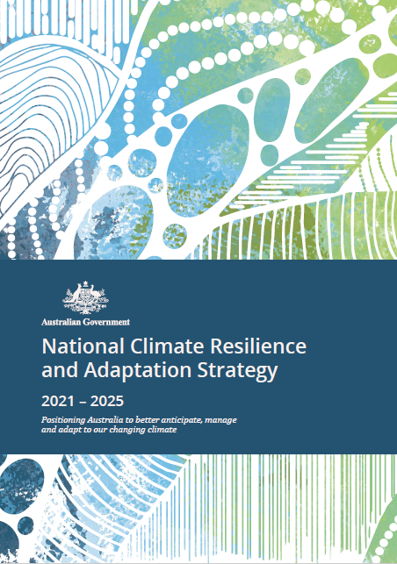




Climate Adaptation
Climate change poses growing challenges to our economic prosperity, the amenity of cities and regions, the health of our environment and ecosystem services, and the wellbeing of our communities.
Adaptation is a critical part of our response to climate change. Successful adaptation will prepare communities, buildings and infrastructure, ecosystems and our economy for a changing climate, and ensure our prosperity, security, and continued economic growth.
Adaptation involves a range of broad, cross-sectoral challenges. An effective national adaptation response requires coordinated action across the natural, built, social and economic domains.
The National Climate Resilience and Adaptation Strategy uses these four domains to frame Australia’s approach to coordinated adaptation.
This document showcases key examples of Australian Government adaptation efforts across each domain including where actions deliver across multiple domains.
Natural Domain
Landscapes, seascapes, ecosystems, agricultural lands, plants and animals.
Built Domain
Human-made surroundings, structures and infrastructure to facilitate human activity.
Social Domain
People, communities, culture, institutions, support systems and interactions.
Economic Domain
The production and consumption of goods. Productivity, financial systems, and economy.

Slide 4

Adaptation in the Natural Domain
Ensuring our natural environment and agricultural industries can adapt to the changing climate will preserve our natural capital, improve productivity, and protect heritage.
The natural domain includes our plants and animals, our ecosystems, landscapes, seascapes and waterways, and the industries that rely on them.
Australia’s biodiversity and ecosystems are some of the most diverse on Earth. This biodiversity is essential for existence and holds intrinsic value.
Healthy ecosystems provide critical services such as fresh water, regulation of regional water cycles, soil fertility and crop pollination, carbon storage, recreation, and buffering from the impacts of hazards.
These services, along with industries such as tourism, agriculture and fisheries that depend on natural resources and assets, are vital for both our prosperity and wellbeing.
However, there are limits to the capacity of natural systems to adapt to the impacts of climate change. Climate change impacts species health and distribution and exacerbates the impacts of other environmental pressures.
First Nations Australians have been Caring for Country for thousands of years and, in implementing traditional and innovative land management practices, demonstrate how the natural environment can be better prepared for the future climate.
The Australian Government is taking practical action to help our natural domain adapt to climate change.

Slide 5
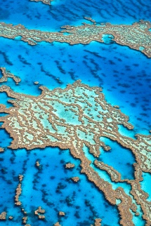



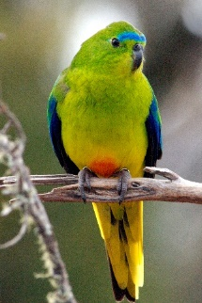
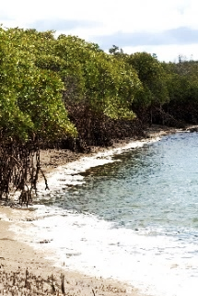
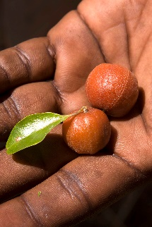

Adaptation in the Natural Domain
Reef 2050 Long-Term Sustainability Plan
The Reef 2050 Plan is the Australian and Queensland Governments’ overarching framework for protecting and managing the Great Barrier Reef to 2050. The focus of the Reef 2050 Plan is on reducing local and regional pressures to support the Reef’s health while adapting to climate change. The Australian Government is investing more than
$2 billion over the decade to 2023–24 to implement the plan.
Threatened Species Strategy
The Government’s new 10 year Threatened Species Strategy
(2021–2031), includes a focus on climate change adaptation and resilience. Action Plans under the Strategy will identify actions needed to assist threatened species adapt and build resilience to climate change, such as integrating climate risk within conservation planning and identifying and conserving places that will be refuges for threatened species.
Oceans Leadership Package
The $100 million Australian Government Oceans Leadership Package to protect our sea life, restore coastal ecosystems, reduce emissions and enhance management of oceans. It includes action to restore blue carbon ecosystems like seagrass and mangroves that play a key role improving the health of coastal environments and protecting native species and habitats.
National Environmental Science Program
NESP Phase 2 represents a $149 million investment by the Australian Government. It will fund environment and climate research to support decision-makers across the Australian community, including Indigenous communities. A new Climate Systems Hub will drive coordinated research across all four new hubs under a cross-cutting climate adaptation mission to inform climate adaptation solutions and improve resilience.

Slide 6
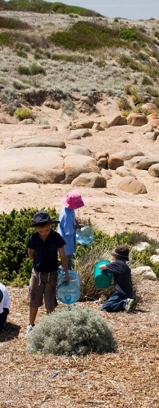
Adaptation in the Social Domain
Action taken now to increase the adaptive capacity of society will position Australian communities to thrive into the future, despite a harsher climate.
The social domain includes our people, our communities, culture, institutions, support systems, and the interactions between them. This includes families, health and education systems and services, social services and emergency management services.
There are strong relationships between the quality of the environment – of air, water, and food systems – and physical and mental health and wellbeing.
These relationships need attention as climate change challenges the health and wellbeing of Australians and the capacity of its health and social support systems, now and in the future.
As we adapt in the social domain, particular attention should also be given to how vulnerable communities experience the impacts of climate change.
Adaptation must be inclusive and account for the underlying factors that contribute to vulnerability, such as issues related to geography, culture, age, gender, diversity, disability and other socioeconomic status.
The Australian Government’s consideration of adaptation issues will seek to improve equality and fairness for vulnerable communities.
The Australian Government is taking practical action to help our social domain adapt to climate change.

Slide 7
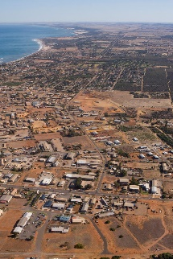
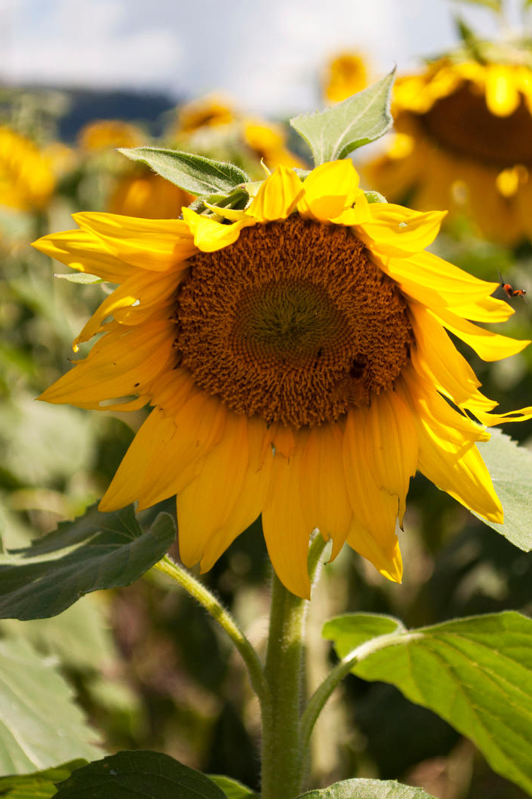
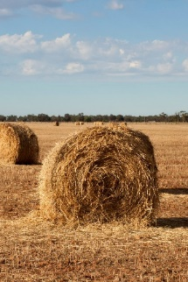

Adaptation in the Social Domain
National Disaster Risk Reduction Framework
The 2019 Framework sets out the foundational work required nationally, across all sectors, to proactively reduce systemic disaster risk associated with natural hazards to minimise the loss and suffering caused by disasters. The Framework identifies initial strategic outcomes, over the five-year period 2019–23, to inform decision-making across all domains.
National Preventive Health Strategy
Australia is developing a National Preventive Health Strategy. This
10-year Strategy will provide the overarching, long-term approach to prevention in Australia by working to build systemic change across the health system. Areas of focus for the next 10 years are identified in the Strategy as well as evidence-based policy achievements.
Future Drought Fund
The $5 billion Future Drought Fund is a key part of the Government’s Drought Response, Resilience and Preparedness Plan to deliver support to Australian farmers and communities to enable them to be sustainable and productive, despite inevitable future droughts. $100 million will be made available each year from the Fund to support Australian farmers and communities to prepare for and become more resilient to the effects of future drought.
National Disaster Mental Health and Wellbeing Framework
After the 2019-20 bushfires, the National Mental Health Commission led the development of the first National Disaster Mental Health and Wellbeing Framework. The Framework offers an integrated cross-jurisdictional approach to supporting the mental health and wellbeing of people impacted by disasters.

Slide 8
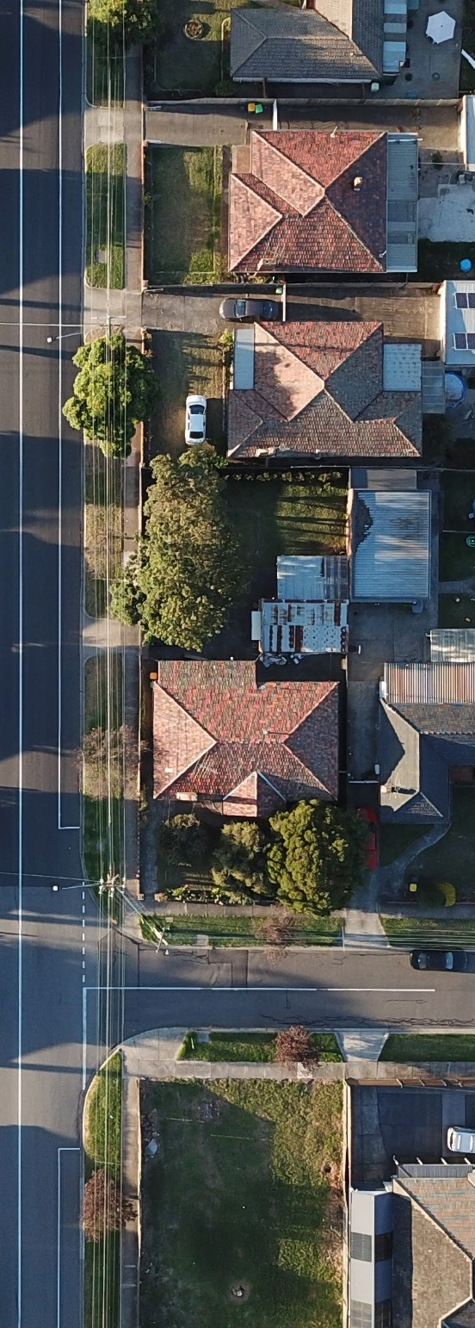
Adaptation in the Built Domain
Adapting the built environment to a changing climate provides resilient, safe, and liveable spaces for Australians to live, work, play, and innovate.
Australia’s built environment is more than our buildings. It includes green and urban spaces, cities and towns, and the networks of roads, transport, energy, water and telecommunications infrastructure that connect them.
In cities, the effects of rising temperatures can be exacerbated because of the urban heat island effect. This effect is caused by the prevalence of heat-absorbing materials such as dark-coloured pavements and roofs, concrete, urban canyons trapping hot air, and a lack of shade and green space.
Gradual impacts like sea level and temperature rise, and extreme events like floods, heatwaves and bushfires, can also affect the liveability of our urban environments and pose challenges for ageing publicly and privately owned assets and infrastructure systems that were not designed and built with climate change in mind.
Australian governments, experts, industry, and communities continue to develop standards and practices to improve the resilience of the built environment to climate change.
The Australian Government is taking practical action to help our built domain adapt to climate change.

Slide 9


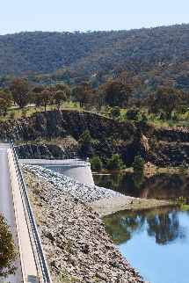
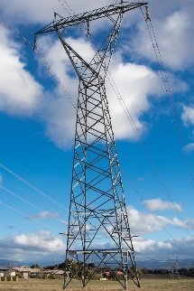
Adaptation in the Built Domain
Preparing Australia Program
The Preparing Australia Program will invest $600 million to deliver long term risk reduction and resilience outcomes for Australian communities to ensure they are better prepared for future disasters. The program aims to make Australia stronger in the face of natural hazards and reduce the cost of recovery support as we adapt to climate change. The program will focus on initiatives which will invest in the built, natural, social and economic domains.
Pathway to Infrastructure Resilience
Infrastructure Australia and Infrastructure NSW recommend a whole-of-system, all-hazards approach to resilience planning that focuses on strengthening an asset, network and sector, as well as the place. The paper identifies opportunities for transformational and systemic change in planning, and guidance for asset owners and operators in the short term.
National Water Grid Investment Framework
The National Water Grid Investment Framework underpins the Australian Government’s investment in water infrastructure. One of its key investment principles is that projects should help secure the nations’ water supply, building resilience to future drought, supporting primary industries and promoting regional prosperity.
Electricity Sector Climate Information Project
The Electricity Sector Climate Information project has delivered improved climate and weather information to support electricity sector resilience to climate change and extreme weather events. The project enables risks related to future weather events to be integrated into existing sector planning and risk modelling using a standard process.

Slide 10
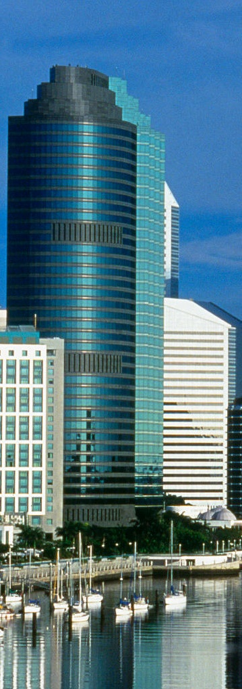
Adaptation in the Economic Domain
Australia has a strong economy that is projected to continue growing over the next 40 years, positioning Australia to respond to future challenges and seize opportunities
Climate change has the potential to impact our economy in many different ways. Some of our most important industries and biggest employers are dependent on the climate, such as the agriculture and tourism industries.
Climate change could impact the productivity and competitiveness of certain industries, the nature of work in those industries, future occupations, and structure of our economy.
Better understanding and proactively managing climate change will help Australian businesses to continue to prosper, and our people to continue to have access to secure and meaningful jobs and opportunities in our future climate.
Australia’s financial sector will continue to play an important role in shaping how we plan for and adapt to climate change.
Insurance can also be an important risk management tool for individuals and businesses that are exposed to climate-related risks.
Making efficient and well-targeted investments in adaptation now can reduce risks and avoid significant costs in the long term, while taking advantage of opportunities.
The Australian Government is taking practical action to help our economic domain adapt to climate change.

Slide 11

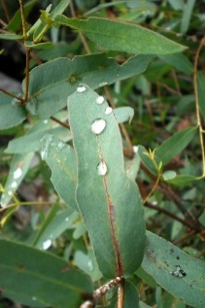
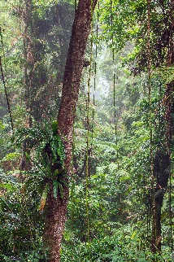
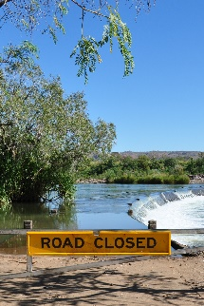
Adaptation in the Economic Domain
Council of Financial Regulators
The Council of Financial Regulators is made up of The Treasury, Reserve Bank of Australia, Australian Prudential Regulation Authority, and Australian Securities and Investments Commission. The Council considers the risks of climate change as part of its discussions and initiatives, including Climate Vulnerability Assessments which aim to identify risk and assist financial institutions.
Natural Capital Metrics
The Government is working in partnership with interested banks and financial institutions and industry to develop and trial natural capital metrics. These enable the financial sector and land managers to easily value natural capital and pave the way for increased private sector investment in maintaining and restoring our natural environment.
Intergenerational Report
The 2021 Intergenerational Report projects an outlook for the economy and the Australian Government’s budget over the next 40 years. It highlights the importance of adapting to a changing climate to support economic resilience – this is a shared responsibility of governments, communities and businesses.
Reinsurance Pool for Cyclone and Related Flood Damage
The Government intends to establish a reinsurance pool covering the risk of property damage caused by cyclones and cyclone-related floods. damage. The pool will seek to improve the accessibility and affordability of insurance for households, strata and small businesses in cyclone-prone areas, which are mainly located in northern Australia.

