Slide 1
Australia's 2030 climate change emissions reduction target – abatement potential May 2016

Slide 2
Australia’s 2030 climate change target and the measures we can pursue to achieve it
Australia’s commitments
Signed the Paris Agreement on 22 April 2016
Nationally Determined Contribution (NDC) is to reduce Australian domestic emissions by 26 to 28 percent below 2005 levels by 2030
Energetics’ analysis focused on abatement measures
Over 70 measures considered
Across all Australian sectors and all economic segments

Slide 3
Summary
Australia can reach its 2030 abatement target under the current policy framework. Large emitters must be effectively engaged and programs pursued without delay. Energetics’ modelling of over 70 emissions reduction measures has found that approximately 960 Mt CO₂-e of abatement can be achieved by 2030.
Modelling over the period 1993 – 2015 shows the emissions intensity of the Australian economy fell on average by 2.3 percent each year, suggesting that national emissions are decoupling from economic growth.
Australia will achieve its 2020 cumulative abatement target under the Kyoto protocol, equivalent to 5 per cent below 2000 levels by 2020. Energetics has identified further abatement opportunities that can be pursued, to reach an absolute 2020 target.

Slide 4
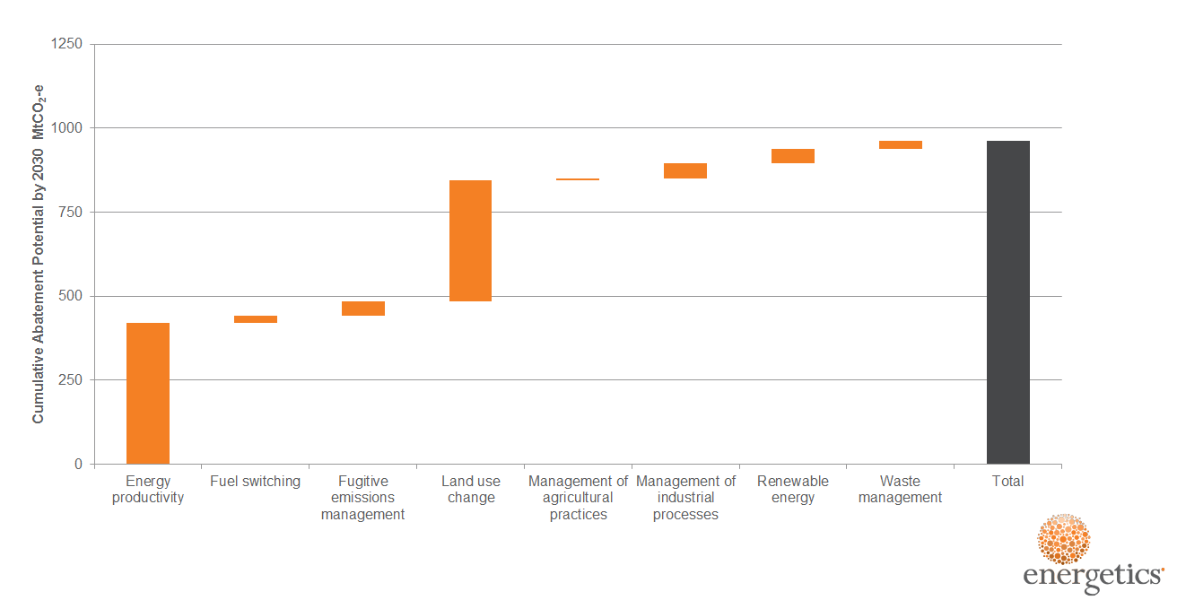
Australia’s emissions reduction potential – by measure
Energy productivity (44%) and land-use change (38%) can deliver 82 per cent of Australia’s cumulative abatement potential from 2021 to 2030.
Renewable energy and management of industrial processes can each contribute a further five percent of the identified abatement potential.
Figure 1: Cumulative abatement potential categorised by abatement type

Slide 5
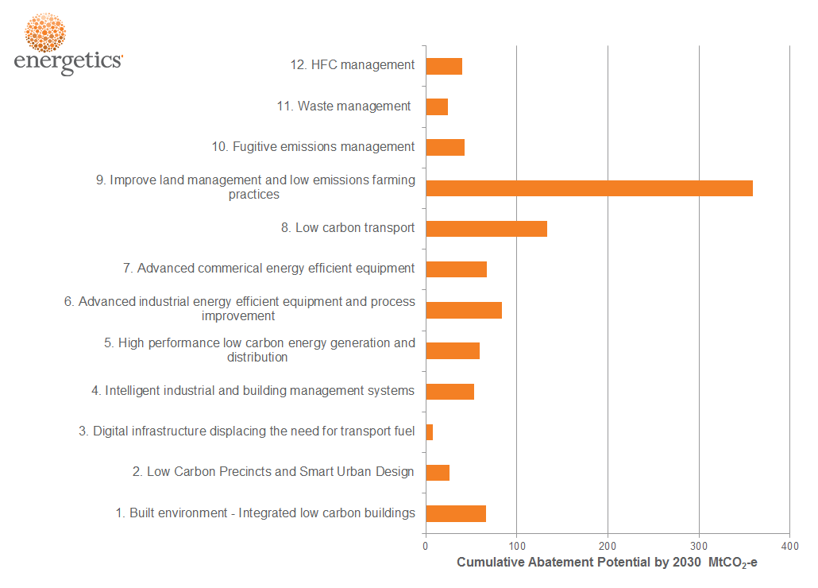
Australia’s emissions reduction potential – by measure group
Figure 2: Cumulative abatement potential by grouping

Slide 6
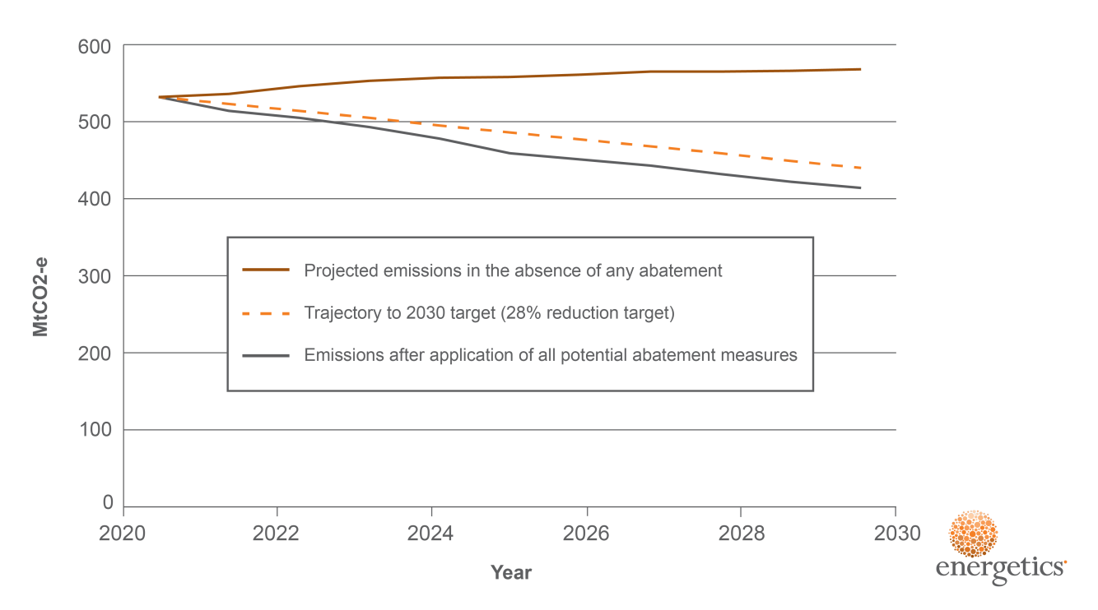
Emissions trajectory through to 2030
Figure 3: Australian emissions trajectory and impact of abatement

Slide 7
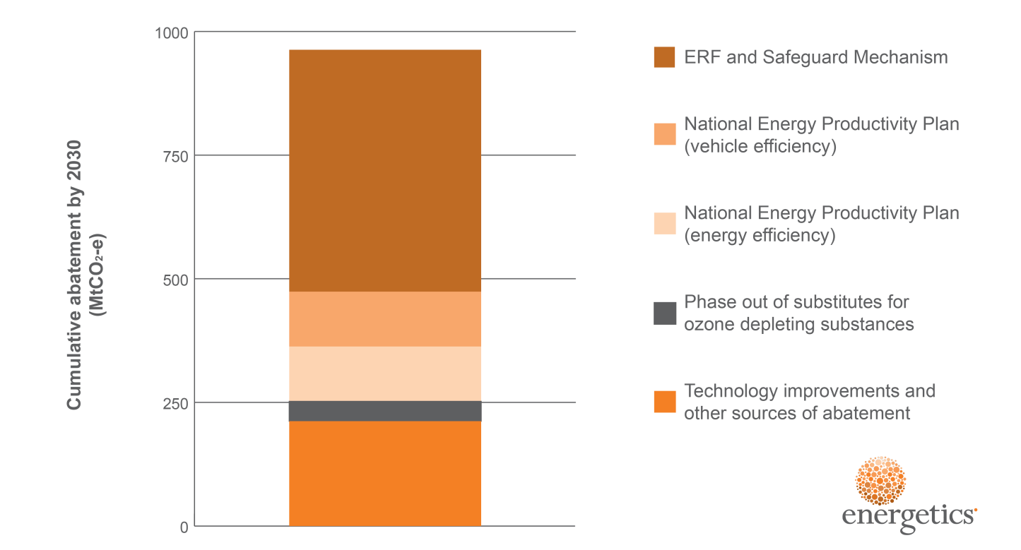
Leveraging Australian policies and programs to achieve the 2030 target
The total abatement opportunity identified can be delivered
The Emissions Reduction Fund (ERF) and Safeguard Mechanism could evolve to generate the necessary cumulative abatement over 2021 to 2030
The National Energy Productivity Plan (NEPP) is expected to further drive a share of emissions reductions.
Figure 4: Cumulative abatement potential by policy and program

Slide 8
Key insights
The current suite of policies can deliver the 26-28% emissions reduction target provided:
substantial emissions reduction occurs prior to 2020. This analysis assumes the 2020 target, <5% from 2000 levels, is met.
the Safeguard Mechanism, through declining baselines, could deliver the majority of the ‘ERF/Safeguard Mechanism’ wedge.
the abatement potential in the National Energy Productivity Plan (both energy and vehicle efficiency) can be significant. This could require regulatory requirements, alternative financial incentives and harmonisation with state activities.
Any increase to the target beyond 26-28% would require greater focus on decarbonising the electricity generation sector.

Slide 9
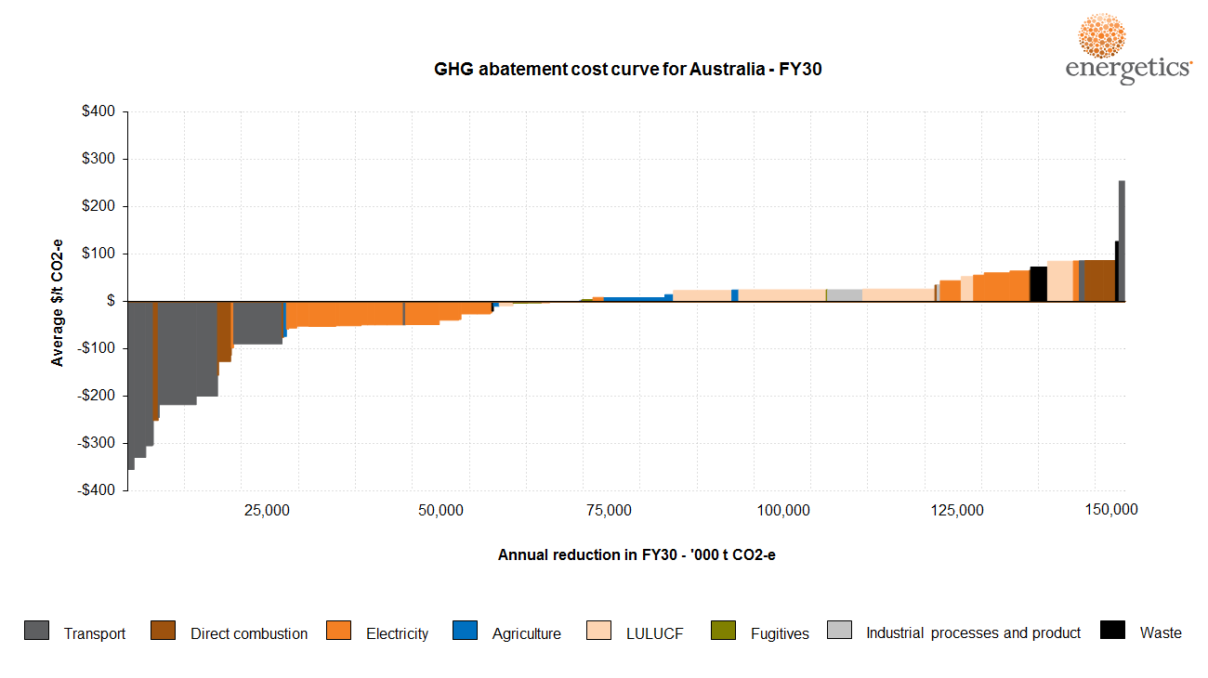
Australia’s abatement cost curve
Figure 5: Australian 2030 abatement cost curve

Slide 10
Recommendations
The following recommendations can build on the current work undertaken and may form part of the 2017 review:
Use scenarios
Consider alternative 2020 start-point scenarios to understand the impacts on meeting the 2030 target.
Broaden scope of abatement measures to include electricity generation sector decarbonisation measures.
Understanding the impact of technology change
Assess technology impacts to baselines, uptakes and projections (e.g. solar PV).
Identify disruptive technologies, specifically the impact of energy storage and electric vehicles over the next 5-10 years.
Assess policy implications
Consider potential approaches to align policies to appropriate measures and remove overlap (for instance, NEPP to deliver energy efficiency measures rather than the ERF).
Understand cost to investors and to society

