Slide 1

Industry Information Session
Brown Marmorated Stink Bug (BMSB) Seasonal measures
August 2024
Caryn Scott, Director, Hitchhiker Pests Policy

Slide 2
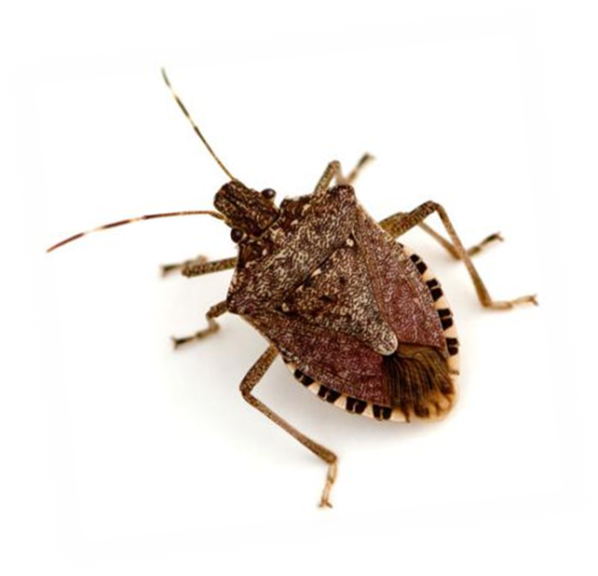
Agenda
Acknowledgement of country
Review of the 2023-22 BMSB season
  Common issues identified
Measures for the upcoming BMSB season
  Target goods, countries, dates
  Containerised vs break bulk
  NUFT and 120 hours
  BMSB onshore treatments
  BMSB offshore treatment
  Vessels
Questions
Notes:
​I acknowledge the Traditional Custodians of the land we are meeting on, the Ngunnawal people. I acknowledge and respect their continuing culture and the contribution they make to the life of this city and this region. I extend that recognition to the Traditional Custodians of all other lands on which you are gathered today and to all Aboriginal and Torres Strait Islander peoples attending today's event
We will take questions at the end
Please note we are policy teams that oversee the BMSB and offshore treatments measures, we will not be able to answer any questions in regards to staffing and inspection times.

Slide 3
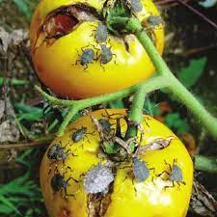
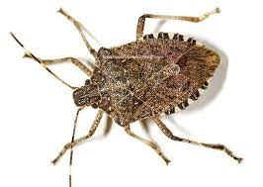
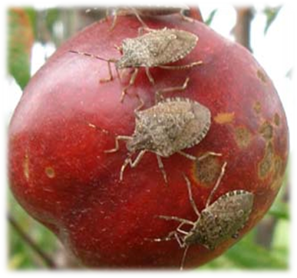
Brown Marmorated Stink Bug
Ranked 9 on Australia’s National Priority Plant Pests list
Potential to severely impact Australian and New Zealand agricultural industries
BMSB is known to feed on around 300 different plant species
Juveniles and adults feeds on, and severely damage fruit and vegetable crops
Notes:
BMSB is ranked number 9 in the National Priority Plant Pests list and It is also listed in the Exotic Environmental Pest List (EEPL)
If any exotic species (including BMSB) became established, they would cause significant damage to our environment including our unique native plants, animals and First Nations heritage sites.
Historically, biosecurity systems were built to manage limited threats that evolved slowly or not at all. We now face multiple threats on multiple fronts, including from our near north. FMD, varroa mite, lumpy skin disease are some of the current threats you would have heard about
Border and import controls remain critical but other risk pathways are increasing in importance.​
Contributing factors to biosecurity pressures:​
shifting climate & environmental conditions​
greater volumes and increasingly complex supply chains ​
limitations in detection and diagnostics capabilities
increase in illegal activity and malicious actors​

Slide 4
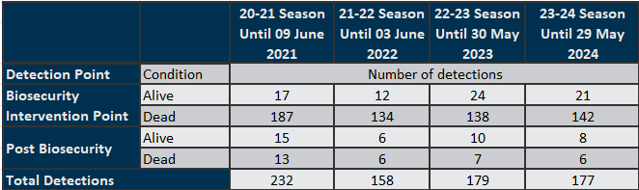
2023-24 BMSB Season - Review
Offshore treatment providers
228 registered across 25 countries
Intervention
  BMSB Profiled consignments:
      96,275 entries referred for BMSB
      7,358 Inspections
      Whitelisted 65,988 consignments that were treated offshore
  The department directed 76 consignments for export due to arriving non-compliant to import conditions regarding mandatory offshore treatment requirements
Notes:
The department has directed 76 consignments for export due to arriving non-compliant to import conditions. 29 consignments were due to a treatment provider under review, 45 break bulk/flat racks consignments arriving untreated and 10 of these exceeded the 120 hour post treatment window requirements, and 7 with non-compliant treatments. *there may be multiple containers within a consignment

Slide 5
2023-24 BMSB Season – common issues encountered
  Not treating BB, OT, FR prior to loading – exported on arrival in Australia
    If transhipping, please treat in that port of call
    Onshore treatment will not be permitted
    Treat if near the cusp of season start
  Exceeding 120 hour post treatment window
  Mixing untreated target high risk goods with non target risk goods
    Removal of lines will not be permitted
  BMSB NUFT
    Only applies to certain tariffs – do not mix tariffs
    Applies to start date not end date
    Refers to current BMSB risk season
Notes:
This is a list of common issues managed by the team over the last season
Please treat offshore port of export or at transhipping port
onshore treatment will NOT be granted for untreated BB, OT, FR
Non target risk counties = no 120 hour window
Do NOT mix untreated target high risk with non risk items
The whole consignment will be directed for treatment - containerised
BB/OT/FR if you mix, the whole consignment will be directed for export
Includes BMSB NUFT goods
Do not ask for an exemption, you will not get one

Slide 6
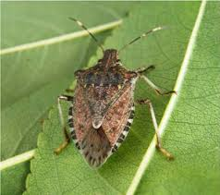
2024-25 BMSB Seasonal Measures
China and the Republic of Korea have been added for heightened vessel surveillance only
Measures apply to goods shipped between 1 September and 30 April (inclusive of the current risk season) as sea cargo. Any target high risk or target risk goods manufactured in, or shipped from a target risk country are subject to the BMSB seasonal measures
    Target high risk goods – mandatory treatment
    Target risk goods – subject to random inspection
Any vessel that berths at, loads or tranships goods from these countries are also subject to heightened vessel surveillance
Emerging risk countries - UK and China only
Notes:
The risk season applies to 1 Sept – 30 April each year. We have removed any references to years on our webpage as BMSB is now BAU.
going forward you won’t see many big announcements. Industry advice notices will be published to remind that the season is starting/ending, and if there are any changes to the measures. This will also be the last year that we are holding these sessions.
Going forward please check our webpages as all relevant information will be there.
Measures are for goods arriving into Australia as sea cargo
Shipped on board is defined by the date on the Bill of Lading. This does not refer to the vessel departure date.
Emerging risk countries changed will remain as China and UK - will also see chapters 39, 94 & 95 targeted for random inspections.
This will not apply to target risk countries.
39 - plastics
94 – furniture
95 –toys and games
All target high risk chapters – inspection only for emerging risk

Slide 7









































Target risk countries
USA
Belgium
Germany
Luxembourg
Romania
Turkey
Canada
Bosnia and Herzegovina
Greece
Moldova, Republic of
Russia
Ukraine
Albania
Bulgaria
Hungary
Montenegro
Serbia
Uzbekistan
Andorra
Croatia
Italy
Netherlands
Slovakia
Armenia
Czechia
Kazakhstan
North Macedonia
Slovenia
Austria
France
Kosovo
Poland
Spain
Azerbaijan
Georgia
Liechtenstein
Portugal
Switzerland
Heightened vessel surveillance only
Japan
China
Republic of Korea

Slide 8
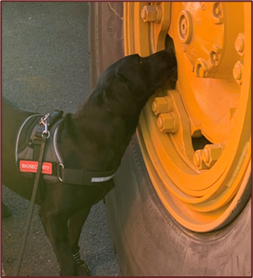
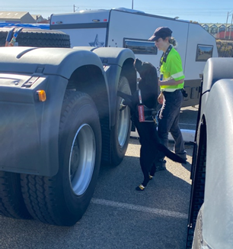
2023-24 measures continued
Three approved BMSB treatments:
    Methyl Bromide
    Sulfuryl Fluoride
    Heat Treatment
  All target high risk and target risk goods will be subject to random verification inspections
    Includes post treatment verifications
    Includes random inspections of risk goods
    Inspections of goods from emerging risk countries
  All random onshore verification inspections must be conducted in a metropolitan location.
Notes:
Last season saw a change to the verification regime to Inspect (unpack) directions instead of Secure Seals Intact inspection directions. This put the onus of managing live pest risk onto the Approved Arrangements (AA) under the conditions of their operations.
AAs were directed to collect container sweepings for each consignment.
This allowed AAs to unpack containers prior to inspection. Alleviates demurrage charges on container for importers.
It reduced the inspection booking times required for ASG. Inspection bookings times went from 2-4 hours to 30 mins to an hour assisting in reducing booking delays.

Slide 9
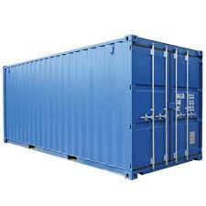
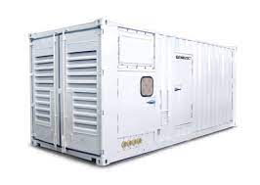
Containerised vs Break Bulk
Containerised:
Refers to 6 hard sided containers - general purpose/dry box
Refrigerated containers (operating or non-operating) fall into this category and are subject to the measures
Has the option for onshore treatment
Must be sealed within 120 hours of treatment completing (if treated prior to 1 December)
Hard top open tops (detachable steel roof) are deemed to be 6 hard sided container
Break bulk (includes flat rack and open top containers)
All target high risk goods shipped as break bulk must be treated offshore
No allowances will be made for untreated break bulk and goods will be directed for export
Must be shipped on board within 120 hours of the completion of treatment (if treated prior to 1 December)
FCL containers that have been modified, such as those used to house in-built power generators, portable workshops etc; are break bulk
Notes:
If you do wish to ship target high risk goods inside a reefer, please ensure the goods are treated prior to packing
Onshore treatment of containerised goods will be managed at the container level
This means that goods cannot be removed/deconsolidated and treated separately
Completion of treatment refers to:
When ventilation started for fumo
When heat treatment finishes
Break bulk, open tops (in gauge) and flat racks must be treated offshore by an approved offshore BMSB treatment provider

Slide 10

120 hour window – Post Treatment and Transhipping
Goods treated in a target risk country are subject to the 120 hour post treatment window when treated prior to 1 December
    Containerised goods must be sealed in the container
    Break bulk goods (incl FR and OT) must be shipped on board the vessel
  If break bulk has been shipped outside the 120 hour window (but less than 48 hours over), and evidence can be provided, the in-transit policy may be enacted.
  The 120 hours does NOT apply to:
    Goods treated in non-target risk countries
    Good treated after 1 December
  Breakbulk goods that tranship in a target risk country prior to 1 December, are subject to the 120 hour window. Does not apply to sealed containers.
Notes:
The shipped on board date as indicated on the bill of lading is used to determine the 120 hours. This is the date the goods are loaded onto the vessel.
The vessel departure date is not used to calculate the 120 hours.
If your goods tranship in a target risk country, they are also subject to the 120 hour window. This includes different ports within the same country
The 120 hour transhipment window does not apply to goods arriving in the target risk country from 1 Dec onwards.
Goods transhipping in a non target risk country are not subject to the 120 hour window
Where untreated/non-compliant BB tranships in a non-target risk country on the way to Australia, we recommend to have the goods treated in these ports to avoid export.

Slide 11
New, Unused and Not Field Tested (NUFT)
From 1 December, certain tariffs that can meet all the BMSB NUFT criteria will not be subject to mandatory treatment.
    Manufacture must have started on or after 1 December of the current BMSB risk season; and
    classed as new machinery, vehicles, vessels/new complex parts and equipment, and are classified under the following tariff chapters only: 82, 84, 85, 86, 87, 88 and 89; and
    Accompanied by a BMSB NUFT manufacturer’s declaration (that meets minimum documentary and import declaration requirements policy)
  If NUFT criteria is not met, the goods may be directed for export or onshore treatment (containerised only)
  NUFT declaration MUST state the manufacture start date
  Refurbishments are not deemed to be new and unused
Notes:
In addition to Minimum Documentary and import declarations policy requirements for manufacturers declarations (sections 4.6.1), your BMSB NUFT Manufacturers declaration must :
contain the statement “the product is new, unused and not field tested”
Must have a manufacture start date.

Slide 12
BMSB Onshore Treatment
Three approved arrangement (AA) classes support onshore treatment providers to manage BMSB:
    12.1 - Methyl Bromide fumigation,
    12.2 - Sulfuryl Fluoride fumigation and
    12.3 - Heat treatment
Class 4.7 AA site
    Class 4.7 allows a container unpack within a secure environment to enable effective treatment of the goods.
    Requests must be sent by the treatment provider to the Onshore treatments team via email (treatments@aff.gov.au).
To reduce delays at the border, the department recommends that industry treat offshore or pack containers to allow effective onshore treatment.
If onshore treatment is a preference, please refer to the BSMB consignment suitability factsheet: https://www.agriculture.gov.au/biosecurity-trade/import/before/brown-marmorated-stink-bugs/offshore-bmsb-treatment-providers-scheme/treatment-guidance
Notes:
Where treatment cannot be performed at the container level (eg overpacking or plastic wrap), options are export or treatment at 4.7AA (secure unpack for treatments of seasonal hitchhiker biosecurity pests)
4.7 cannot be used as a first option for treatment or for the purposes of splitting a consignment to treat select lines. All goods must still be treated
Requests for must be sent by the treatment provider to the Onshore treatments team via email (treatments@agriculture.gov.au) for actioning.
If your preference is to treat onshore, please refer to the consignment suitability factsheet which can be found on the BMSB Offshore treatment providers scheme page

Slide 13
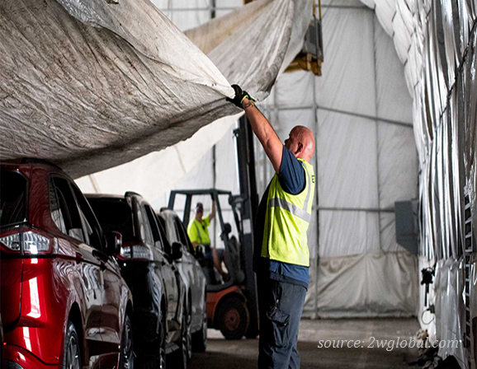
Offshore BMSB Treatment Providers Scheme
The Scheme continues for the 2023-24 BMSB season
All treatment providers in target risk countries that intend to
conduct BMSB treatments must register on the scheme
Treatment providers in non-target risk countries that intend to
conduct BMSB treatments are encouraged to register on the scheme
Treatment providers must re-register for the 2023-24 season
All applicants must demonstrate their ability to meet all requirements of the scheme and the treatment types they wish to conduct
Registration allows BMSB treatments to be conducted for both Australia and New Zealand

Slide 14
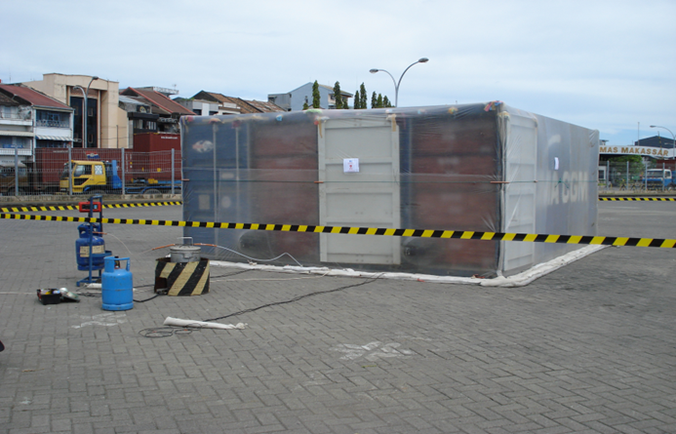
Offshore BMSB Treatment Providers Scheme cont
Approved treatment providers will be listed on Offshore BMSB Treatment Providers scheme webpage:
https://www.agriculture.gov.au/biosecurity-trade/import/before/brown-marmorated-stink-bugs/offshore-bmsb-treatment-providers-scheme/approved-list
Publication of approved treatment providers will occur frequently in the lead up to 1 September
Importers/Exporters use this list to check for most up-to-date details of offshore treatment providers registered onto the scheme

Slide 15

Vessels
Heightened vessel surveillance for all roll-on/roll-off (ro-ro) vessels will be applied through pre-arrival reporting
Vessel operators will be required to conduct self-inspections and report any detections of BMSB and other exotic insects
All ro-ro vessels that berth at, load or tranship
from the target risk countries, will be required
to undergo a mandatory seasonal pest inspection
on arrival in Australia
The Vessel Seasonal Pest Scheme (VSPS) has been discontinued for the upcoming season.

Slide 16
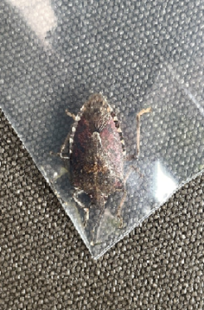
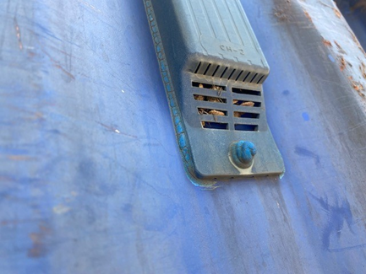
Summary
The main measures remain unchanged.
    China and the Republic of Korea have been added for heightened vessel surveillance
All break bulk, flat racks and open tops (including in-gauge) MUST be treated offshore prior to arrival into Australia
    If goods have been shipped untreated and are transhipping, have them treated in the transhipment port to prevent export
    If you become aware of untreated break bulk prior to arrival advise the department at spp@aff.gov.au
Tariff 39, 94 & 95 are subject to random inspection for emerging risk countries only

Slide 17


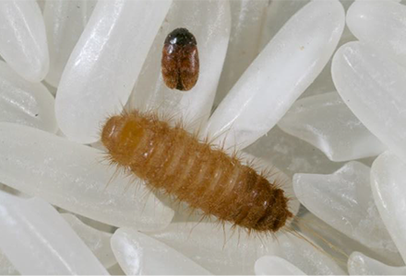
Industry’s role in biosecurity
See. Secure. Report.
Working with offshore suppliers to manage not just BMSB risk, but all pest risks
Recommend watching webinar: Managing the risk of a serious hitchhiker pest
    https://www.agriculture.gov.au/biosecurity/australia/public-awareness/webinar-series

Slide 18


Stay updated on the BMSB seasonal measures by visiting the following webpages
www.agriculture.gov.au/bmsb
Subscribe to our Import Industry Advice Notices to get updates on changes to import requirements, including updates on Brown marmorated stink bug seasonal measures:
https://subscribe.agriculture.gov.au/subscribe
Any questions relating to:
policy for hitchhiker pests can be emailed to: spp@aff.gov.au
safeguarding can be emailed to: safeguarding@aff.gov.au
BMSB treatments can be emailed to: offshoretreatments@aff.gov.au

