Slide 1
Community information sessions

Slide 2
Cleaner Environment Plan
Four pillars:
Clean Air
includes 20 Million Trees – also Clean Land
2. Clean Land
includes Green Army and National Landcare Programme
Clean Water
includes Reef 2050 and Reef Trust
National Heritage
www.environment.gov.au

Slide 3
Agriculture
Commitment to a vibrant, innovative and competitive agricultural sector
Informed by the White Paper on the Competitiveness of the Agricultural Sector
Supported by National Strategic documents such as
Australian Weed Strategy
Vertebrate Pests Strategy
RD&E Soil Strategy
RD&E Strategy for Water Use in Agriculture
National Fishing and Aquaculture Research, Development and Extension (RD&E) Strategy

Slide 4
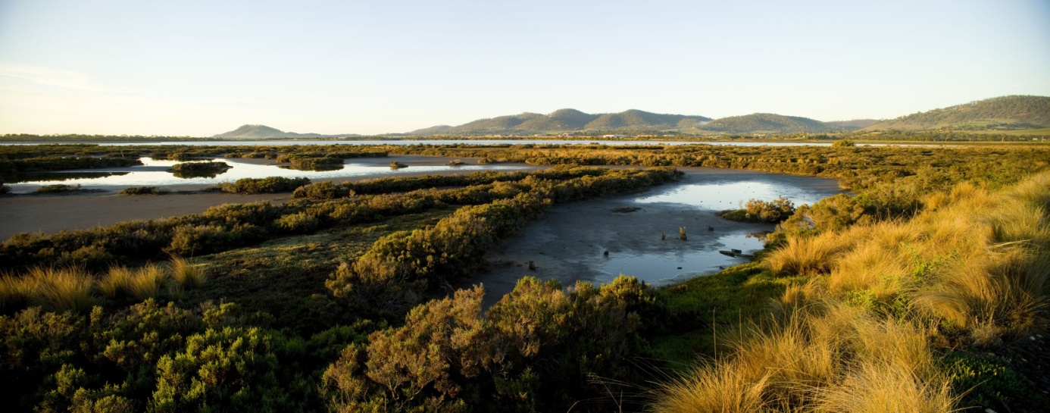
Investing $2 billion over four years in managing our natural resources

Slide 5
National Landcare Programme
Australian Government’s key natural resource management programme
$1 billion over four years
The National Landcare Programme will contribute to:
The Clean Land and Clean Air pillars of the Government’s Cleaner Environment Plan and;
The Government’s commitment to support a vibrant, innovative and competitive agriculture sector

Slide 6
National Landcare Advisory Committee
Will be comprised of expert members from the NRM community
Will provide advice to the Natural Heritage Ministerial Board on:
Investment priorities
Implementation and effectiveness
Community consultation & engagement
Achievement of outcomes

Slide 7
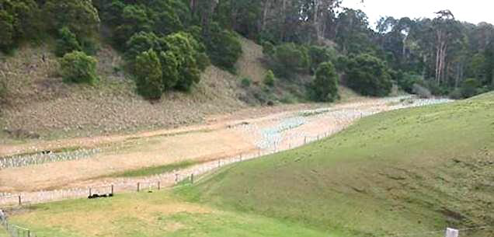
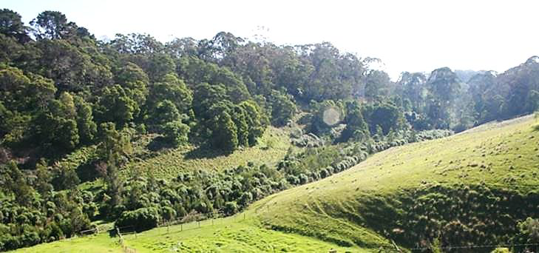
National Landcare Programme
So what’s changed?
Simple
Local
Long-term
before
after
Photos courtesy of East Gippsland CMA

Slide 8
National Landcare Programme Strategic Objectives

Slide 9
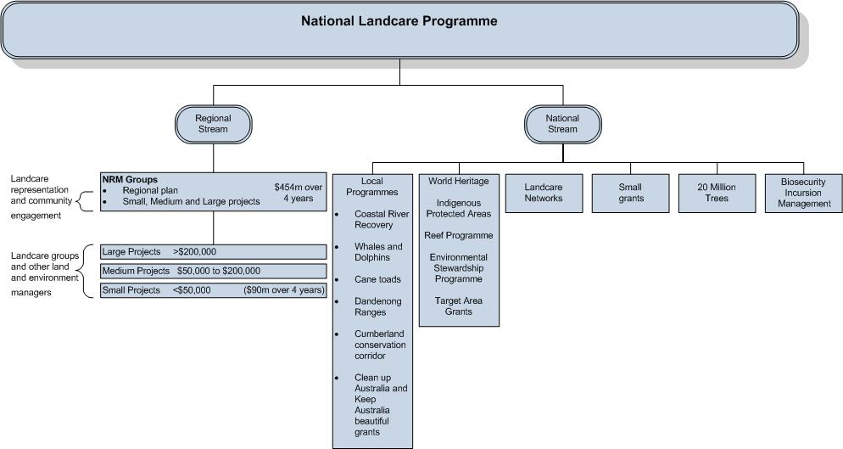

Slide 10
National Stream Biosecurity Incursion Management
Cost-shared agreements with state/territory governments
All levels of government and affected industries work cooperatively to implement national eradication programs
Undertaken when the elimination of a pest or disease is justified and feasible and a national cost-sharing agreement is in place
Examples include: Red Imported Fire Ant, Banana Freckle, Avian Influenza

Slide 11
National Stream 20 Million Trees Programme
Competitive Grants
$8 million over four years for competitive grants between $20,000 & $100,000
Guidelines will be released in coming months.
National Service Provider(s)
Tender process to engage one or more national service providers.
Service provider/s will be contracted to deliver larger-scale revegetation projects.

Slide 12
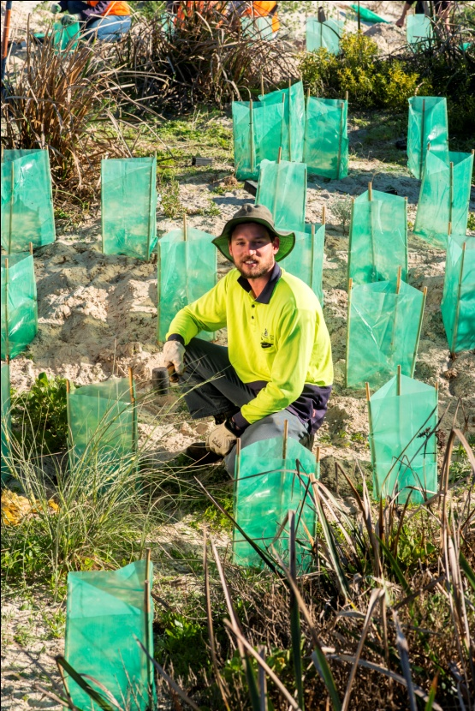
National Stream
Local Programmes
Coastal River Recovery initiatives
Torrens; Swan Canning; Tamar; Tuggerah Lakes; Yarra
Keep Australia Beautiful and Clean Up Australia
Cumberland Conservation Corridor
Dandenong Ranges Programme
Kimberley Cane Toad Clean Up
Whale and Dolphin Protection Plan

Slide 13
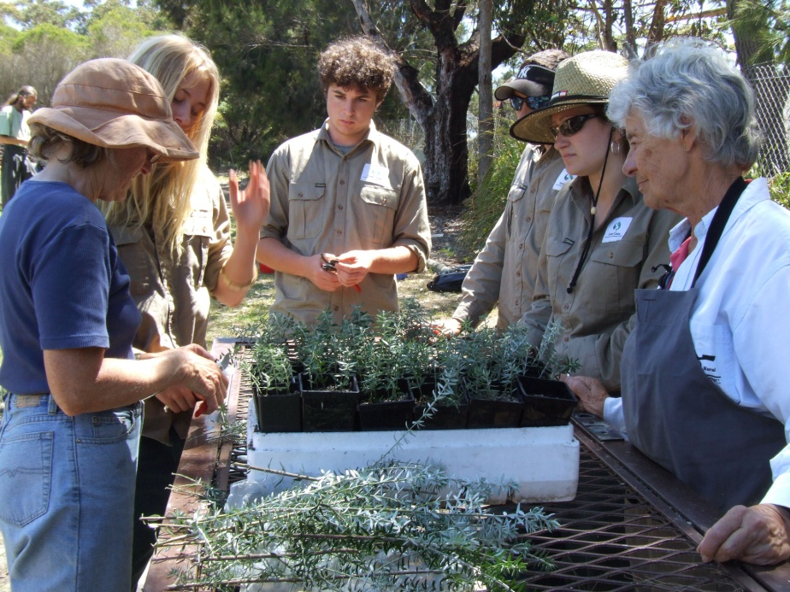
National Stream
Support for national and state Landcare network
$1 million in 2014-15 for state, territory and national Landcare networks to:
Build network capacity
Share knowledge and
deliver projects
Involve groups in Green Army
& 20 Million Trees
Strengthen links between
NRM organisations and
Landcare networks

Slide 14
National Stream
25th Anniversary Landcare Grants
Grants of between $5,000 & $20,000 for local community groups, including landcare, farmers, and other land managers
For projects that:
actively engage communities in NRM activities
build community awareness and skills in NRM
protect, restore and conserve environment
Call for applications around mid September

Slide 15
Regional Stream k Design principles
Focus on locally driven NRM activities
Community engagement & participation
Public good outcomes
Simpler, robust monitoring and reporting
Appropriate risk management
before
after
Photos courtesy of Wimmera CMA

Slide 16
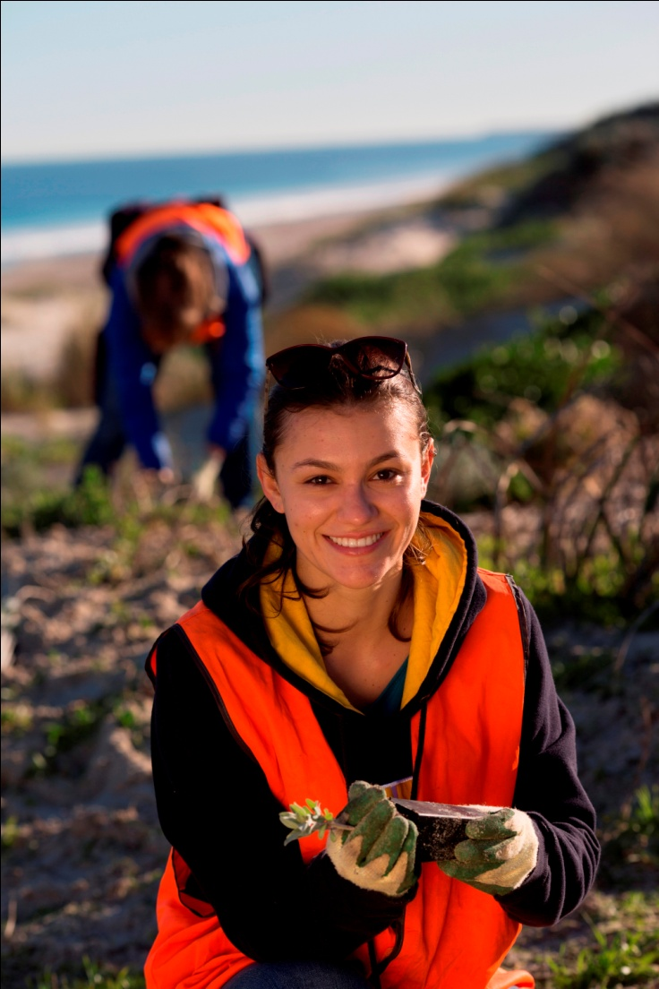
Regional Stream k Delivery through regional NRM organisations
$454 million over four years
Minimum of 20% to be invested in local NRM community projects and engagement
$90 million over 4 years
Apply under new guidelines or renegotiate existing contracts

Slide 17
Regional Stream
Community engagement / participation
Landcare groups
Farmer groups Small & medium
Community groups projects
Land managers
NRM planning to guide investments
with community input
sound scientific basis

Slide 18
National Landcare Programme
natural resource management community
Community -
including landholders, Indigenous groups, local Landcare groups, farmer organisations and industry
Landcare networks
Regional NRM organisations
Local, state and territory governments

Slide 19
Community
landholders and land managers, community groups, including Landcare and Indigenous groups, farmers etc.
Work with regional NRM organisations and Landcare networks to set priorities
Plan and deliver small projects
Community

Slide 20
Build organisational capacity across networks
Work with regional NRM organisations to set priorities
Coordinate and engage volunteer groups in NRM activities
Landcare networks

Slide 21
Regional
NRM organisations
Key delivery agents
Greater autonomy
Regional planning – using science and community to set priorities
Strong governance
Partner with community and industry
Accountable

Slide 22
Local, state and territory governments
Address statutory NRM responsibilities
Partner with regions
Coordinate with Australian Government on integrated delivery
Maximise co-investment opportunities

Slide 23
Australian Government Role
Provide leadership on nationwide NRM issues
Address strategic or emerging issues
Support Landcare networks
Facilitate regional natural resource management organisation excellence
Reduce red tape
Ensure accountability and transparency

Slide 24
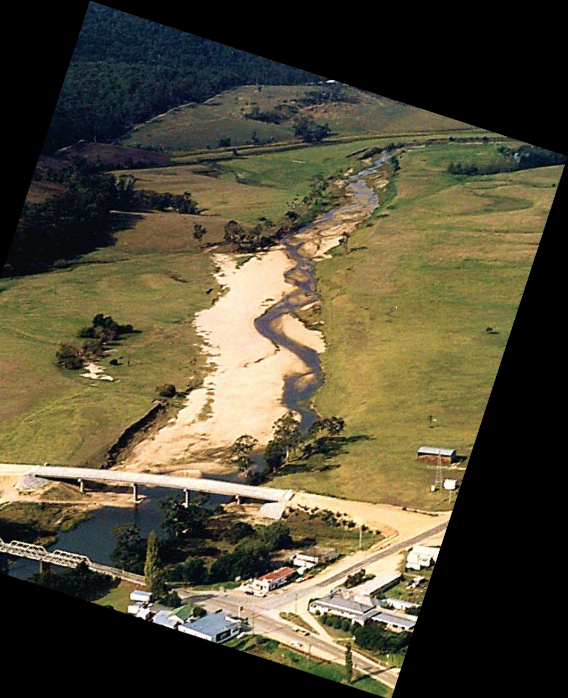
Photos courtesy of East Gippsland CMA
Before (1989)
After (2009))

Slide 25
Programme integration
Green Army Programme
Green Army teams delivering outcomes across environmental themes
Complementary to the National Landcare Programme
Delivered by five Service Providers
Landcare Australia with Manpower Services; CVA; Job Futures; Workskil Australia; and Campbell Page with Skillset
Regional NRM organisations acting as brokers
linking community groups with service providers

Slide 26
Have your Say...
National Landcare Programme Consultation Survey
Available now at www.nrm.gov.au
**Closes 29 August 2014**

