Slide 1
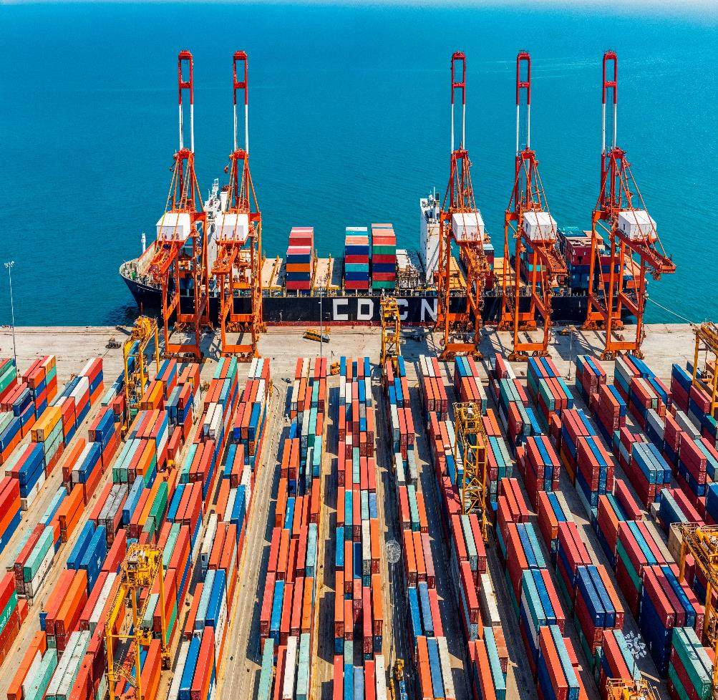

Biosecurity Update and Reforms 2026
Goods and Conveyance Policy – Biosecurity Operations Division

Slide 2

Overview
Sea Cargo Policy Reforms
STEPS update
Introducing the Biosecurity Business Pledge Australia
You and the law
Imported food update
Further Information
Questions

Slide 3
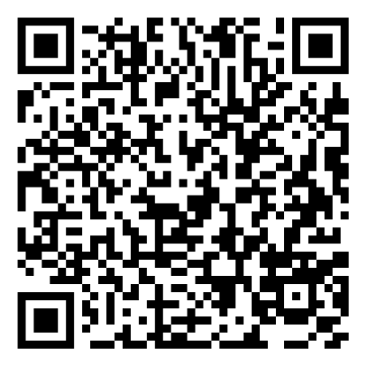
Impacts of conflict in the Middle East
Focus areas for the department:
  Fuel and fertiliser security are key focuses.
  Supporting and accelerating biosecurity clearance of critical imports (IIAN 52-2026, IIAN 55-2026).
  Streamlining border processes for imported fertiliser.
  Published updated inorganic fertiliser management policy (IIAN 56-2026).

Slide 4

Sea Cargo Policy Reforms
Sea Cargo Policy & Strategic Engagement
Goods and Conveyance Policy

Slide 5

Draft New Vehicle Policy Update
Key policy changes:
  Compliance model is based on onshore inspection outcomes.
  Compliance status is determined by the Supplier ID code in recorded in the Integrated Cargo System (ICS).
  Vehicle suppliers and manufacturers are encouraged to implement offshore measures to ensure vehicles meet import conditions and manage biosecurity risk.
  Reduced onshore intervention for compliant suppliers.
  Increased onshore intervention for non-compliant suppliers.
  Applies to break bulk, containerised and air freight vehicles.

Slide 6
Draft New Vehicle Policy Update
Where it’s at:
What’s next:
New vehicle policy drafted.
Internal departmental feedback completed.
Relevant updates incorporated into the policy.
Develop a ‘Have Your Say’ for stakeholder review and comment.
Engage with stakeholders based on feedback received.
Development of guidance material for suppliers, manufacturers and importers on minimising biosecurity risk material on vehicles offshore to meet import requirements on arrival.

Slide 7
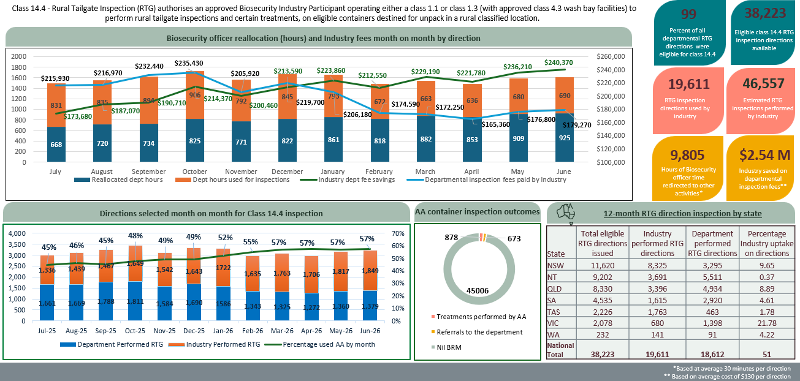
Class 14.4 Approved Arrangement
1 March 2025 – 31 March 2026
AA Class 14.4 – Rural Tailgate Inspection: July 2025 – June 2026

Slide 8
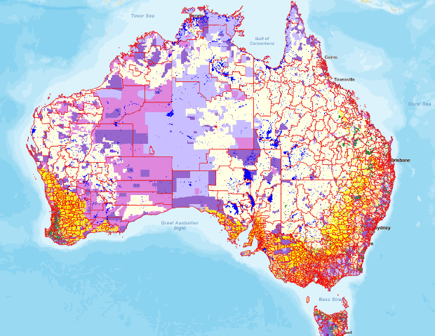


Postcode Classification - Review
Outcome:
A nationally consistent, evidence‑based postcode classification system that reflects today’s land use, transport pathways, and biosecurity risks.
Australian Bureau of Agricultural and Resource Economics and Sciences
Centre of Excellence for Biosecurity Risk Analysis (CEBRA)

Slide 9
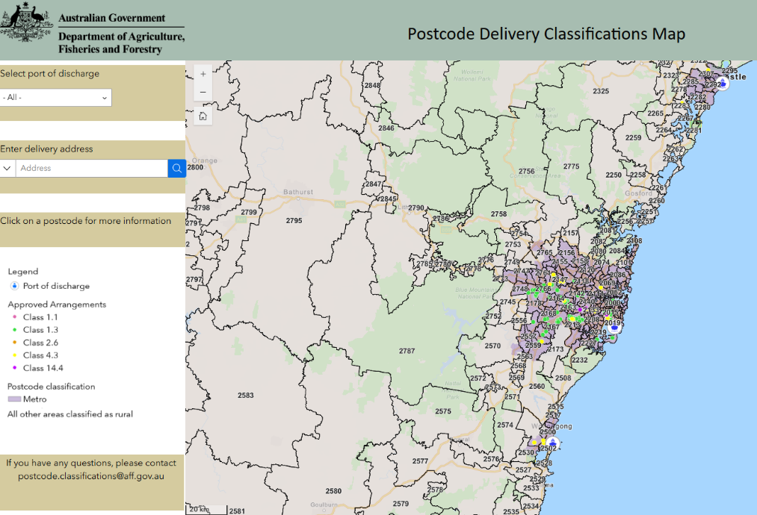
Postcode Classification – Landbridging
Current Position
Movement beyond the metro port of discharge will require intervention.
All inspection activities must be performed at the port of discharge prior to movement.
Updates to departmental systems and Conditions to allow the continued use of Class 19.1 and Class 14.4.
Interactive online map
Exact delivery address information.
Approved Arrangement locations.
Port of discharge, AA site and Postcode information pop ups.

Slide 10

Container Cleanliness &
Movements
Sea Cargo Policy and Strategic Engagement
Goods and Conveyance Policy – Biosecurity Operations Division

Slide 11
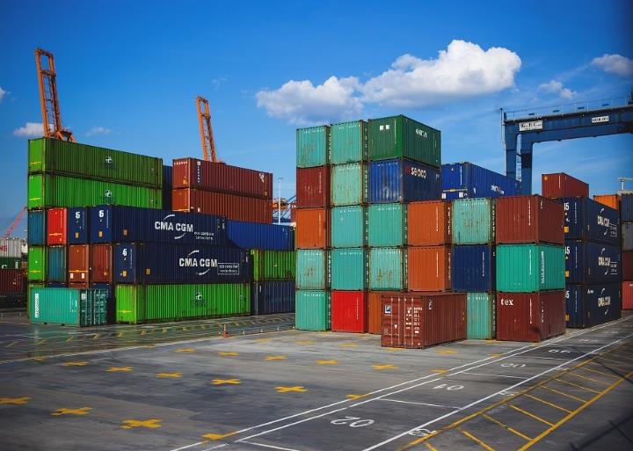
Movement of goods subject to biosecurity
Movement of goods under biosecurity control:
  the goods must be moved as soon as practicable
  via the most direct route to the location specified on the biosecurity direction.
If the Approved Arrangement is inaccessible goods should not be moved from the wharf to an alternative location for storage unless directed by the department.
Where goods are being managed outside of business hours, and an updated movement direction cannot be issued then:
  Seek to have the AA where the goods have been directed, open to receive direct delivery
  Leave the container at port until the AA is open
Goods stored for any period at a location other than the specified location will be considered non-compliant with the biosecurity direction.

Slide 12


Container cleanliness and reporting
Checking cargo and containers
  Exotic pests, diseases and weeds can hitch a ride to Australia with vessels, shipping containers and break-bulk cargo
What to look for
  Live or dead animals
  Live or large numbers of dead invertebrates
  Egg masses on any surfaces
  Holes in timber or frass
  Plant matter, soil or mud
Where to look
  Inside and on the outside of shipping containers
  Attached to machinery and vehicles (or any break bulk)
  In timber (eg pallets)
  In packaging including plastic wrapping, cardboard boxes and polystyrene
  In food stuffs and wrapping

Slide 13

STEPS Program Update
Simplified Targeting and Enhanced Processing Systems (STEPS)
STEPS Implementation
Digital Solutions and Enablement

Slide 14
Overview
  What is STEPS: Recap
  What has been delivered
  What is next for delivery
  Product highlight

Slide 15
How STEPS Delivers Value
Five Core Outcomes
Faster and Easier Assessments - Reduced end-to-end processing times through automation and streamlined decision pathways.
Streamlined Inspections & Management - Digital tools equipping inspectors with real-time data and workflow support in the field.
Better Support for Industry - Self-service capabilities, clear timelines, and transparency.
Improved Data Capture & Visibility - Centralised, high-quality data enabling better reporting, compliance, and risk analysis.
Modern Digital Service - Contemporary user interfaces replacing outdated legacy portals and paper-based processes.

Slide 16


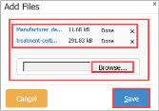
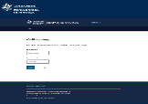
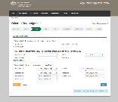
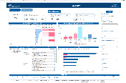
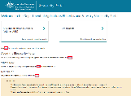
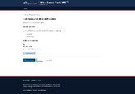
Industry Focussed Delivery
Enhanced
Industry Arrangements
and Support
Product​ | Tech​ | Outcome​ | ​
Approved Arrangement Management Product (AAMP) – Release 1​ | Addition of a new AA management tile on the Biosecurity Client Portal​ | Industry can update Approved Arrangement details online​ | ​
Electronic Verification for eCert (EVE)​ | Addition of a new eCertificates tile on the Biosecurity Client Portal​ | Accredited persons access digital copies of sanitary certificates online​ | ​
COLS enhancement 1​ | Technical upgrades expanding file size limit to existing lodgement system​ | Industry can lodge documents at 2x the previous file size limit​ | ​
COLS enhancement 2​ | Expansion of existing online lodgement system to accept informal entries as well as ship or aircraft stores and carnets, and trigger UPE assessment workflows​ | Enabling more lodgements through COLS rather than email, offering a more streamlined and modern workflow. Hypercare phase ended, no major issues​ | ​
Biosecurity Industry Reporting release 1 – Cargo Status Tracker (MyID login only)​ | New Industry reporting tile (and underlying data analysis) available on the Biosecurity Portal for MyID users​ | AA Class 19’s using a MyID login can check the status of consignments online with the Biosecurity Industry Reporting​ | ​
Biosecurity Industry Reporting release 2 – Fees and AA Class 19 usage and uptake​ | Addition of a Fees Report and an Approved Arrangement (AA) Class 19.2 Usage and Uptake reports under the Industry Reporting tile on the Biosecurity Portal​ | AA class 19 Biosecurity Industry Participants can now check fees and charges (records of service) associated with their consignments online and have visibility of the AA Class 19.2 usage and uptake.​ | ​
Biosecurity Industry Reporting release 3 – expanded access via. Email authentication​ | Extending access to the Biosecurity Industry Reports via the Biosecurity Portal for email authenticated users.​ | Self-service reports mean that accredited persons will no longer need to rely on calling or emailing the department to get this information. ​ | ​
ProviderHub-Release 1 and 2​ | New Offshore Treatment Provider (OTP) registration portal​ | Replacing the current email-based process for registration, offering a simpler exchange of details and more clarity and speed in processing​ | ​

Slide 17
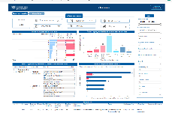
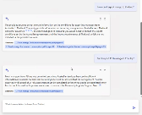
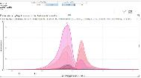
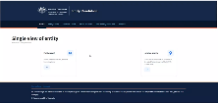
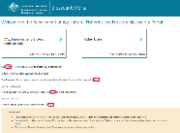
Data Improvements – improve our readiness for AI
Alignment to original SPBC business goals:
Product | Tech | Outcome
Industry reporting release 1 – Biosecurity Cargo Status Tracker | New Industry reporting tile (and underlying data analysis) available on the Biosecurity Portal | Industry can check the status of consignments online
Industry reporting release 2 – Fees and Class 19.2 usage and uptake reporting | Addition of a Fees Report and an Approved Arrangement (AA) Class 19.2 Usage and Uptake reports under the Industry Reporting tile on the Biosecurity Portal | Approved arrangement class 19’s Biosecurity Industry Participants can now check fees and charges (records of service) associated with their consignments online and the class 19.2 usage and uptake.
AI PoC | Exploring the use of automated data extraction to assist in document assessment and check against policy requirements | Demonstrated strong potential as a supportive tool to provide consistency in document assessment, enabling faster and more consistent evaluations
Industry reporting release 3 – expanded access via. alternative login | Expanding access for accredited persons to the Biosecurity Industry Reports via the Biosecurity Portal using an additional log-in method, email and password. | Self-service reports mean that accredited persons will no longer need to rely on calling or emailing the department to get this information.
Modernised data capture, use and visibility
Delivered

Slide 18
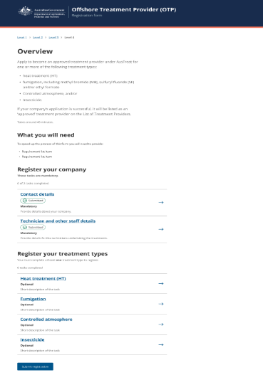
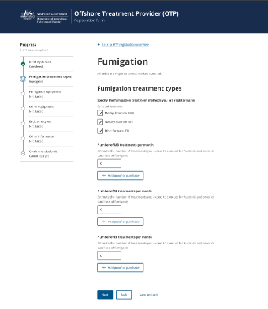
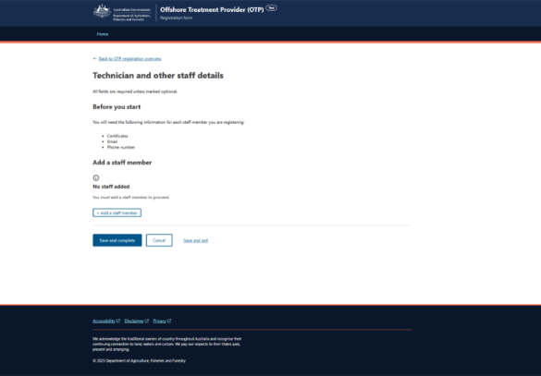
ProviderHub Product Highlight
Release 1 and 2 DELIVERED
Offshore treatment providers under AusTreat can register online
Ability for registered providers to add new treatments to their existing registration.
Efficient assessment process supporting a consistent, transparent and auditable approach to compliance.
ProviderHub strengthens Australia’s borders by improving oversight and compliance of offshore biosecurity treatments, helping to manage biosecurity risk before goods arrive in Australia and supporting more effective onshore risk management.
We estimate ProviderHub will contribute significant savings to both the department and to the importing industry
B1) Reduced cost of regulation for the department annually | B3) Reduced holding cost for industry annually | Total benefits annually
$328k | $16.2m | $16.6m
INDICATIVE ONLY
A Release-3 is scheduled by the end of July 2026.

Slide 19
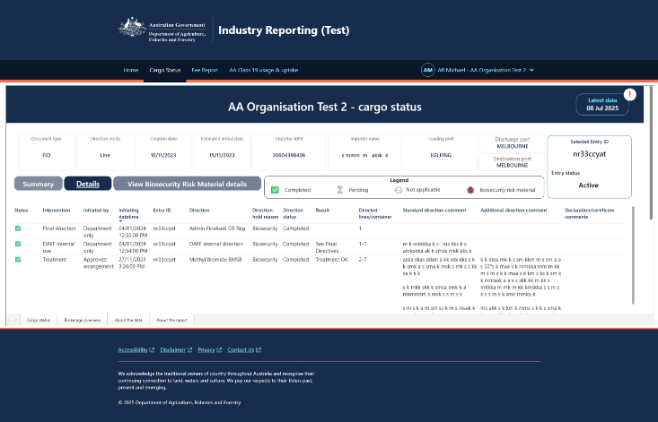
Biosecurity Industry Reporting Product Highlight Delivered
The Biosecurity Industry Reporting is an interactive digital report that allows approved arrangement class 19 accredited persons to view details of their cargo currently being managed by the department.
What you can see
Entries currently in progress
Status of referred consignments
Consignment and historical details
Search by entry reference number
Designed with industry, the reports make it easier to track consignments, understand progress, and reduce follow‑up enquiries.
  The Biosecurity Industry Reporting allows approved arrangement class 19 accredited persons to self-service online via the Biosecurity Portal using the Industry Reporting tile to check the status of their consignments, view the fees and charges, and view their entries processed under their AA Class 19.2

Slide 20
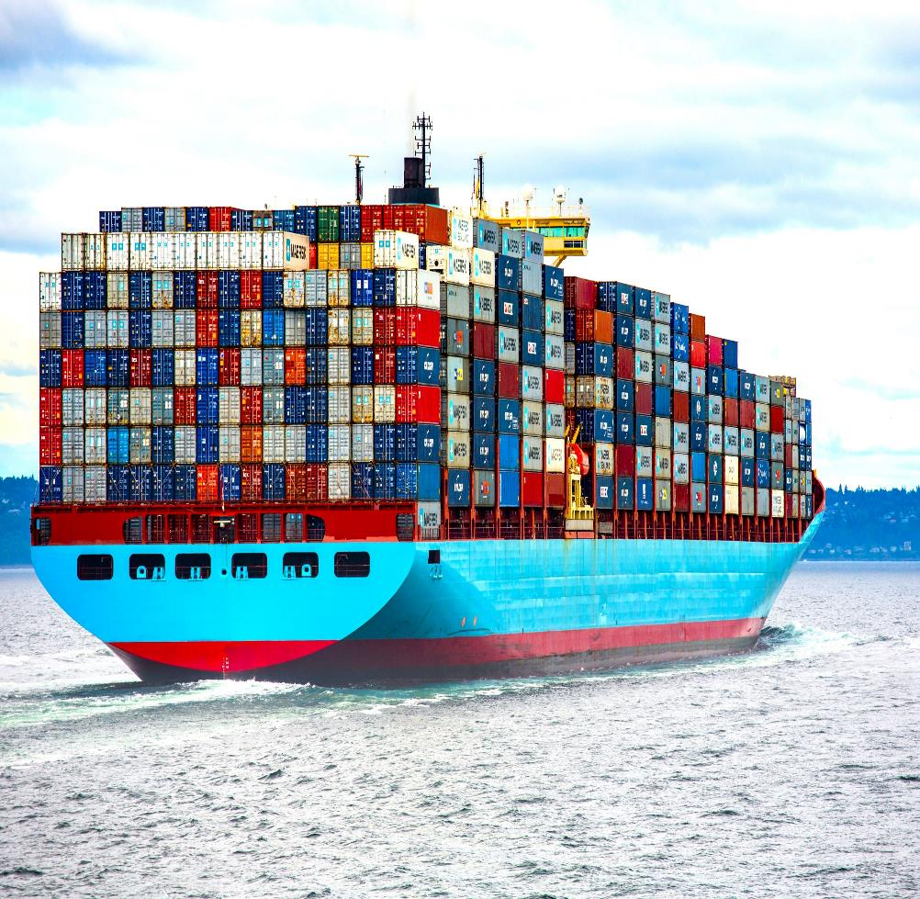
Biosecurity Pledge
Biosecurity Education
Risk Intelligence and Strategy

Slide 21

The Biosecurity Business Pledge
A practical biosecurity initiative for Australian businesses.
Designed to help manage biosecurity risk before issues arise.
Supports supply chain resilience and business continuity.
Voluntary and industry-informed.
Focused on practical value, not regulation.

Slide 22
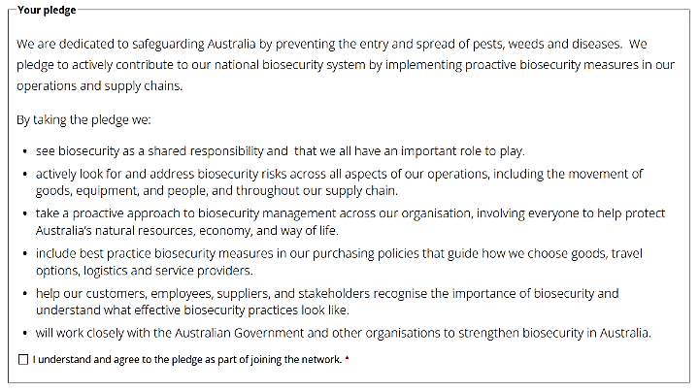
Your Pledge
Strengthens biosecurity risk management.
Covers operations and supply chains.
Internal practices and external commitment.
Proactive and practical approach.

Slide 23

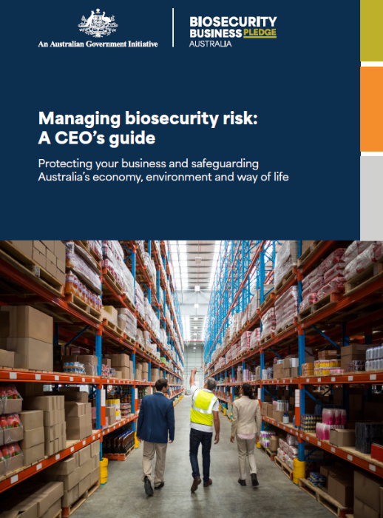

Benefits of taking the Biosecurity Business Pledge
Network access.
Practical support.
Department connection.
Public recognition.
No cost, low effort.

Slide 24

Take the PLEDGE!

Slide 25

You and the law
Cargo Information Policy
Goods and Conveyance Policy – Biosecurity Operations Division

Slide 26

Your responsibilities
As a freight forwarder, you have responsibilities under law.
Section 22 of the Biosecurity Act 2015 defines person in charge (of goods) as:
the owner of the goods; or
a person in possession or control of the goods; or
a biosecurity industry participant operating under an approved arrangement.
If you have the goods in your possession and/or have control the goods, you are subject to biosecurity requirements.

Slide 27
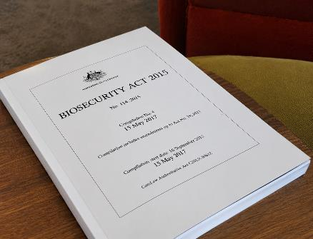
Goods are subject to biosecurity control
Understanding obligations on importers and their representatives
Subject to biosecurity control
Section 119 of Biosecurity Act 2015
s119(2) The goods become subject to biosecurity control when the aircraft or vessel carrying the goods enters Australian territory.
s119(3) The goods remain subject to biosecurity control until they are released under Division 10.
All goods entering Australia are subject to biosecurity control without exception.
Goods must be released from biosecurity control.

Slide 28
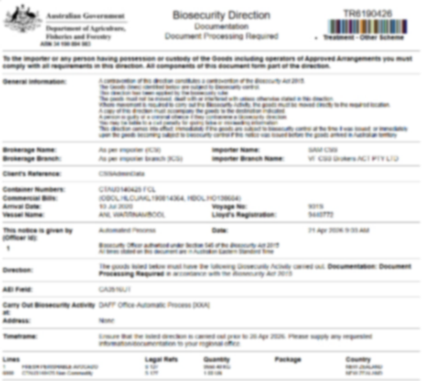
Directions and notices
Goods that are subject to biosecurity control must not be dealt with unless:
a direction or notice has been given allowing that action to occur; or
a direction or notice has been given releasing the goods from biosecurity control.
A direction is issued by a biosecurity officer.
A notice is issued by a biosecurity industry participant operating under an approved arrangement.
Directions and notices are available in the Biosecurity Portal.

Slide 29
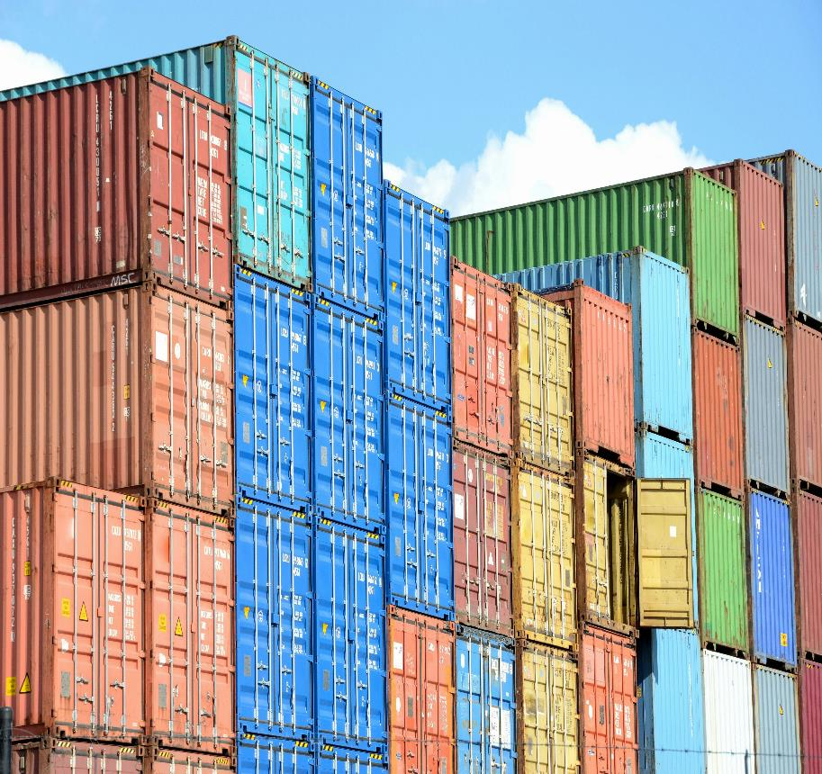
Approved Arrangements
Cargo Information Policy
Goods and Conveyance Policy – Biosecurity Operations Division

Slide 30

What is an approved arrangement?
An agreement between the Director of Biosecurity and a biosecurity industry participant under section 406 of the Biosecurity Act 2015.
Activities that can be undertaken under an approved arrangement are specified in the arrangement itself. Only specified activities can be undertaken under an approved arrangement.
To hold an approved arrangement, a biosecurity industry participant must demonstrate they are a fit and proper person, and that they are able to undertake the activities under the arrangement to manage biosecurity.

Slide 31
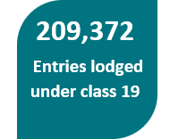
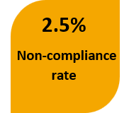
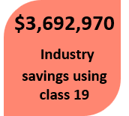
Approved arrangement class 19
Top 5 class 19.1 referrals
Concern type | Code | Entry count
Rural unpack destination – class 14.4 | RUAA | 17,423
Rural unpack destination – class 1 | RURL | 15,290
Packing declaration concerns | PDIN | 3,687
Volunteered – non commodity concerns | BNCC | 1,770
Volunteered – commodity concerns | BCOM | 1,045
Top 5 class 19.2 commodities
Commodity | Eligible | Entry count | Proportion lodged %
Manufactured wooden articles | 116,904 | 63,920 | 54.7
Used vehicles, aircraft, machinery | 101,556 | 47,528 | 46.8
New Tyres | 34,542 | 28,672 | 83
BMSB high risk goods | 87,039 | 23,324 | 26.8
Seafood | 15,624 | 6,503 | 41.6

Slide 32


Due Diligence on Documents
When assessing documents under approved arrangement class 19, ask yourself:
Has this document been issued by the correct entity?
Is it endorsed in an acceptable manner?
Are there any unendorsed alterations?
Does it present any conflicting information?
If in doubt refer it to the department:
By using the relevant volunteer concern code BCOM or BNCC.
Upload the documentation in COLS with a detailed explanation of your concerns.

Slide 33
Non-Commodity General Declaration Question
Are you an accredited person for FCL/X non-commodity clearances? (ID 6)
Are you an accredited person for LCL non-commodity clearances? (ID 8)
Where a branch ID is not approved to lodge under approved arrangement class 19.1, this question must be answered ‘No’ regardless of the individual’s accreditation status.
This includes branch IDs with current applications in progress that have not yet been approved.
Class 19 accreditation status enquiries: email class19@aff.gov.au

Slide 34
Class 19 Micro-Learning Is Coming To LearnHub
Supporting CBC and biosecurity compliance
Just‑in‑time and refresher learning - Bite‑size modules and videos (5–10 minutes) to support ongoing CBC and biosecurity obligations when learning is needed most.
Support when issues arise - Where non‑compliance occurs and a relevant module exists; learning can help clarify requirements and support early correction.
Growing library over time - A planned, expanding set of modules developed over time in response to common issues, changes, and emerging risks.

Slide 35

Imported Food
Imported Food
Residues and Food

Slide 36
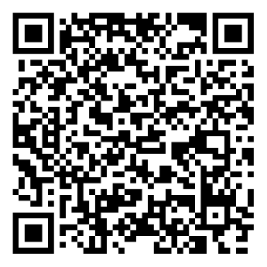
Legislation For Imported Food
1. The Biosecurity Act 2015
Some food not permitted for import
Some food requires permits and/or certification
Some food may require treatment before being imported
Border inspection and testing may apply
See BICON for import conditions
Food must pass biosecurity requirements first
2. Imported Food Control Act 1992
Risk-based border inspection scheme (IFIS)
Some foods are prohibited e.g. prohibited plants and fungi
Some foods require certification
Border inspection and testing may apply
See BICON for more information
How to import food into Australia - A step-by-step guide

Slide 37

Sunsetting of Imported Food Legislation
Under the Legislation Act 2003, legislative instruments automatically "sunset" (cease to have effect) after 10 years unless they are remade or repealed before their sunsetting date.
  Why sunsetting matters?
  Ensures that legislative instruments are up to date and only remain in force for as long as they are needed.
  Provides an opportunity for agencies to review and streamline legislative instruments.
  Is an important mechanism for reducing red tape, delivering clearer laws and aligning existing legislation with current government policy.

Slide 38

Legislative Instruments Under Review
Imported Food Control Regulation 2019
Imported Food Control Order 2019
Imported Food Control (Recordkeeping) Determination 2019

Slide 39
Timeline
Consider feedback and draft new legislation for approval by Minister
Legal and OIA consultation
Policy approval from Minister
Release consultation paper on new Policy
Internal
consultation
Policy
development
1 October 2029: Date of sunsetting

Slide 40
Managing Food Safety Risks
The Imported Food Control Order 2019 provides for the operation of the risk-based Imported Food Inspection Scheme by identifying risk foods.
This is based on advice published by Foods Standards Australia New Zealand that the food poses a potential medium or high risk to public health.
Schedule 1 lists risk food (targeted risk management).
There are currently 26 foods on this list.
Schedule 2 lists risk food that is New Zealand product (required to be inspected).
Subsection 6 lists food that must be covered by a recognised foreign government certificate.
Subsection 7 lists risk food that must be covered by a food safety management certificate.

Slide 41
New Food Safety Requirements For Imported Foods
Food type | Identified hazard(s) | New food safety requirements
Enoki mushrooms | Listeria monocytogenes | Classified as a risk food Border testing for Listeria monocytogenes Verify labelling includes storage and cooking instructions When: 02 March 2026
Kava products from New Zealand |  | Kava from New Zealand no longer exempt from IFIS due to Trans-Tasman Mutual Recognition Arrangement (TTMRA). Check compliance with ANZ Food Standards Code (Standard 2.6.3 Kava) When: 02 March 2026
Fresh/frozen melons | Listeria monocytogenes Salmonella spp | Will be classified as a risk food Will require a food safety management certificate When: March 2027
Pufferfish | Tetrodotoxin | Will be classified as a risk food Will require foreign government certification When: March 2028
We use the Have Your Say platform to consult on proposed changes to food safety requirements for new risk foods

Slide 42
For More Information
Page | Description
Imported food notices - DAFF | Provides information on changes to (food safety) requirements for food imported into Australia.
Imported food legislation | Summarises imported food legislation, biosecurity laws and imported food laws.
BICON - Australian Biosecurity Import Conditions | BICON is a database that can help you determine: 1. what biosecurity import conditions exist and if an import permit is required, and 2. what food safety requirements apply
Imported Food Inspection Scheme - DAFF | Summarises the IFIS and provides definitions of food categories, food safety recognition agreements, voluntary government certification, food inspection and failing food.
How to import food into Australia - DAFF | Provides an overview of considerations for importing food into Australia
Australia New Zealand Food Standards Code | Food Standards Australia New Zealand Food Standards Code legislation page.

