Slide 1
Methyl Bromide Fumigation Methodology version 3.0
Overview of key changes
Compliance and Enforcement Division
Department of Agriculture, Fisheries and Forestry

Slide 2
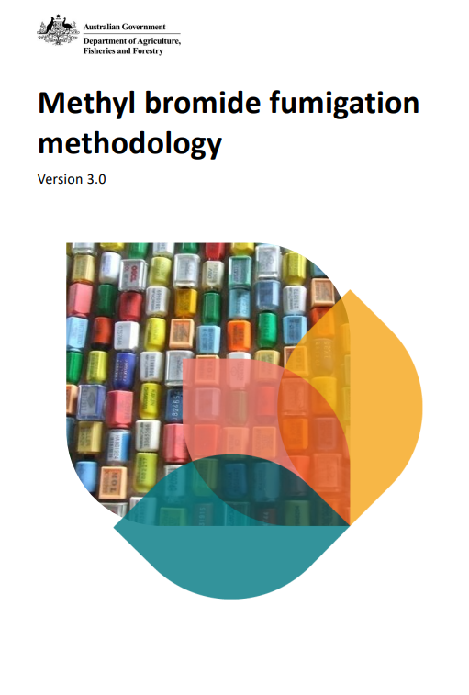
Overview
Version 3.0 comes into force 1 May 2025.
The methodology sets out the minimum requirements. Additional requirements can be found in import conditions through BICON.
Methyl bromide fumigation methodology – Prepare now for 2025 update - DAFF
Methyl Bromide Fumigation Methodology v3.0

Slide 3
What’s changed?
Order of the document
Existing clauses reworded
Temperature
Gas concentration monitoring
Topping up
Other minor improvements
The way a successful fumigation is performed has not changed.

Slide 4
Enforceability and clarity
Some clauses have been reworded for clarity and enforceability.
What does this mean?
“Sufficient free airspace”
“As close as practicable”
“Where” vs “If”

Slide 5
Wording, language and readability
Current | New
1.6.1 Impervious wrappings must have 4 or more holes of 6 mm diameter or 5 or more holes of 5 mm diameter for every 100 mm x 100 mm of surface area. Wrappings with at least 6 pinholes per 10 mm x 10 mm surface area are also acceptable. | 3.2.3 To be considered pervious, wrappings must have at least: a) 4 holes of 6 mm diameter per 100 mm x 100 mm surface area, or b) 5 holes of 5 mm diameter per 100 mm x 100 mm surface area, or c) 6 pinholes per 10 mm x 10 mm surface area.

Slide 6
Temperature requirements
New sections
6
7
6.1 Ambient temperature fumigations
6.2 Controlled temperature fumigations
6.3 Perishable commodity fumigations
7.1 Ambient temperature fumigations
7.2 Controlled temperature fumigations
7.3 Perishable commodity fumigations

Slide 7
Ambient temperature
Obtaining the forecast
Verifiable weather source
Checking the temperature hasn’t dropped below the temperature used for dosing

Slide 8
Controlled temperature
Enclosure needs to be monitored – no change
Temperature data in the enclosure needs to be recorded every 15m
Minimum temperature recorded on the ROF

Slide 9
Perishables temperature
Temperature used to calculate the dose
Temperature sample must be taken from every type of produce
Temperature samples must be taken before treatment starts
Temperature during the exposure period
The temperature of the enclosure must be obtained and recorded every 15m
Minimum temperature recorded on the ROF

Slide 10
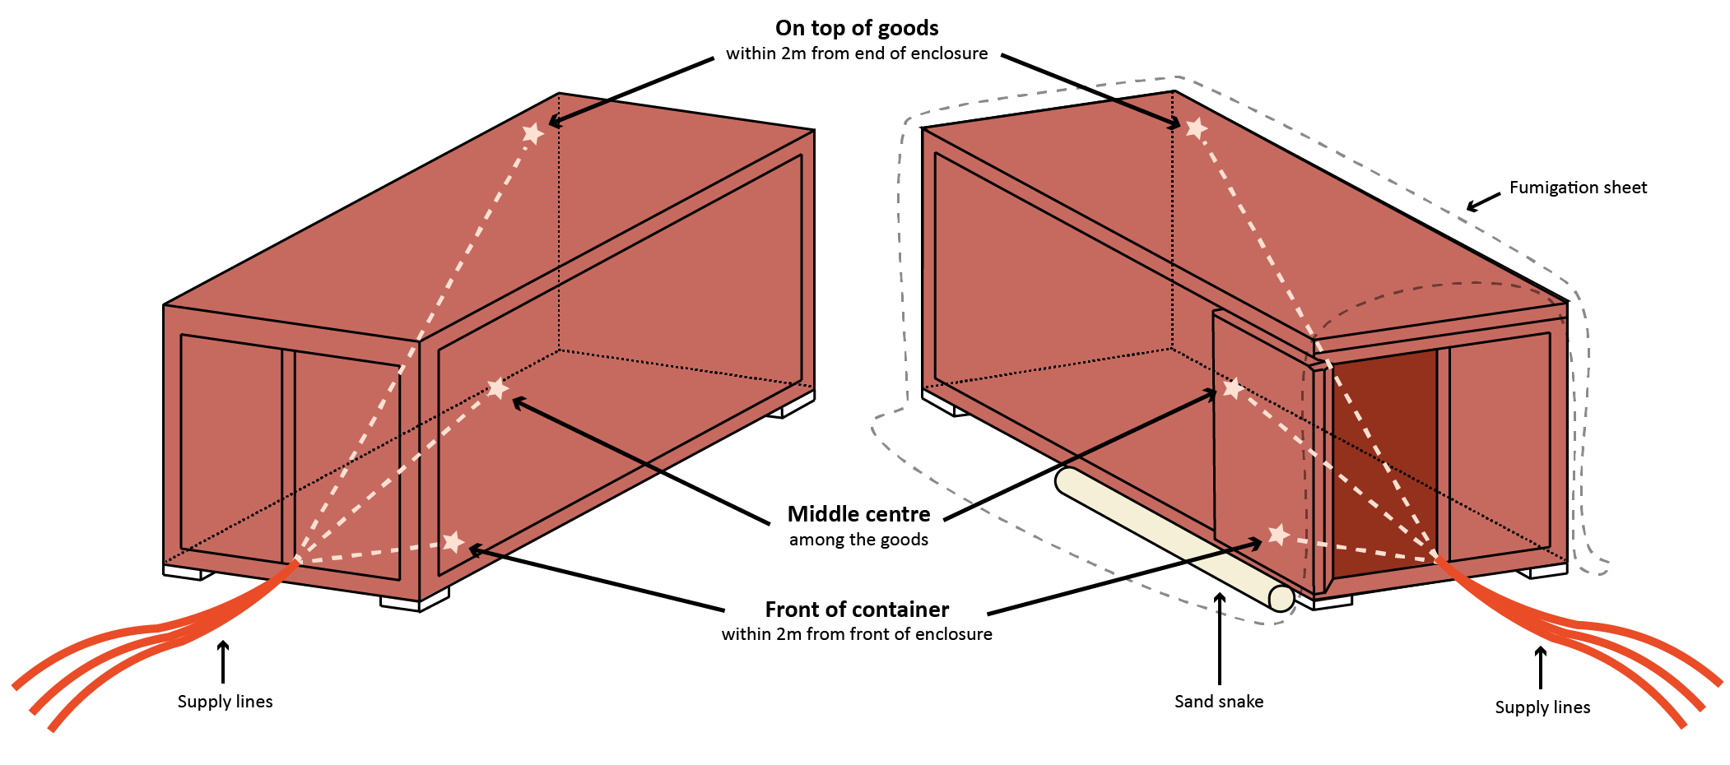
Gas concentration monitoring locations
Wording change from ‘sampling tube location’ changed to ‘gas monitoring location’
Location of gas monitoring lines clarified/specified
Single container enclosures
Unsheeted
Sheeted

Slide 11
Sheeted enclosures
Multi-container sheeted enclosure
Each container in a sheeted enclosure must have 3 monitoring lines
New allowance: one container can fail

Slide 12
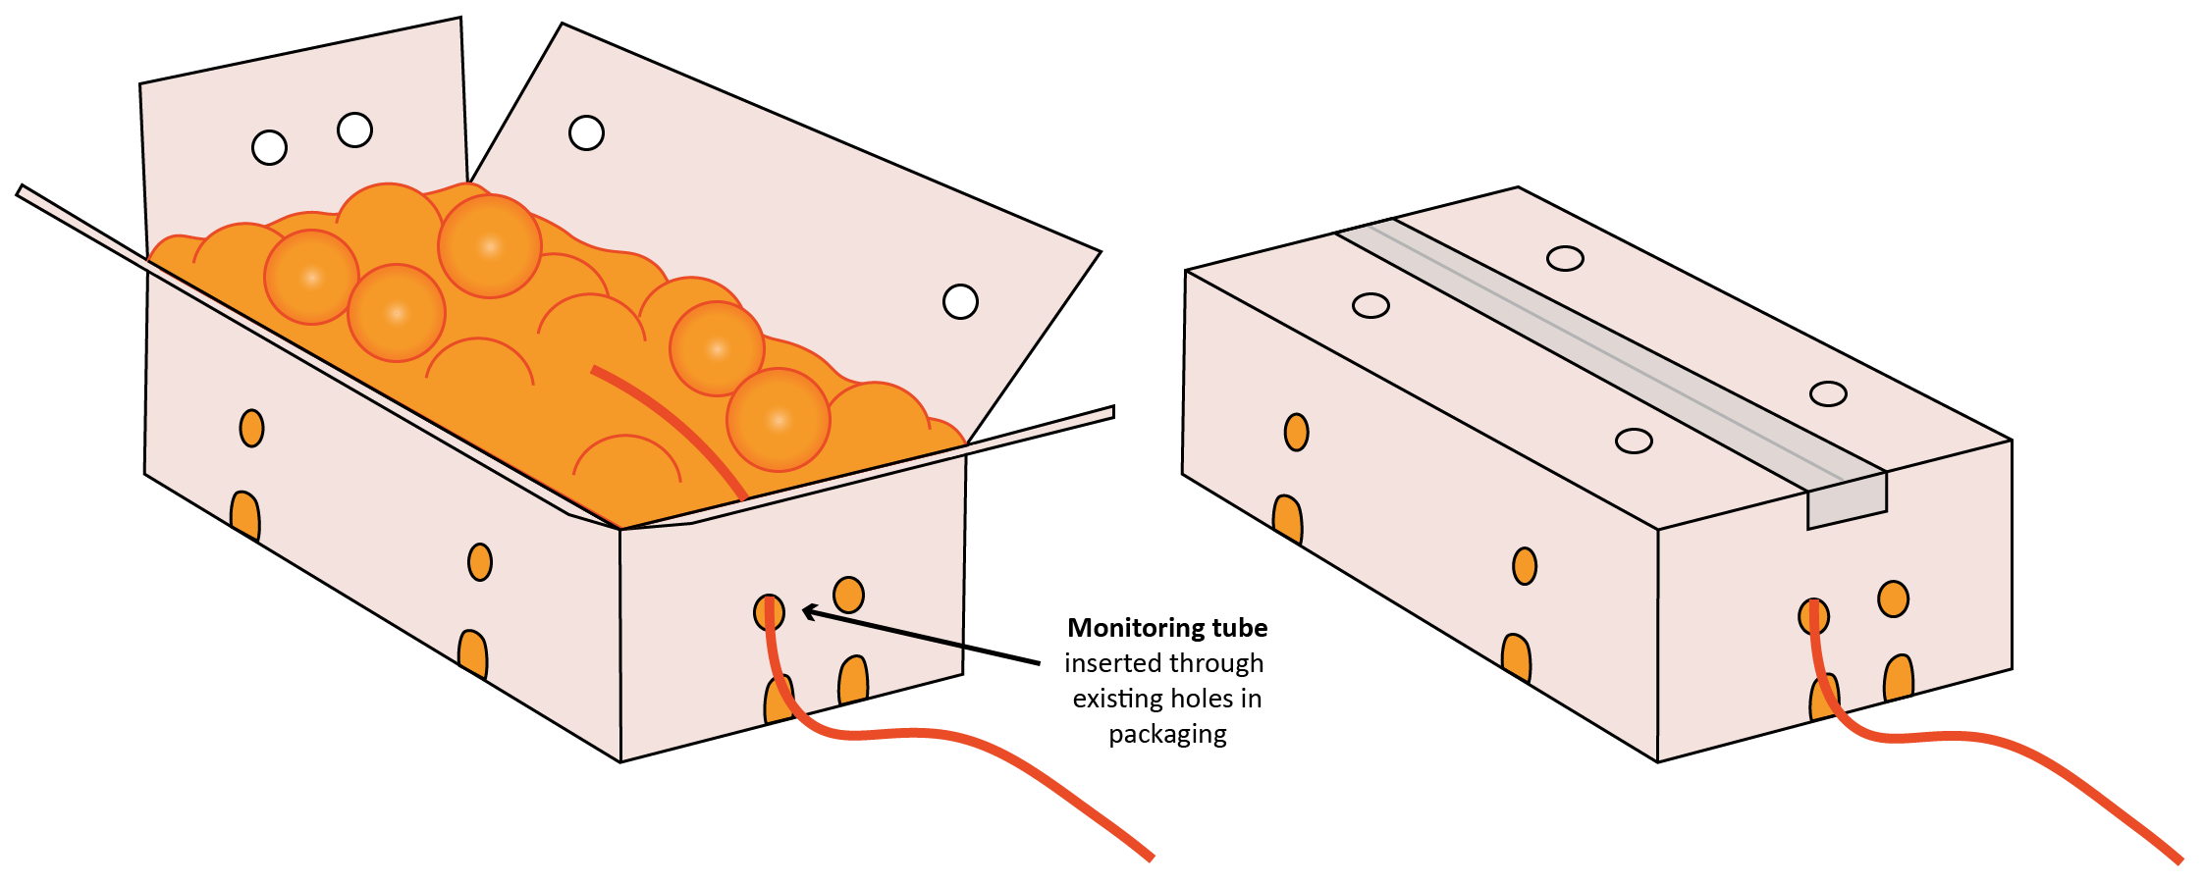
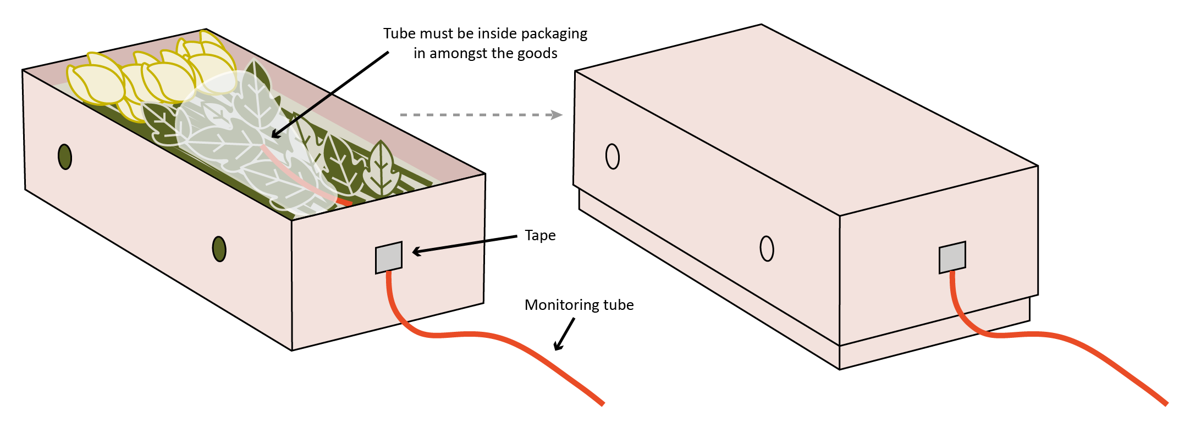
Gas concentration monitoring locations - perishables

Slide 13
Topping up
During the exposure period – if concentration is equal to or above the standard
Permitted for treatments under 12 hours
The ‘Standard’ concentration
C
Maximum
top-up amount
A
B
Minimum to allow top-up

Slide 14
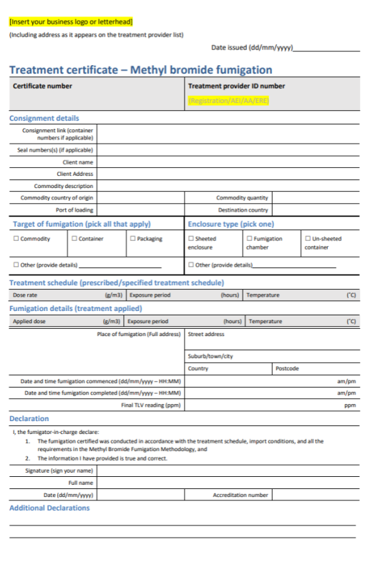
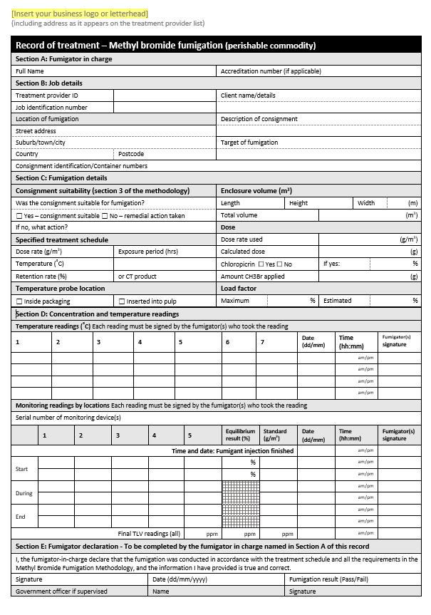
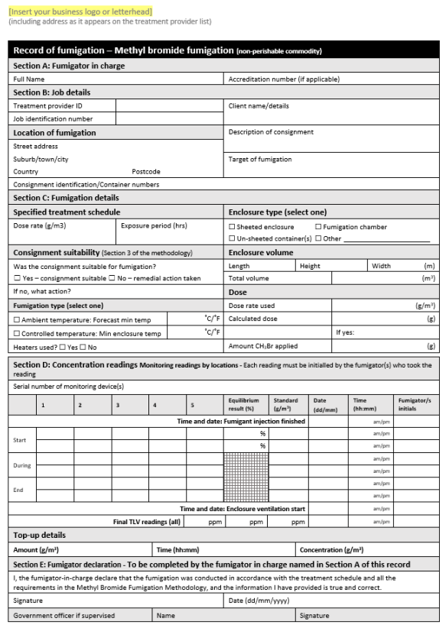
Documentation
Minimum requirements listed in the methodology
New templates available on the webpage

Slide 15
Record of fumigation
Pass/fail option
Airspace/impervious surfaces question has turned into a general ‘consignment suitability’ question
Serial number for monitoring device
3 final TLV readings
Fumigator initials for each concentration reading
Instructions on how to fill out a ROF and treatment certificate in the ‘Guide to performing quarantine pre-shipment (QPS) fumigations with methyl bromide v2.0’

Slide 16
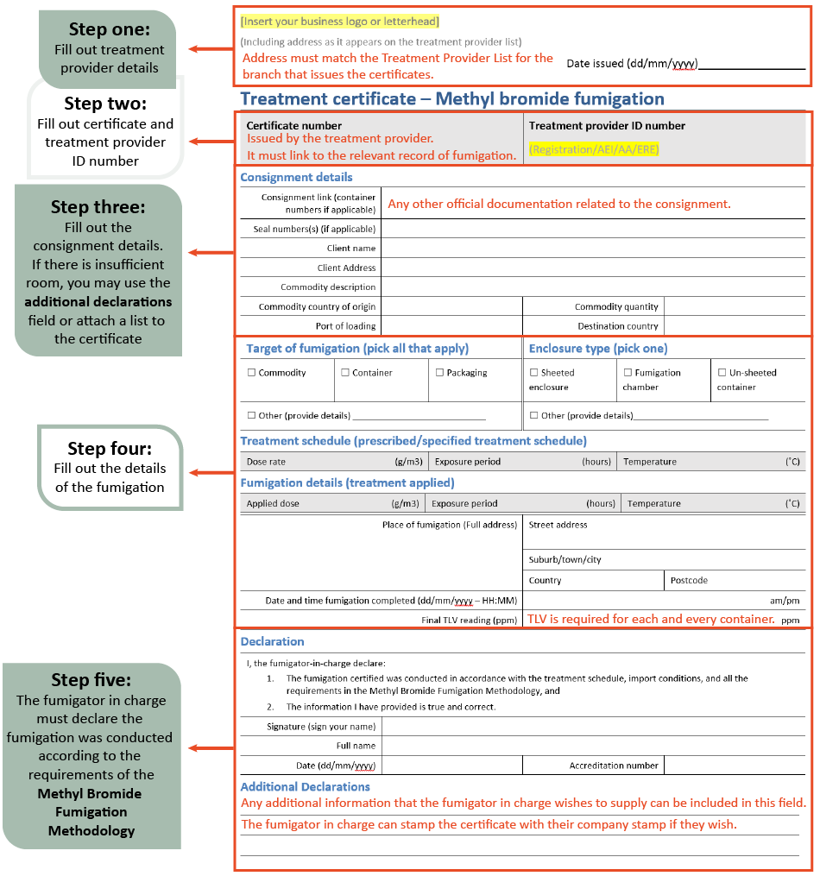
Treatment certificate
Requires a declaration that the consignment complies with the treatment schedule, import conditions, and all requirements of the Methyl Bromide Fumigation Methodology
Date fumigation commenced
Importer/exporter address is now client address and place of fumigation
Instructions on how to fill out a ROF and treatment certificate in the ‘Guide to performing quarantine pre-shipment (QPS) fumigations with methyl bromide v2.0’

Slide 17
Other minor improvements
Mostly to wording
Safety
Free airspace
Enclosure types
Glossary definitions
Consignment suitability

Slide 18
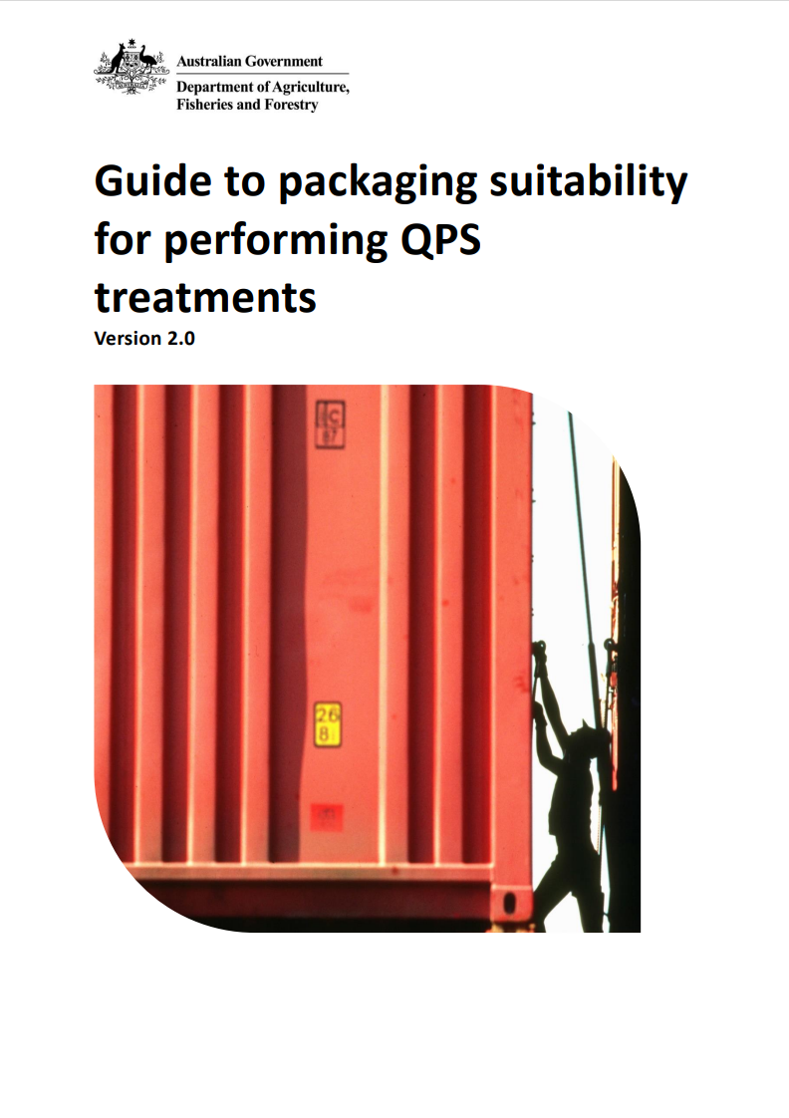
Consignment suitability
More details included and existing requirements clarified
New section for perishable commodity packaging
Reworded timber requirements
Clearer impermeable packaging requirements
Guide to packaging suitability for QPS treatments v2.0

Slide 19
Consignment suitability
Current | New
1.2.2 If the consignment does not conform to the suitability requirements remedial action must be taken or an alternative acceptable treatment method used. | 3.1.2 If the consignment is not suitable for fumigation, remedial action must be taken to make the consignment suitable prior to fumigation. If the consignment cannot be made suitable, the consignment must not be fumigated with methyl bromide. 3.1.3 If the target of fumigation includes the exterior of a sea container, the fumigation must be performed as a sheeted enclosure in accordance with section 4.2 Sheeted enclosures or otherwise made suitable for fumigation. 3.1.4 If the target of fumigation is inside a sea container, and the sea container is not sufficiently gas tight (in accordance with section 4.1 All Enclosures), compliant with section 4.1.1a), the fumigation must be performed as a sheeted enclosure in accordance with section 4.2 Sheeted enclosures or otherwise made suitable for fumigation.

Slide 20
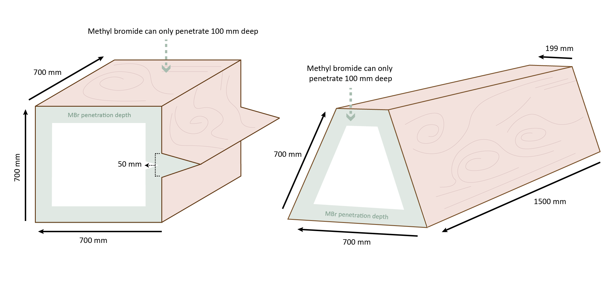
Timber suitability
Re-worded to ensure conditions apply to oddly shaped timber

Slide 21
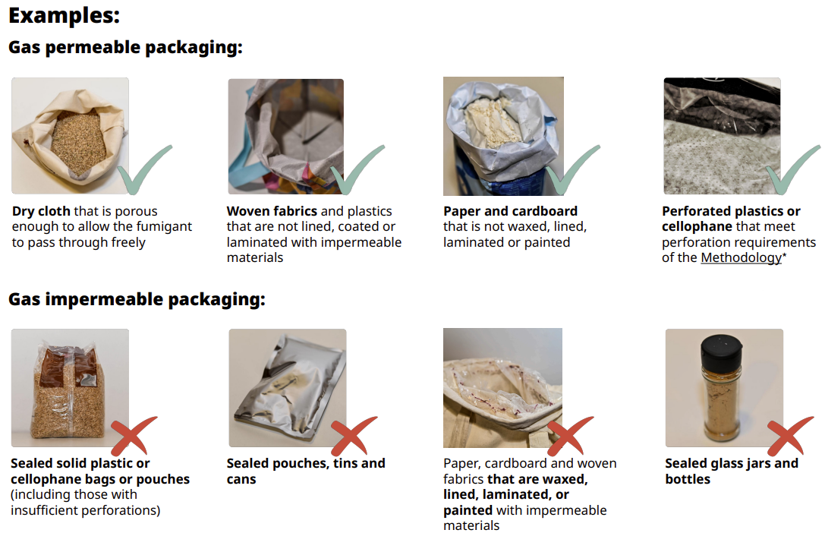
Factsheet available at: Measures for plant products under the khapra beetle urgent actions - DAFF

Slide 22
Summary
Version 3.0 comes into force 1 May 2025.
All methyl bromide fumigations with a start date and time at or after 1 May 2025 00:00 (midnight local time) must adhere to the new requirements. Local time means the place where the fumigation was performed.
Example: A treatment certificate has a start date listed as 30 April 2025 and an end date of 2 May 2025 and arrives in Australia on the 15 May 2025. Version 2.0 methodology requirements apply.
Example: A treatment certificate has a start date of 1 May 2025 and an end date of 3 May 2025, and arrives in Australia on the 18 May 2025. Version 3.0 methodology requirements apply.

Slide 23
Where to get more information:
Methyl bromide fumigation methodology – Prepare now for 2025 update - DAFF (agriculture.gov.au)
offshoretreatments@aff.gov.au

Slide 24
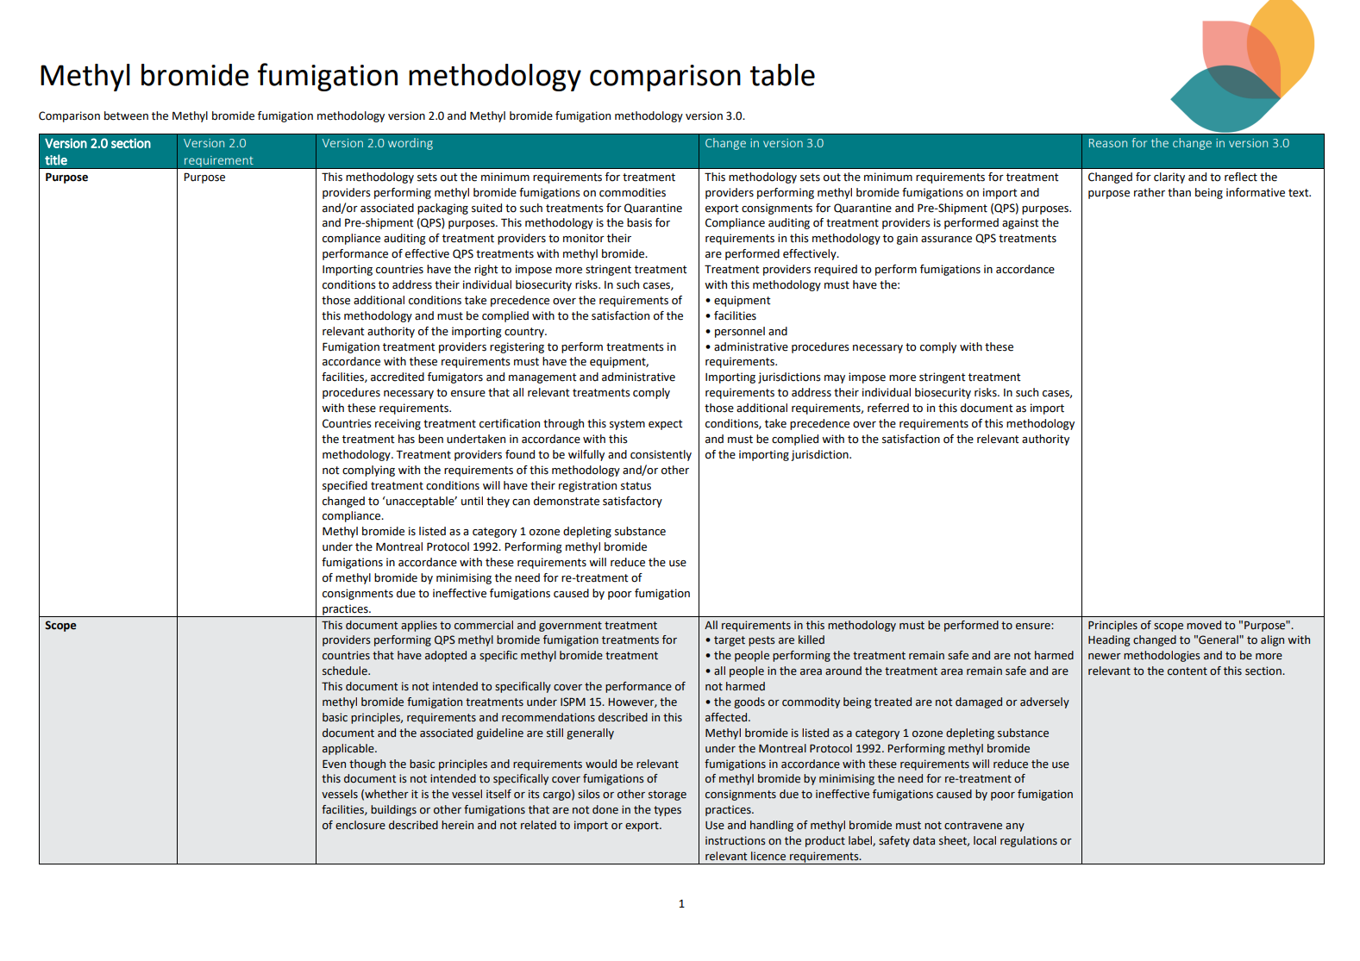
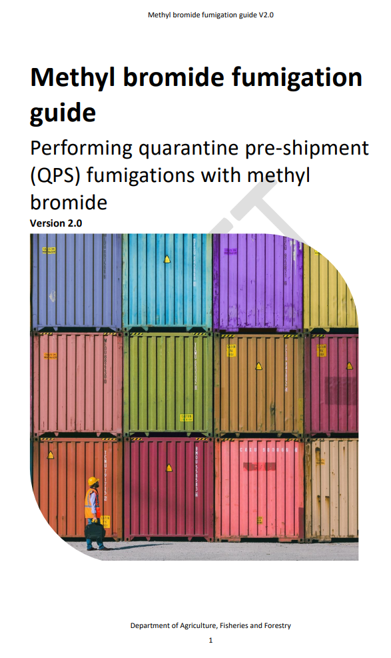
Resources

Slide 25
Questions
Please type your questions in the chat or upvote the question(s) you would like to be answered.

