Slide 1
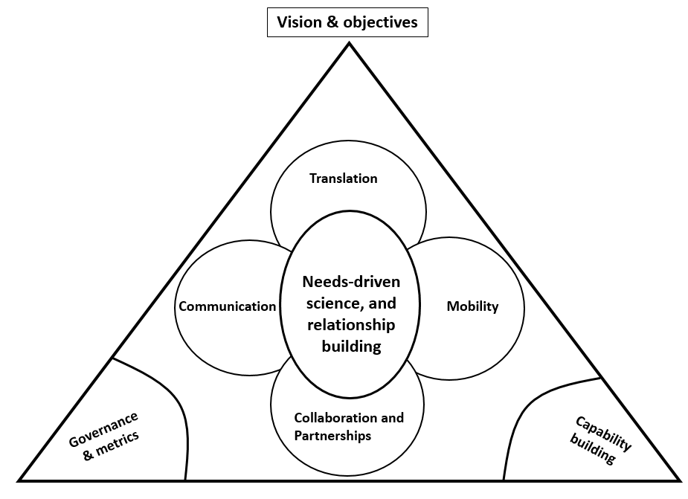
Science Strategic Action Plan SSAP:
a 12-18 month roadmap
Proce ss
Actions
Metrics
The department is developing and implementing a Science Strategy Action Plan (SSAP) to improve the delivery and application of science to support evidence-based policy, regulatory and operational decision-making.
The SSAP was developed through workshops held with senior science leaders from across the department in October 2020. It builds on outputs from workshops held in July/August 2020 with science staff from across the department.
STAKEHOLDER SATISFACTION, INTERNALLY AND EXTERNALLY
‘How readily applicable, and valuable in impact, are our science outputs and commissioned science to both internal and external end users and science partners?’ (Annual survey)
INTERNAL STAFF SATISFACTION
‘How well are our scientific staff supported to produce high quality and impactful science outputs and commissioned science?’ (Annual survey)
RETURN ON OUR INVESTMENT IN SCIENCE
‘Do we get good value for money from the science developed in the department as well as procured by the department? (End of project assessments)
SCIENCE QUALITY ASSESSMENT
‘How do our departmental science outputs and commissioned science rate, relative to appropriate research sector standards/benchmarks, and can be improved? (Bi-annual independent reviews)
Vision
The Department is a leader in solving problems through science. We produce, commission and apply world-class science to inform regulatory and policy decisions and find innovative solutions to enhance Australia’s agriculture, unique environment, heritage, and water resources.
We do this by building the scientific capability of our staff, collaborating with research institutions, innovators and Indigenous Australians, and sharing our expertise and findings with our stakeholders, partners and the community.
STAFF MOBILITY AND COLLABORATION/PARTNERSHIPS
Enable and incentivise short and longer term staff transfers/exchanges
Increase cross-fertilization and collaboration with the external research sector through strategic partnership arrangements
Scope the feasibility of a departmental science capability search tool
Ensure early and genuine Indigenous engagement is incorporated into departmental practices for science development and application
STAKEHOLDER ENGAGEMENT (NEEDS-DRIVEN SCIENCE) AND TRANSLATION
Increase targeted stakeholder relationship building
Scope potential for better utilizing relevant steering committee boards
ENHANCED COMMUNICATION
Increase communication training for departmental scientists
Better (and more) communication around the science we do, and its impact, across a range of platforms and opportunities
CAPABILITY: CAREER DEVELOPMENT + RESOURCING
Create a policy that specifically recruits and retains high performing talent, and provides tailored scientific career progression provisions
Enhance tools, systems and technologies to support science practitioners
GOVERNANCE
Establish robust and sustainable departmental science governance and increase executive level science representation
Implementation
Objectives
“Vision without execution is hallucination”, Thomas Edison, Inventor & Business Leader, (1847-1931)
Our plan…
Executive Board sign off for SSAP (by mid-November)
Put in place Science Council meetings (mid-November, mid-December)
Communicate SSAP appropriately, inc. initiate related external stakeholder discussions
Initiate implementation of three cross-divisional projects in the next three months (including developing a resource budget); conclude “new look” CSIRO contractual arrangements; etc.
SUPPORT POLICY DEVELOPMENT AND REGULATION
To support the department’s policy and regulatory efforts through evidence, based on the best available science
NEEDS-DRIVEN SCIENCE, BASED ON RELATIONSHIPS
To build effective stakeholder relationships to properly understand stakeholder needs, problems and opportunities
QUALITY PARTNERING
To build goal-oriented networks collaborating with research institutions and innovators both internally and externally
DELIVERY OF IMPACT
Through quality and timely communication with end users, deliver impact through translation and take up of scientific findings
CAPABILITY AND CAREER DEVELOPMENT
To support science capability; and ensure the department’s scientific cohort are motivated, well resourced and connected.
INDIGENOUS ENGAGEMENT
Partnering with Indigenous communities to actively incorporate Indigenous knowledge
Resources
“A strategy isn’t a strategy unless resources shift”, GG Garrett & GJ Davies, “Herding Cats”, Triarchy Press, UK (2010)
Resources = $ + people’s time, i.e. importantly, how we might expect people to operate differently
We recognise departmental fiscal resources are very tight.
At this point in time the only likely financial requirement is to provide project leaders with backfilling capacity when we are utilising their key staff members for focused, cross-boundary projects (as per implementation action 4 above)

