Slide 1
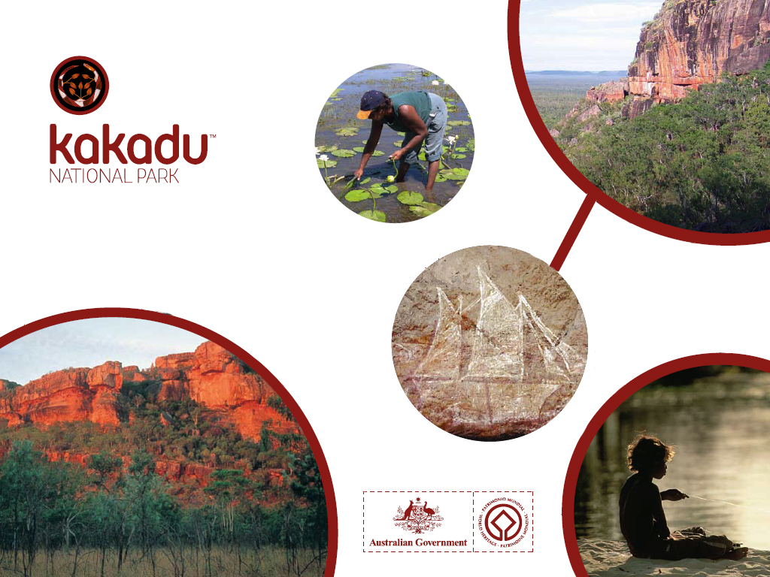

Slide 2

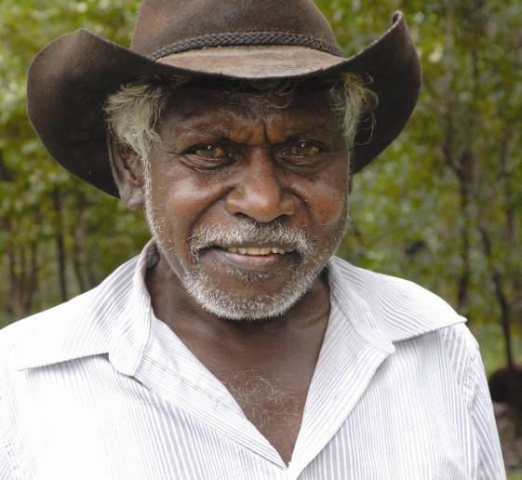
Welcome to country.
‘Our land has a big story.
Sometimes we tell a little bit at a time.
Come and hear our stories, see our land.
A little bit might stay in your hearts.
If you want more, you can come back…’
Jacob Nayinggul

Slide 3
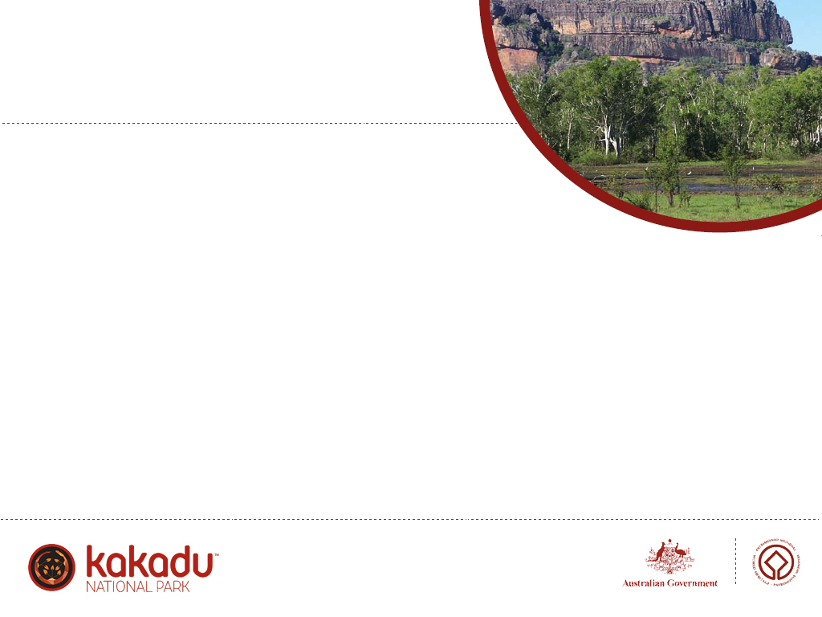
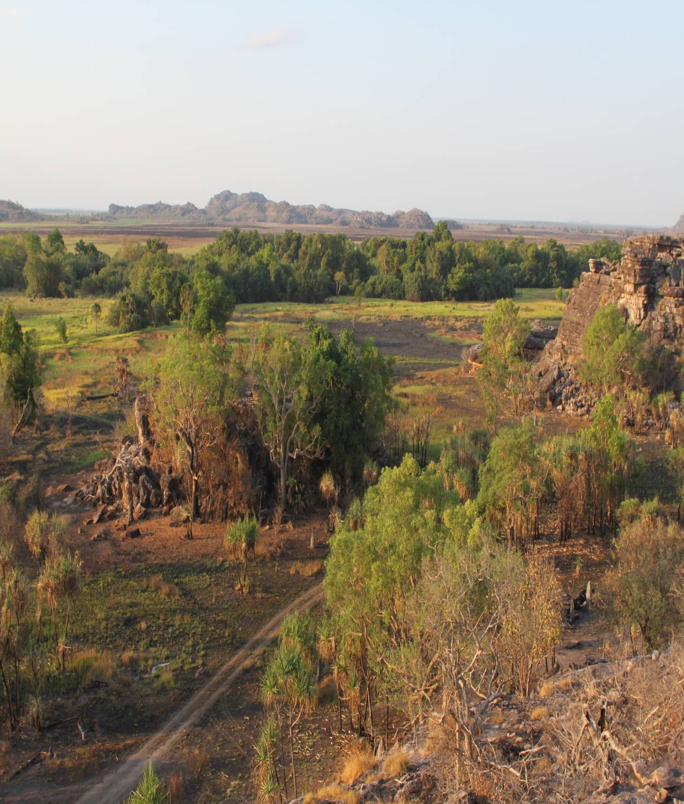
Information for Tour Operators and Guides
Ubirr Wet Season Access

Slide 4
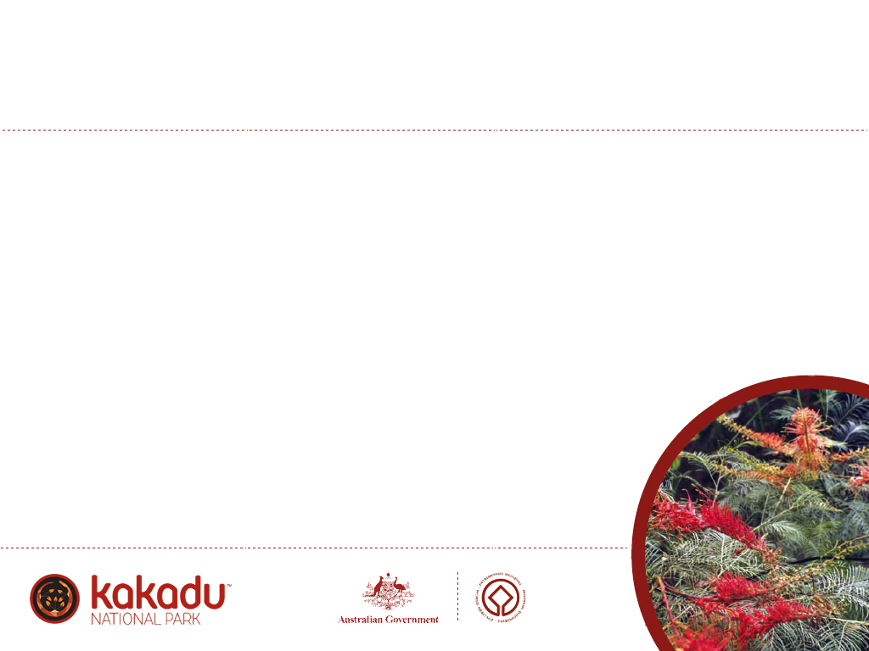
The Importance of Ubirr
Aboriginal families have lived continually in the Ubirr area for tens of thousands of years.
The paintings at Ubirr hold special significance to Aboriginal people. A strong association exists between these sites and their living traditions and beliefs.
Ubirr is a very important place for a number of different clan groups in this region.

Slide 5

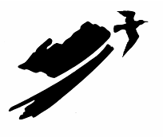
Ubirr in Context of World Heritage
Kakadu is inscribed on the World Heritage List under the World Heritage Convention for its outstanding natural and cultural values.
Stage One of the Park was inscribed on the list in 1981.
Ubirr’s cultural heritage is irreplaceable. Ubirr and other sites in Kakadu are regarded as among the finest examples of rock art in the world.
The wetlands surrounding Ubirr are recognised internationally as important waterfowl habitat under the Ramsar convention.

Slide 6
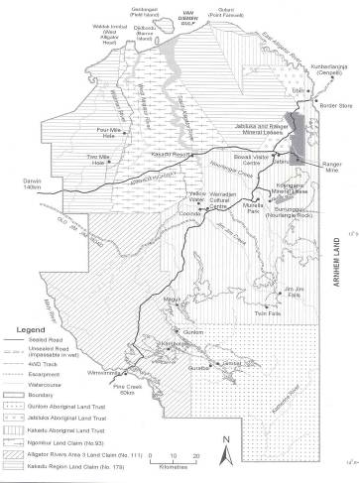
Establishment of Kakadu National Park
Most of the land that was to become part of Stage One of Kakadu National Park was granted to the Kakadu Aboriginal Land Trust under the Aboriginal Land Rights (Northern Territory) Act 1976 in August 1978.
Ubirr is part of the Kakadu Aboriginal Land Trust.
The Director of National Parks and the Land Trust signed a lease agreement for the land to be managed as a national park in November 1978.
Stage One of Kakadu National Park was declared on 5 April 1979.

Slide 7

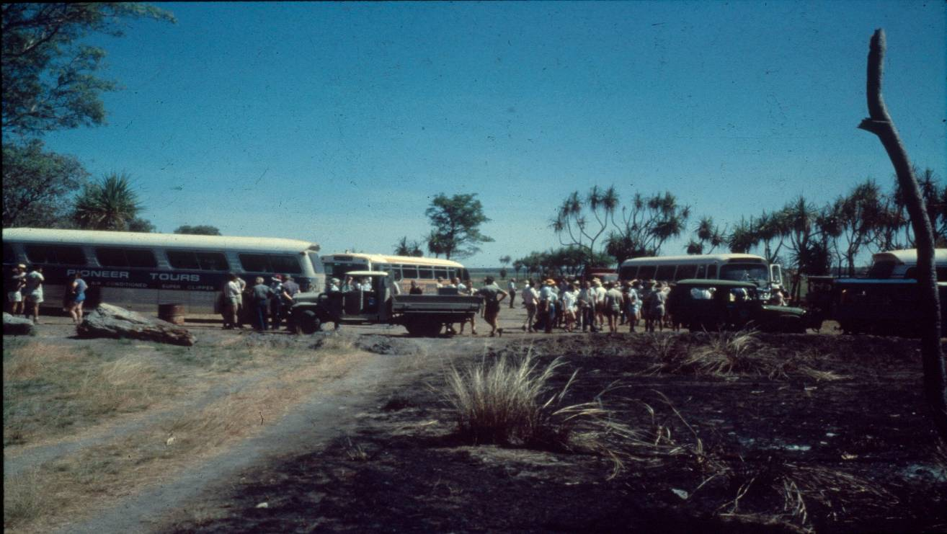
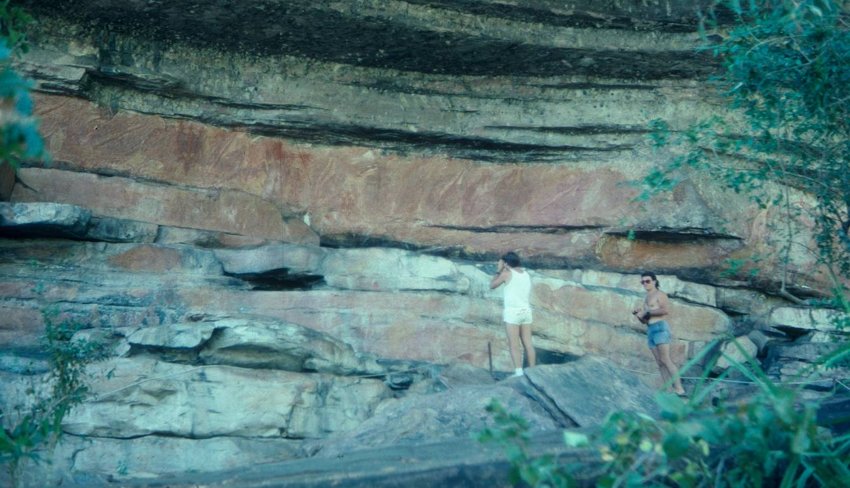
• Prior to 1979 access to Ubirr was across the Nadab floodplain via the Cannon Hill dirt track. Visitors would park cars and busses near the edge of the floodplain.
• There were no barriers or pathways. Unmonitored visitors climbed over rocks and touched paintings.

Slide 8

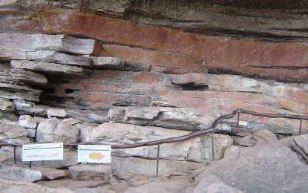
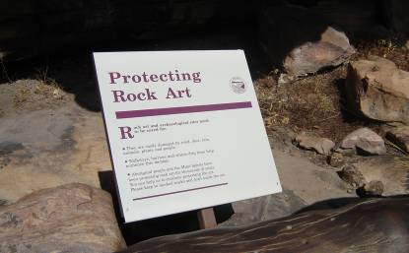
Past and Present Management of Ubirr
• With increasing visitor numbers to Ubirr it became necessary to introduce pathways, boardwalks, barriers and signs.
• Interpretation material provided at each site has been designed to increase visitor’s understanding and appreciation of Ubirr.
• This in turn helps to protect Ubirr – a special place for local clan groups and a World Heritage site.

Slide 9
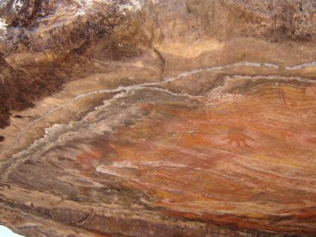
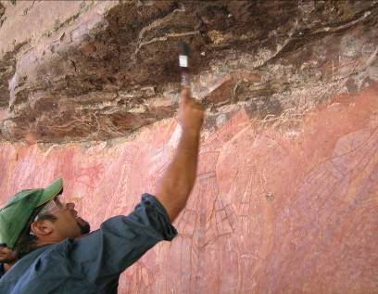
• Rock art provides a wealth of cultural knowledge by showing objects, animals and activities familiar to people today.
• Rock art site conservation is carried out to remove mud wasp nests, dust and water damage (silicon drip lines).

Slide 10
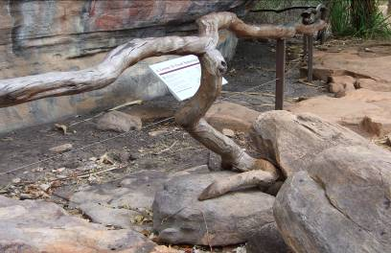
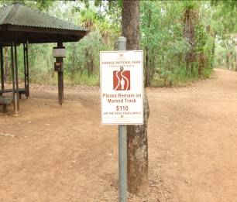
The ironwood barriers at Ubirr were designed and installed by a creative woodcraft person, local resident Rex Maxwell. Every piece has been carefully chosen to complement each site.
The stable heartwood of 20 year old fallen branches was sourced in the Darwin rural area and collected over a period of months.
A sign directing all visitors to remain on the marked track is located at the start of the walking track into Ubirr. There is an the spot fine for any person who does not comply with this request.

Slide 11
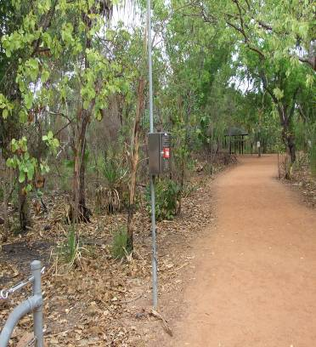
• An Emergency Call Device (ECD) is located at the start of the walking track into Ubirr.
• The ECD must only be used to request medical help or a search and rescue operation, or to notify a member of park staff of a death, injury, missing person or other incident.

Slide 12
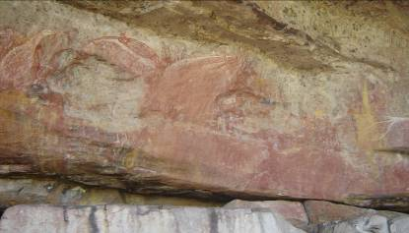
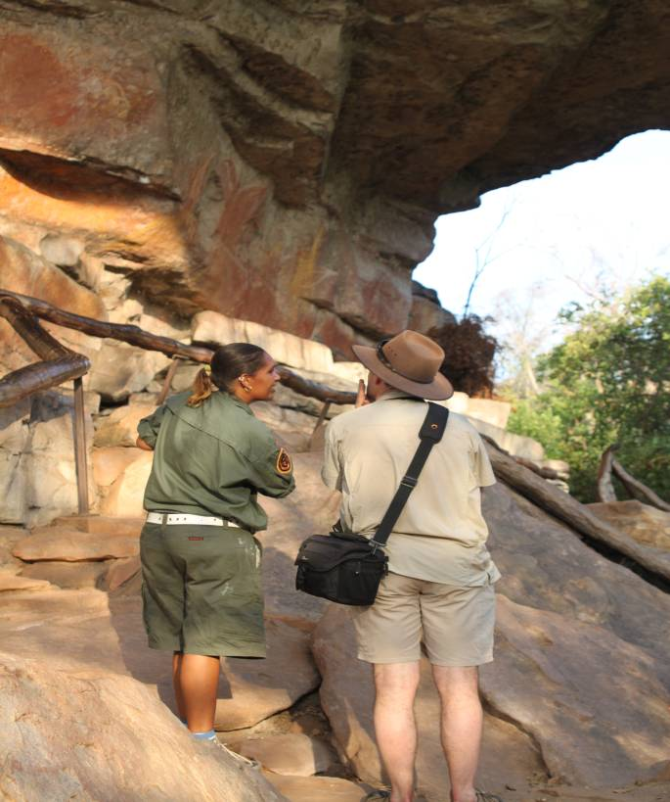
Surveillance at Ubirr
The Main Gallery at Ubirr was vandalized in late 1989.
Understandably, traditional owners were very upset. There was talk of closing Ubirr to the general public.
Discussions between traditional owners and Parks Australia resulted in the introduction of a Surveillance Officer, to patrol Ubirr while the site is open to the public.
Permanent surveillance commenced at Ubirr in 1990, with reduced opening hours to the site for the general public during the wet season.

Slide 13
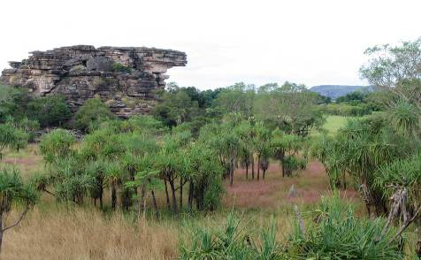
Wet Season Access to Ubirr
The current level of access at Ubirr depends on tour guides helping to look after the site.
Traditional Owners and Parks Australia have entrusted you to help protect Ubirr for future generations.

Slide 14
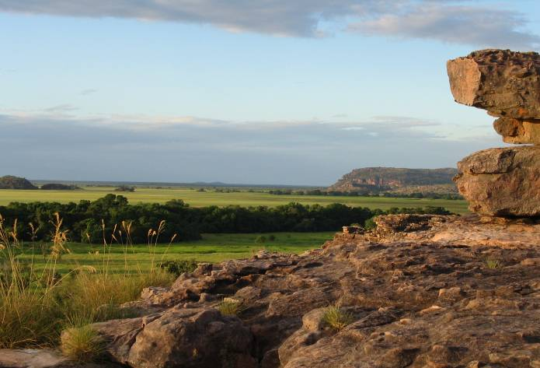
Access to
Ubirr
Art Site
1 December 2021
31 May 2022

Slide 15
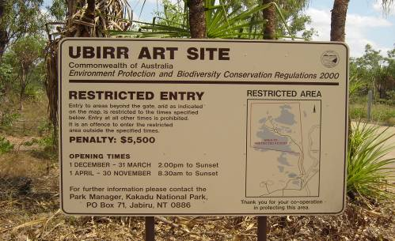
• Tour operators may access Ubirr art site between the hours of 8.30am and sunset, from 1 December to 31 May, if they hold a current wet season permit and key.
• Ubirr will open to the general public from 2.00pm to sunset from 1 December to 31 March, conditions permitting.

Slide 16
Important changes
To assist operators during the early dry season when road access may be restricted due to weather conditions, this year’s permit period is to the 31 May 2022.

Slide 17
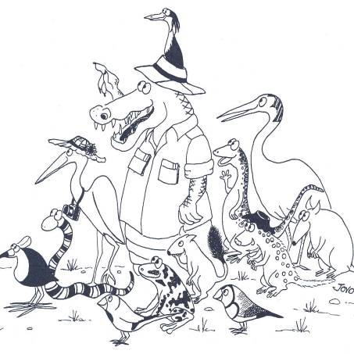
It is particularly important that:
• Tour guides emphasise the following rules, and that the rules are understood by passengers before entering Ubirr
• Remember that the tour group’s behaviour is the tour operator’s responsibility.

Slide 18
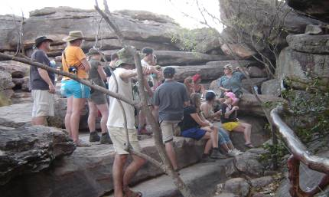
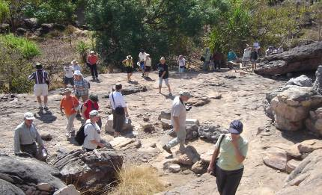
• With increasing visitor numbers to Ubirr it became necessary to introduce pathways, boardwalks, barriers and signs.
• Interpretation material provided at each site has been designed to increase visitor’s understanding and appreciation of Ubirr.
• This in turn helps to protect Ubirr – a special place for local clan groups and a World Heritage site.

Slide 19
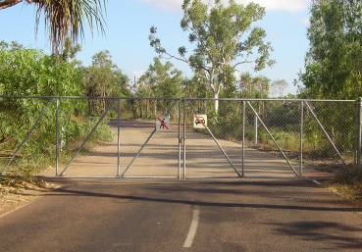
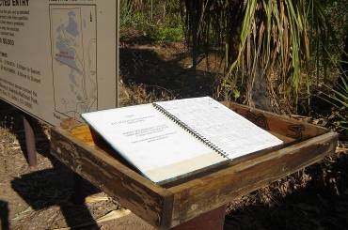
•Tour groups do not let anyone else in to Ubirr.
• Do not leave the gate unlocked.
• Do not pick up any extra passengers.
• Tour guides must complete the required details in the visit register upon entry and before leaving Ubirr.

Slide 20
• Keys are not to be used outside the hours of 8.30am to sunset between the dates of
1 December 2021 and
31 May 2022.

Slide 21
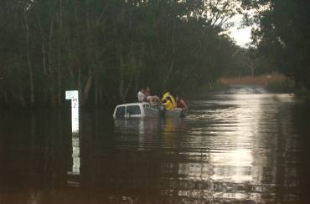
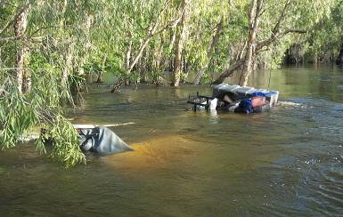
Important Notice
Oenpelli Road is designated and sign posted by the Department of Transport as impassable when the Magela Creek reaches approximately 0.5 metres.
Anyone attempting to cross the creek does so entirely at their own risk.

Slide 22
Quality Information
It is important to give accurate and appropriate information to Park visitors.
This presentation and the Kakadu Knowledge for Tour Guides course provide information about Ubirr art sites and their relevant stories.
Part of working in a cross cultural context is the ability to learn and understand differences and to respect those differences.

Slide 23
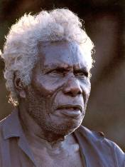
As Bill Neidjie said:
‘I like visitors to come to Ubirr to look at the paintings. The outside (public) stories are good to tell visitors. Its good for Balanda (non-Aboriginal people) to learn about the Aboriginal way of life.’

Slide 24
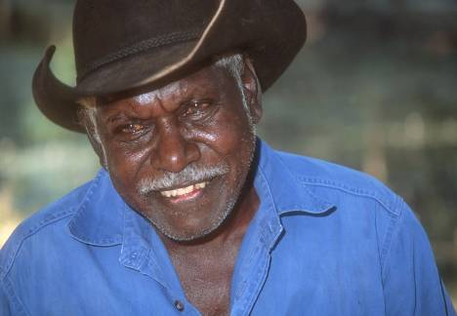
‘Pay attention to stories.
Get the feeling of peacefulness, so that when you leave Ubirr you will have learnt something.’
Jacob Nayinggul, Manilagarr clan

Slide 25
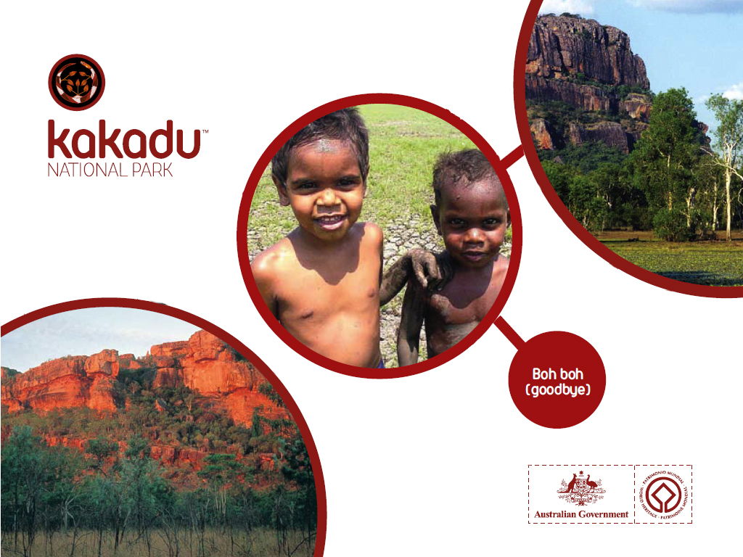
Bobo
(goodbye)

