Slide 1



Review of the biosecurity risks of prawns imported from all countries for human consumption – draft report
Webinar
Dr Beth Cookson
Dr Kally Gross
Dr Belinda Morahan
Dr Yvonne Gonzales-Cendales
24 November 2020

Slide 2
Introduction
Introduction and welcome from Dr Beth Cookson, Assistant Secretary Animal Biosecurity
Department of Agriculture, Water and the Environment
Prawn review webinar
Dr Beth Cookson
24 November 2020
2

Slide 3
Presentation overview
The draft report
The methodology
Biosecurity measures considered
Risk assessment example
Proposed import conditions
Next steps
Question and answer session
Department of Agriculture, Water and the Environment
Prawn review webinar
Dr Kally Gross
24 November 2020
3

Slide 4
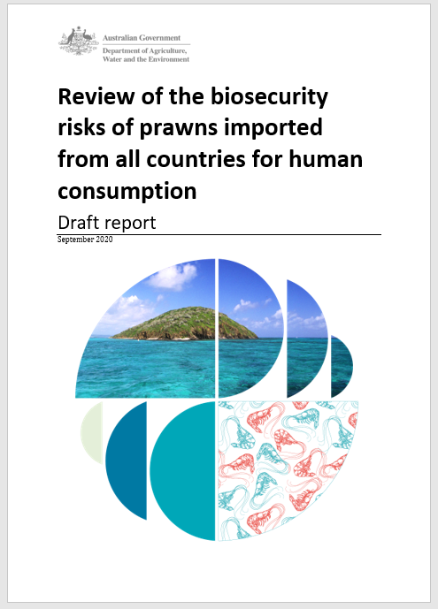
The draft report
The draft report documents our review of the biosecurity risks of prawns imported from all countries for human consumption.
The draft report provides recommendations about if and how prawns can be imported in a manner that achieves Australia’s appropriate level of protection (ALOP).
The draft report was released on 28 September 2020.
Comments can be made about the draft report until 15 January 2021.
  haveyoursay.awe.gov.au
Department of Agriculture, Water and the Environment
Prawn review webinar
Dr Kally Gross
24 November 2020
4

Slide 5

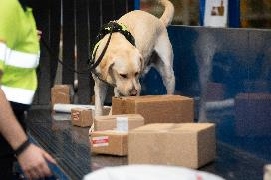
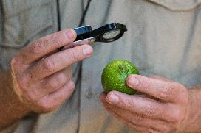
Australia’s biosecurity framework
Australia’s biosecurity system protects our people, plants, animals and our environment against risks that may arise from exotic pests and diseases.
Australia’s biosecurity framework is supported by the following:
Commonwealth, state and territory biosecurity legislation
policies
import conditions
shared responsibilities.
offshore
border
onshore
Source: M. Masters
Source: K. Trapnell

Slide 6

Australia’s international obligations
The department conducts animal/animal product risk analyses in accordance with international biosecurity obligations including:
World Trade Organization (WTO) Agreement on the Application of Sanitary and Phytosanitary Measures (SPS agreement).
www.wto.org/english/tratop_e/sps_e/spsagr_e.htm
World Organisation for Animal Health (OIE)
www.oie.int/
World Health Organization (WHO)
ww.who.int/
Department of Agriculture, Water and the Environment
Prawn review webinar
Dr Kally Gross
24 November 2020
6

Slide 7
The methodology
The prawn review was conducted using a risk analysis process that is consistent with that described by the World Organisation for Animal Health (OIE) in the Aquatic animal health code.
Department of Agriculture, Water and the Environment
Prawn review webinar
Dr Kally Gross
24 November 2020
7

Slide 8

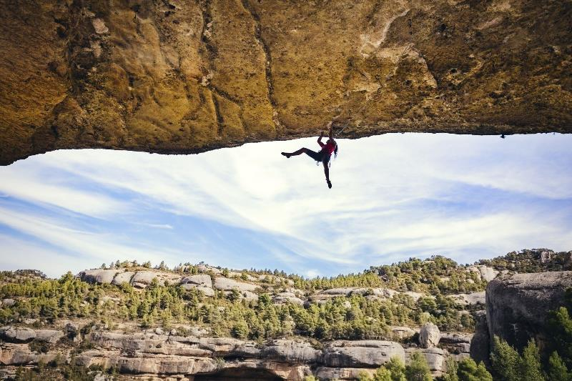
Risk = likelihood × consequence
Department of Agriculture, Water and the Environment
Prawn review webinar
Dr Kally Gross
24 November 2020
8

Slide 9
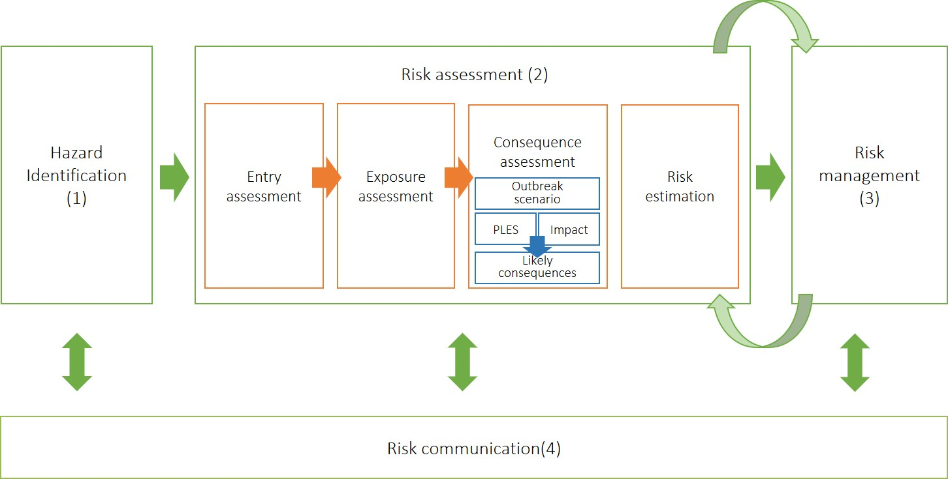
Risk analysis process
Chapter 4 of the draft report provides the details on the general considerations taken into account by the department when undertaking the risk assessments and a detailed explanation of the methodology used.
Department of Agriculture, Water and the Environment
Prawn review webinar
Dr Kally Gross
24 November 2020
9

Slide 10
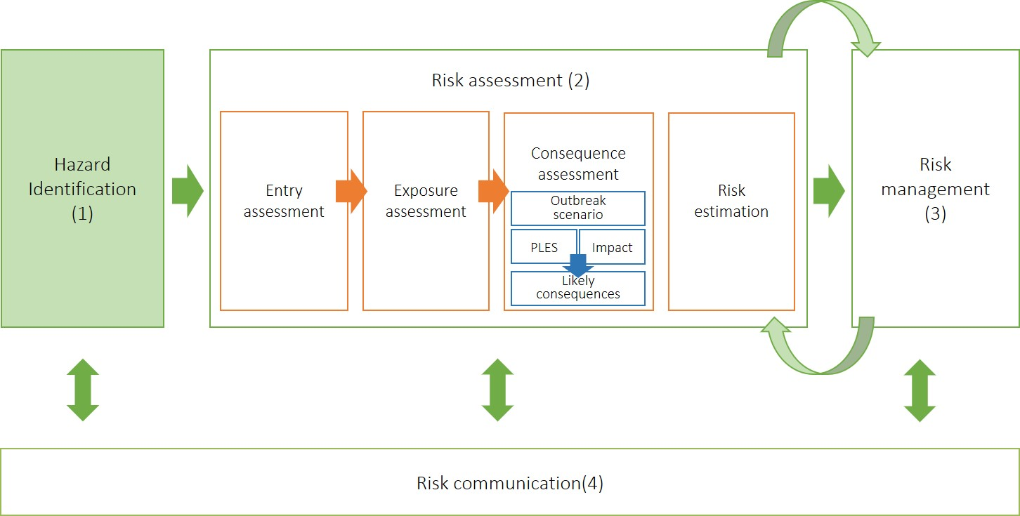
1. Hazard identification
Hazards retained for risk assessment
“Candidatus Hepatobacter penaei” (“Ca. H. penaei”)
covert mortality nodavirus (CMNV)*
decapod iridescent virus 1 (DIV1)*
Enterocytozoon hepatopenaei (EHP)
infectious myonecrosis virus (IMNV)
Laem-Singh virus (LSNV)
Taura syndrome virus (TSV)
Vibrio parahaemolyticus strains containing Pir toxins (Vp AHPND)
white spot syndrome virus (WSSV)
yellow head virus genotypes 1 (YHV1) and 8 (YHV8)#.
* The department notes that DIV1 & CMNV are emerging diseases. We continue to monitor the situation.
#The department considered there was insufficient information regarding YHV8 to conduct a risk assessment. We continue to monitor the situation.
Department of Agriculture, Water and the Environment
Prawn review webinar
Dr Kally Gross
24 November 2020
10

Slide 11
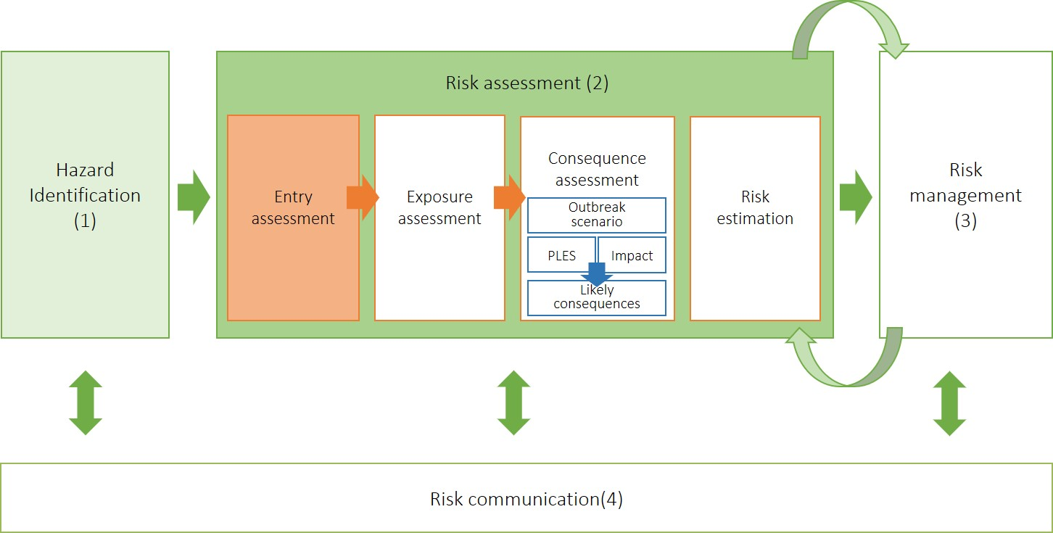
2.1 Entry assessment
The first step in the risk assessment is the entry assessment.
The entry assessment describes the pathway(s) for the introduction of the hazard into Australia and estimates the likelihood of that occurring.
Single-entry scenario: the importation (from all countries) of non-viable, farm-sourced, frozen, uncooked, whole prawns intended for human consumption.
  Also known as ‘unrestricted risk’.
Department of Agriculture, Water and the Environment
Prawn review webinar
Dr Kally Gross
24 November 2020
11

Slide 12

Factors considered in the entry assessment
To estimate the likelihood of entry we considered key factors, such as the:
    biological characteristics of the hazard
    effectiveness of post-harvest inspection and grading in removing infected prawns before export
    effect of processing, transport and storage on the hazard.
The likelihood of entry of each hazard was estimated as:
    high, moderate, low, very low, extremely low or negligible.
Department of Agriculture, Water and the Environment
Prawn review webinar
Dr Kally Gross
24 November 2020
12

Slide 13
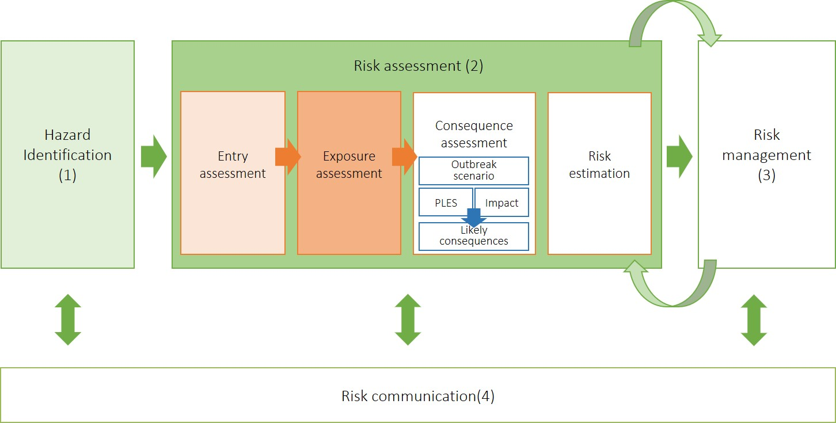
2.2 Exposure assessment
The second step in the risk assessment is the exposure assessment
The exposure assessment estimates the likelihood of direct exposure of an exposure group to the hazard.
To estimate the likelihood of exposure we:
identified the exposure groups.
identified the exposure pathways.
considered hazard and exposure group specific information.
The partial likelihood of exposure (PLE) was estimated for each of the three exposure groups as:
  high, moderate, low, very low, extremely low or negligible.
Department of Agriculture, Water and the Environment
Prawn review webinar
Dr Kally Gross
24 November 2020
13

Slide 14
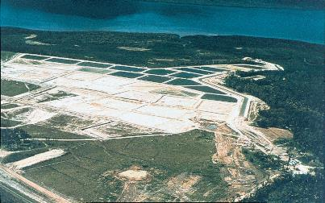
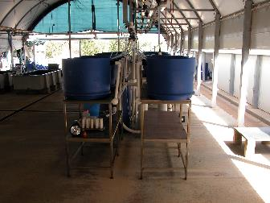
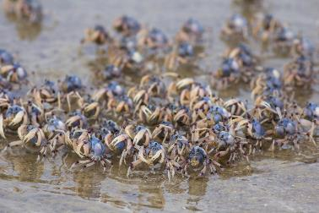
Identification of three exposure groups
  farmed crustaceans
  hatchery crustaceans (encompassing crustacean hatchery broodstock and postlarvae, crustaceans in research facilities and crustaceans in public aquaria)
  wild crustaceans.
Source: shutterstock.com
Department of Agriculture, Water and the Environment
Prawn review webinar
Dr Kally Gross
24 November 2020
14

Slide 15
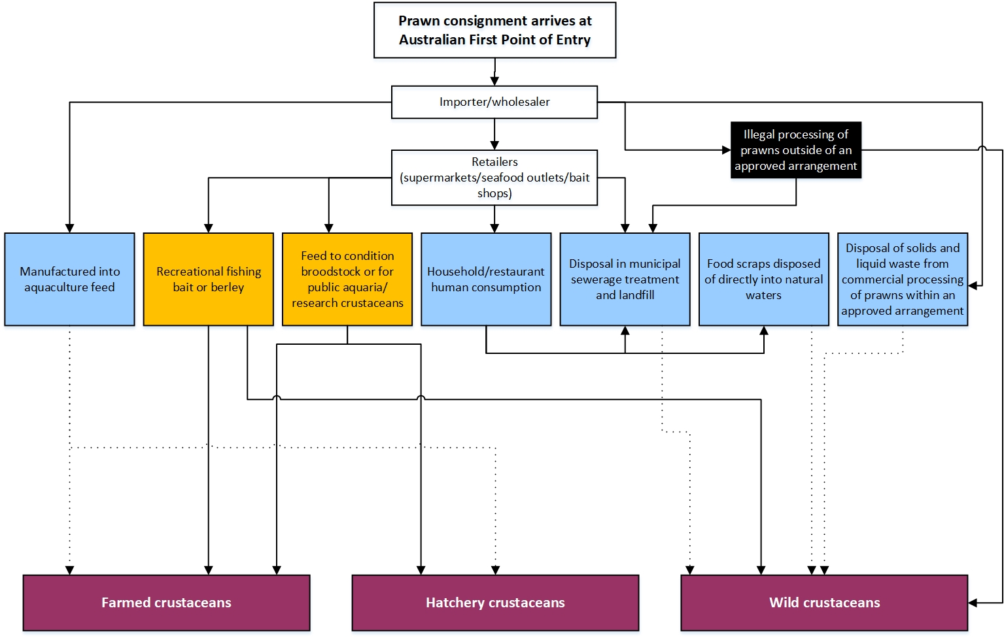
Identification of exposure pathways and estimation of partial likelihood of exposure

Slide 16
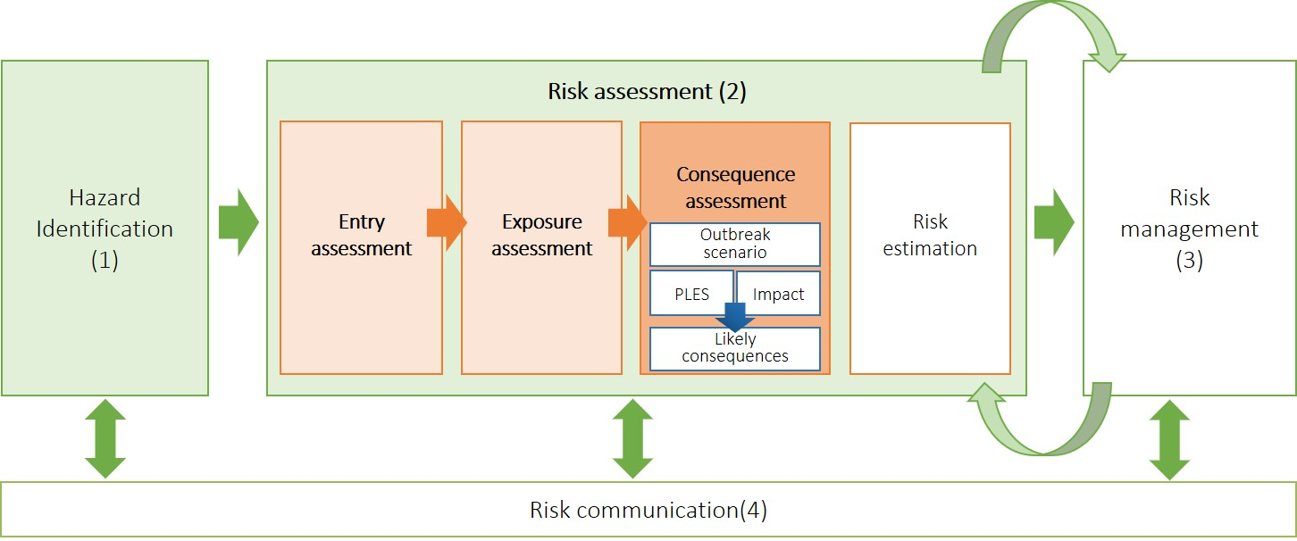
2.3 Consequence assessment
The third step in the risk assessment process is the consequence assessment
The consequence assessment describes the potential consequences of a given exposure, and estimates the probability of them occurring.
  To undertake the consequence assessment we:
  identified a likely outbreak scenario
  estimated the partial likelihood of establishment and spread
  determined the overall impact of establishment and spread
  determined the likely consequences of the outbreak scenario.
  The likely consequences of the outbreak scenario for each hazard were expressed as:
  extreme, high, moderate, low, very low or negligible.
Department of Agriculture, Water and the Environment
Prawn review webinar
Dr Kally Gross
24 November 2020
16

Slide 17
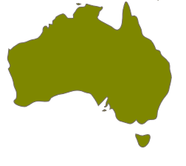
Determining the overall consequences of establishment and spread
Outbreak scenario
  ‘the hazard establishes in the directly exposed population and spreads to wild and farmed populations, is not eradicated, becomes endemic in Australia and eventually spreads to its natural geographical limits’.
The partial likelihood of establishment and spread (PLES) is estimated for each of the 3 exposure groups.
  How likely is it that one index case will result in the hazard establishing and spreading to the other exposure groups and eventually to its natural geographic limits.
Overall impact of establishment and spread is estimated across the exposure groups.
  What will be the biological, economic and environmental impacts associated with the outbreak scenario occurring.
Likely consequences of the outbreak scenario.
  Determined by combining the overall impact with the partial likelihood of establishment and spread for each exposure group.
Department of Agriculture, Water and the Environment
Prawn review webinar
Dr Kally Gross
24 November 2020
17

Slide 18
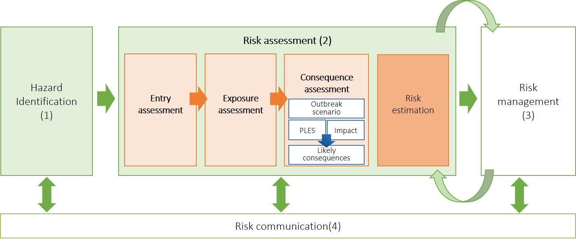
2.4 Risk estimation
The fourth step in the risk assessment is risk estimation
Risk estimation is the integration of likelihood of entry and exposure and likely consequences to obtain the overall annual risk associated with entry, establishment and spread of a hazard.
Risk estimation:
estimated the overall annual risk for the single-entry scenario (unrestricted risk)
identified whether the overall annual risk achieved Australia’s ALOP.
The overall annual risk was reported using one of the following ratings:
extreme, high, moderate, low, very low or negligible.
Department of Agriculture, Water and the Environment
Prawn review webinar
Dr Kally Gross
24 November 2020
18

Slide 19
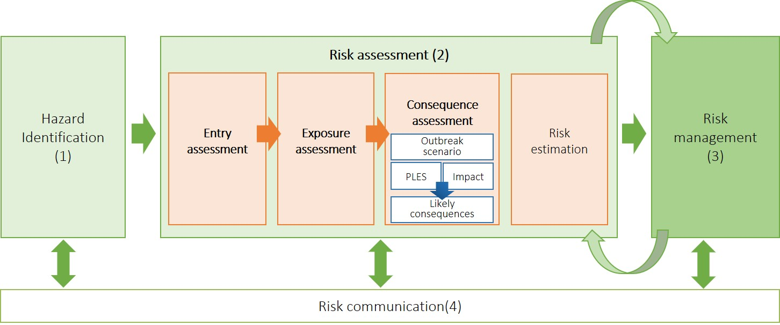
3. Risk management
Risk management is the third component of risk analysis
Risk management is the process of identifying, selecting and implementing measures that can be applied to reduce the level of risk of a hazard, while at the same time, ensuring that negative effects on trade are minimised.
Australia’s ALOP provides a benchmark for evaluating risk and determining whether biosecurity measures are required.
If the unrestricted risk achieved Australia’s ALOP (negligible or very low), biosecurity measures were not required.
If the unrestricted risk did not achieve Australia’s ALOP (low, moderate, high or extreme) biosecurity measures were identified and the risk was recalculated with the biosecurity measure applied (restricted risk).
  If the restricted risk was then found to be negligible or low, that biosecurity measure was considered to manage the biosecurity risk of the hazard to a level that achieves Australia’s ALOP.
Department of Agriculture, Water and the Environment
Prawn review webinar
Dr Kally Gross
24 November 2020
19

Slide 20
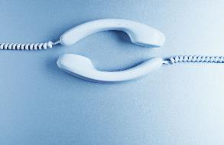

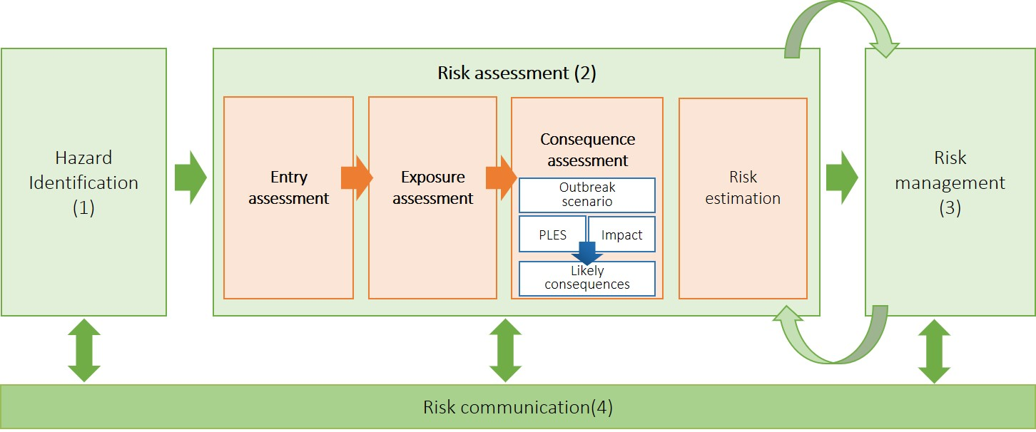

4. Risk communication
Risk communication is the fourth component of risk analysis
Risk communication is an ongoing process and includes both formal and informal consultation with stakeholders.
The department has been committed to ongoing communication and consultation with stakeholders throughout the process of the review, including the use of the Prawn Review Liaison Officer.
Department of Agriculture, Water and the Environment
Prawn review webinar
Dr Kally Gross
24 November 2020
20

Slide 21
Biosecurity measures considered
The following biosecurity measures were selected from a range of pre-export and on-arrival measures considered practicable and form the basis of the biosecurity measures that are recommended to apply to the importation of prawns for human consumption.
Alternative biosecurity measures that are demonstrated, to the satisfaction of the department, to provide equivalent biosecurity will also be considered on a case-by-case basis.
Department of Agriculture, Water and the Environment
Prawn review webinar
Dr Kally Gross
24 November 2020
21

Slide 22
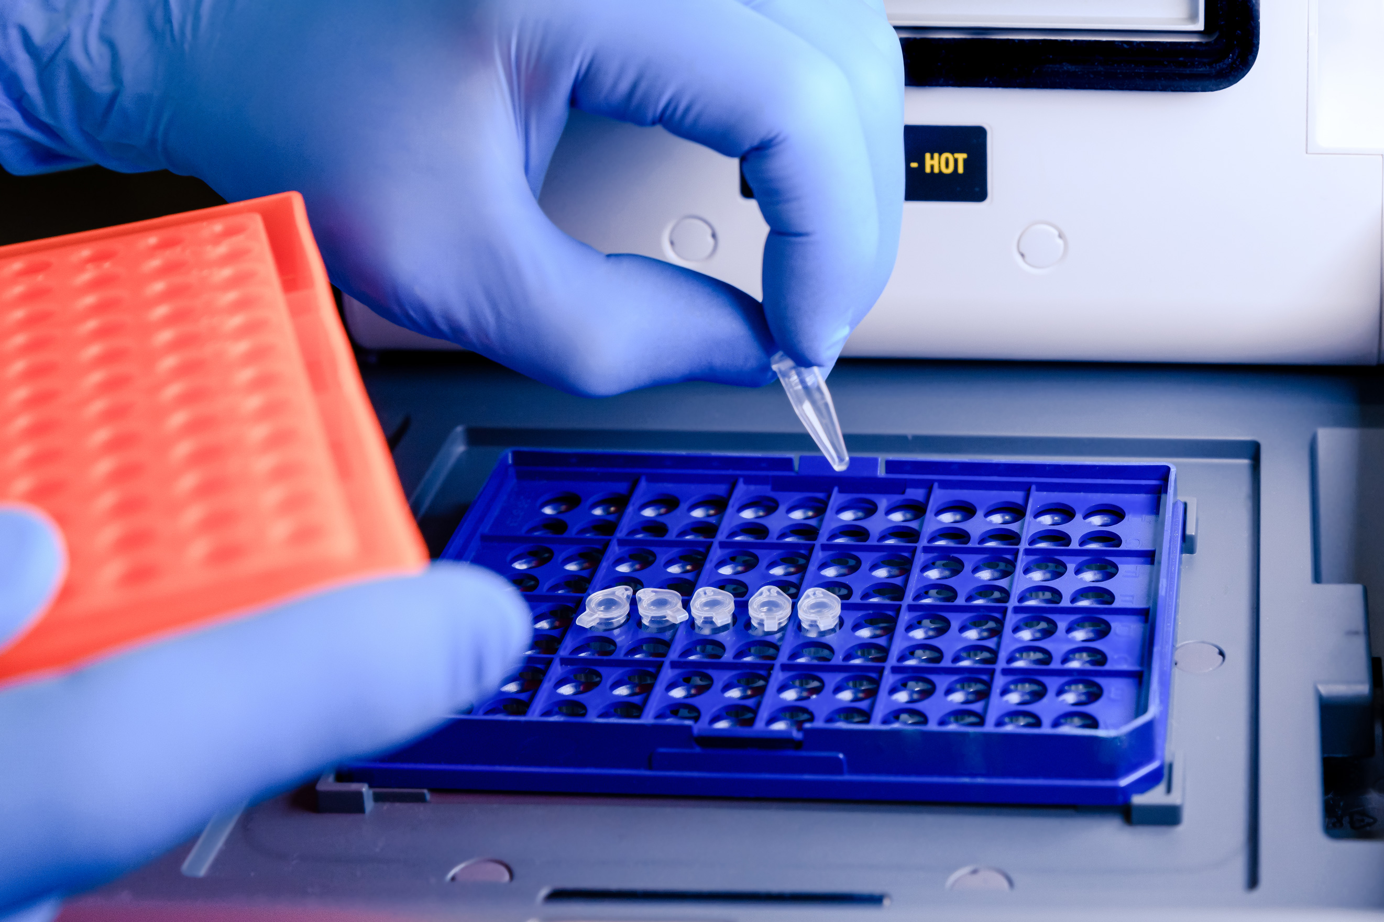
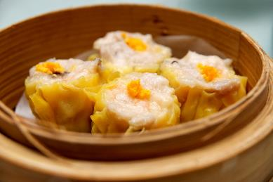
Biosecurity measures
There are two means by which biosecurity measure reduce the overall risk of a hazard to achieve Australia's ALOP:
Reducing the likelihood of hazards entering Australia in imported prawns.
Reducing the likelihood that susceptible animals in Australia would be exposed to the hazard in imported prawns.
The extent to which the biosecurity measures will reduce the likelihood of entry and/or exposure is dependent upon the specific hazard and the exposure groups.
Source: shutterstock.com
Source: shutterstock.com
Department of Agriculture, Water and the Environment
Prawn review webinar
Dr Kally Gross
24 November 2020
22

Slide 23
Summary of ways in which biosecurity measures reduce likelihood of entry and/or likelihood of exposure
Biosecurity measure | How reduces likelihood of entry | How reduces likelihood of exposure
Sourcing from disease-free populations | Reduces likelihood of entry for all hazards. | N/A
Freezing | Reduces likelihood of entry for hazards which are affected by freezing. - “Ca. H. penaei” - Vp AHPND | Reduces likelihood of exposure for those hazards expected to persist and remain infectious in frozen prawns at time of exposure. - “Ca. H. penaei” - Vp AHPND
Head and shell removal (last tail segment and tail fans permitted) | Reduces likelihood of entry for hazards which are primarily present in the head, shell and associated tissue. - LSNV | Reduces likelihood of exposure for farmed and hatchery exposure groups. - all hazards
Head and shell removal in combination with deveining (removal of the digestive tract to at least the last shell segment) | Reduces likelihood of entry for hazards which are primarily present in the head, shell and digestive tract. - EHP | N/A – does not reduce likelihood of exposure any more than head and shell removal.
Batch testing for hazards (pre-export and on-arrival testing) | Reduces likelihood of entry for hazards where appropriate testing methods are available. - WSSV - YHV1 | N/A
Cooking | Reduces likelihood of entry for hazards which are affected by temperatures used in commercial cooking of prawns. - IMNV -Vp AHPND - WSSV | Reduces likelihood of exposure for all exposure groups. - all hazards
Value-added products including breaded, battered and crumbed prawns and dumpling and dim sum type-products) | N/A | Reduces likelihood of exposure for all exposure groups. - all hazards
Labelling for human-consumption | N/A | Makes clear the intended end-use is for human consumption and that the product should not be diverted to bait or feed suppliers.

Slide 24
Example risk assessment –WSSV
Risk assessments were conducted for 10 hazards.
Department of Agriculture, Water and the Environment
Prawn review webinar
Dr Kally Gross
24 November 2020
24

Slide 25
Risk = likelihood × consequence
Department of Agriculture, Water and the Environment
Prawn review webinar
Dr Kally Gross
24 November 2020
25

Slide 26
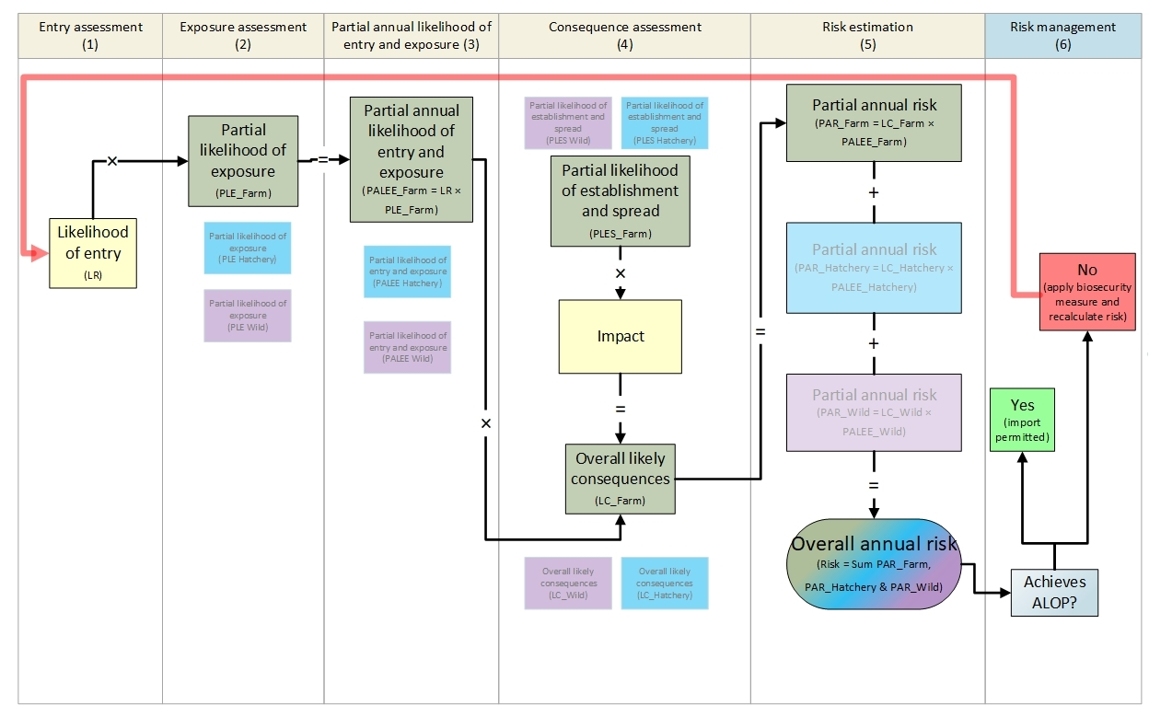
Flowchart summary of risk analysis process

Slide 27
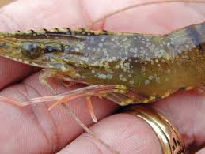
White spot syndrome virus
f = farmed exposure group, h = hatchery exposure group, w = wild exposure group
Key factors considered | Risk assessment | Risk management
Present in whole body of the prawn. Infections can be sub-clinical. Survives freezing. Impacted by cooking. All decapod crustaceans susceptible. Use of imported prawns as bait or berley by fishers and feed for captive crustaceans. Causes high mortality. High impact if becomes established in Australia. | Likelihood of entry High Partial likelihood of exposure (PLE) Low (f), Moderate (h), High (w) Partial annual likelihood of entry and exposure (PALEE) Low (f), Moderate (h), High (w) Partial likelihood of establishment and spread (PLES) High (f), Moderate (h), Moderate (w) Impact High Likely consequences High (f), High (h), High (w) Partial annual risk Moderate (f), High (h), High (w) Overall annual unrestricted risk = Extreme. | Head and shell removal Likelihood of entry unchanged. Reduced PLE in farmed and hatchery. PLES/Impact/Consequences unchanged. Overall annual restricted risk = High Head and shell removal + pre-export testing Likelihood of entry reduced. Reduced PLE in farmed and hatchery. PLES/Impact/Consequences unchanged. Overall annual restricted risk = Moderate Head and shell removal + pre-export + on-arrival testing Likelihood of entry reduced. Reduced PLE in farmed and hatchery. PLES/Impact/Consequences unchanged. Overall annual restricted risk = Very Low Cooking Likelihood of entry reduced. Reduced PLE for all exposure groups. PLES/Impact/Consequences unchanged. Overall annual restricted risk = Very Low Value-added products Likelihood of entry unchanged. Reduced PLE for all exposure groups. PLES/Impact/Consequences unchanged. Overall annual restricted risk = Very Low
Source: D. Lightner

Slide 28
Proposed import conditions
The following provides the proposed import conditions for prawns and prawn products exported to Australia.
The draft report does not propose any changes to the way prawns are currently imported, with the exception of whole uncooked prawns which require an assessment by the department to demonstrate freedom from additional hazards.
Department of Agriculture, Water and the Environment
Prawn review webinar
Dr Kally Gross
24 November 2020
28

Slide 29
Proposed import conditions
A summary of the import conditions proposed in the draft report are presented below. With the exception of requirements for whole uncooked prawns, they are consistent with current import conditions.
Product type | Summary of import conditions
Whole uncooked prawns: | have been sourced from a country, compartment or zone that is recognised by Australia to be free of all hazards (DIV1, CMNV, EHP, IMNV, LSNV, TSV, VpAHPND, WSSV, YHV1) listed in the draft report. Freedom from “Ca. H. penaei” applies only for chilled product.
Uncooked prawns: (includes marinated prawns, Australian prawns processed overseas outside approved systems and BBC prawns which have not been par-cooked) | are frozen, deveined and have had the head and shell removed have tested pre-export and each batch has been found to be free of WSSV and YHV1 are subject to seals intact inspection and each batch is tested for WSSV and YHV1 on–arrival and must be found negative before it is released from biosecurity control.
Breaded, battered and crumbed (BBC) prawns: | are prawns which have had the head and shell removed, are coated for human consumption by being breaded, battered or crumbed, and have undergone a par-cooking step after the prawn has been coated.
Dumpling and dim sum-type products: | are products which contain uncooked prawns (which have had the head and shell removed) which have been processed to the extent that no discernible pieces of meat are salvageable.
Cooked prawns: | are prawns which have been cooked so that all the protein in the prawn meat has coagulated and no raw prawn meat remains.

Slide 30
Next steps
Anticipated timeframe | Activity
28 September 2020 | Draft report released for consultation
24 November 2020 | Webinar
15 January 2021 | Draft report consultation ends
Early to mid-2021 | Consideration of comments on draft report, bait and berley data and any new information received
Mid-2021 | Preparation of final report
Mid to late-2021 | Final report released
Mid to late-2021 | New import conditions put in place (if needed)
Department of Agriculture, Water and the Environment
Prawn review webinar
Dr Kally Gross
24 November 2020
30

Slide 31
Image sources
Aquaculture Pathology Laboratory, University of Arizona., 2019. Pacific White Shrimp Infected With The White Spot Syndrome Virus [image] Available at: https://www.texassaltwaterfishingmagazine.com/fishing/education/texas-parks-wildlife-field-notes/concerns-of-shrimp-virus-across-texas-gulf-coast.).
Australian Government Department of Agriculture 2019, ‘Aquatic animal diseases significant to Australia: Identification field guide, 5th Edition’, Canberra, available at https://www.agriculture.gov.au/animal/aquatic/guidelines-and-resources/aquatic_animal_diseases_significant_to_australia_identification_field_guide#other-diseases-of-crustacean.
Lightner, DV (ed) 1996, A handbook of shrimp pathology and diagnostic procedures for disease of cultured penaeid shrimp, World Aquaculture Society, Baton Rouge, Louisiana, USA.
Poornima, M, Seetang-Nun, Y, Alavandi, SV & Dayal, JS 2012, ‘Laem-Singh virus: a probable etiological agent associated with monodon slow growth syndrome in farmed black tiger shrimp (Penaeus monodon)’, Indian Journal of Virology, vol. 23, no. 2, pp. 215-25, available at http://dx.doi.org/10.1007/s13337-012-0099-7.
Qiu, L, Chen, M-M, Wan, X-Y, Li, C, Zhang, Q-L, Wang, R-Y, Cheng, D-Y, Dong, X, Yang, B, Wang, X-H, Xiang, J-H & Huang, J 2017, ‘Characterization of a new member of Iridoviridae, shrimp hemocyte iridescent virus (SHIV), found in white leg shrimp (Litopenaeus vannamei)’, Scientific Reports, vol. 7, p. 11834, available at doi: 10.1038/s41598-017-10738-8, accessed 9 February 2018.
Tran, L 2019, ‘Lessons learned from the emergence of AHPND, EHP, and White Feces Disease’, Santiago, Chile, 2-4 April 2019, available at https://www.oie.int/aquatic-conference2019/wp-content/uploads/2019/04/3.LocTran_LocTran_270319.pdf.
Zhang, Q, Liu, Q, Liu, S, Yang, H, Liu, S, Zhu, L, Yang, B, Jin, J, Ding, L, Wang, X, Liang, Y, Wang, Q & Huang, J 2014, ‘A new nodavirus is associated with covert mortality disease of shrimp’, Journal of General Virology, vol. 95, no. 12, pp. 2700-9, available at http://dx.doi.org/10.1099/vir.0.070078-0
Department of Agriculture, Water and the Environment
Prawn review webinar
Dr Kally Gross
24 November 2020
31

Slide 32
Question and answer session
Contact the Prawn Review Liaison Officer if you would like to arrange a follow-up discussion, request a factsheet or provide feedback on the webinar.
  prawnreview@awe.gov.au
Visit Have Your Say to comment on the draft report.
  haveyoursay.awe.gov.au
Consultation period closes 15 January 2021.
The transcript from today will soon be available on the Prawn Review Webpage.
  agriculture.gov.au/biosecurity/risk-analysis/animal/prawns
Department of Agriculture, Water and the Environment
Prawn review webinar
Dr Kally Gross
24 November 2020
32

